Slide 1
CEEW-CEF Market Handbook Q1 2020-21
Image: iStock
10 September 2020
© Council on Energy, Environment and Water 2020

Slide 2
CEEW-CEF Market Handbook
India is undergoing an energy transition from fossil-based to clean energy. Evidence-based decision-making can accelerate the process.
CEEW Centre For Energy Finance’s Market Handbook aims to help key investors, executives and policymakers with evidence-based decision-making by:
Identifying and analysing trends critical to India’s energy transition
Presenting data-backed evidence based on the most relevant indicators
Connecting the dots and presenting a short-term market outlook
The handbook attempts to comment and answer on some critical questions such as:
What is India’s generation capacity and energy mix?
What are the key trends in renewable energy (RE) tariffs?
What is the current situation of the discom payment delay situation?
How have the power market reforms progressed?
What are key trends in the electric vehicles (EV) and energy storage markets?
cef.ceew.in

Slide 3
Contents
Generation Capacity And Energy Mix
4
Coal Phase-Out
6
RE Auctions
7
Discom Payables
8
Power Markets
9
Policy and Regulatory Developments
10
Renewable Energy Finance
11
Energy Storage
14
Electric Mobility
15
Image: iStock
Annexures
17
19
About Us
cef.ceew.in

Slide 4
Generation capacity: slowdown in RE capacity addition, but impressive capacity sanctioned in Q1 FY21
4
Takeaways & Outlook
No noticeable gas/diesel, nuclear and hydro capacity additions since FY18.
Coal/lignite capacity grew at a compounded annual growth rate (CAGR) of 9% in the last decade. RE capacity grew at 19% (off a relatively low base of 15.5 GW in FY10) for the same period.
Here onwards, RE capacity will need to grow at a CAGR of 16% to reach the 450 GW target by 2030.
Quarterly RE capacity additions have slowed down in the last four quarters. Pace of grid scale solar & wind capacity additions are by and large a function of auctions held in the preceding 12-24 months.
Solar (grid-scale and rooftop) contributed nearly 84% of the RE capacity addition in Q1 FY21.
Despite Covid-19, 12 GW of solar and 400 MW of solar–wind hybrid capacity was sanctioned/auctioned in Q1 FY21. This is equivalent to an impressive 14% of India’s aggregate installed RE capacity of 87.7 GW.
Source: Central Electricity Authority. *Does not include solar roof-top capacity (2.8 GW as of June 2020)
Source: Ministry of New and Renewable Energy.
cef.ceew.in

Slide 5
Energy mix : share of RE up from 9.9% in Q1 FY20 to 11.8% in Q1 FY21
5
Takeaways & Outlook
Total generation for Q1 FY21 was down by 15.9% from Q1 FY20 due to the Covid-19 nationwide lockdown.
April: Down by 23.8%
May: Down by 14.6%
June: Down by 9.8%
Total Q1 FY21: Down by 15.9%
Fall in total generation mainly attributable to coal/lignite (down 24.2% vs Q1 FY20).
From a share of total generation perspective, RE and hydro are on the rise, whereas coal/lignite is on a decline.
RE: Share up from 9.9% to 11.8%
Hydro: Share up from 10.0% to 12.1%
Coal/lignite: Share down from 73.1% to 65.9%
With a high wind season extending till July–August, relatively less variable (vs wind) solar insolation across the year, and upcoming RE capacity addition, RE’s share of total generation expected to remain high in Q2 FY21.
RE share snapshot
 | Q1 FY19 |  | Q1 FY20 |  | Q1 FY21
 | RE share % | Day | RE share % | Day | RE share % | Day
Highest | 16.2% | 12 June 2018 | 15.3% | 17 June 2019 | 16.0% | 28 May 2020
Lowest | 6.2% | 3 April 2018 | 7.4% | 2 April 2019 | 8.8% | 30 June 2020
Average | 9.0% | NA | 9.9% | NA | 11.8% | NA
Source: POSOCO. Note: RE technologies include solar, wind, biomass, waste to energy and small hydro and does not include rooftop solar and hydro generation.
cef.ceew.in

Slide 6
Coal phase-out: coal capacity addition on a sharp decline
6
Takeaways & Outlook
Although still net positive (additions less retirement), the pace of new coal capacity addition has declined sharply.
With INR 1,06,908 crore of power sector loans turning non-performing (per RBI as of September 2019), incremental bank lending to the sector faces challenges. Many banks may also be approaching statutory limits on power sector exposure.
While data for RE loan book component of aggregate power sector exposures is not readily available, anecdotal evidence suggests that RE loans as a category have performed much better than power sector as a whole.
PFC/REC continues to back coal projects in India, although their share in its loan book has started to decline (from 63% in Q2 FY19 to 58% in Q4 FY20). To compensate, exposure to RE and hydro projects has increased, which now account for 6% and 5% of its loan book, respectively.
With declining RE plus storage tariffs (already reached 4.04 INR/kWh), operational coal fleets are expected to come under increasing pressure.
Source: Central Electricity Authority
Source: PFC investor presentations; figures are derived from the same. Note: Sector-wise break up of PFC loan asset data unavailable for Q1 FY20.
cef.ceew.in

Slide 7
RE auctions: new tariff records being set despite Covid-19 disruption
7
Key auction results
(last 6 months)
Capacity allotted (MW)
Least tariff discovered (INR/kWh)
Bid spotlight: SECI round-the-clock (RTC-I), 400 MW
Takeaways & Outlook
All time low RE tariff (2.36 INR/kWh) was discovered in SECI Tranche-IX, with a 2,000 MW bid, owing to low entry barriers and high competition between participants, backed by foreign investors.
India’s first hybrid RE bids concluded with tariffs of 6.12 INR/kWh (LCOE of 4.04 INR/kWh) for assured peak power supply for six hours and 2.90 INR/kWh (LCOE of 3.60 INR/kWh) for round-the-clock energy supply, with a minimum 80% CUF requirement.
Government actions include the removal of tariff caps on solar and wind auctions to improve investor sentiment.
The implementation of the safeguard duty (SGD) may not impact solar tariffs, as the duty lapses in July 2021. Module procurement for new projects can be timed to take place once the duty lapses.
With increasing RE share and discoms facing integration challenges, we expect more hybrid auctions going forward, with firm, flexible, and dispatchable RE procurement.
Tariff and winner
Tariff: INR 2.90/kWh (first year) with an annual escalation of 3%. Levelised cost of energy (LCOE) of INR 3.60/kWh
Key provisions
Round-the-clock energy supply with a combination of solar, wind, and storage technologies. Provision to locate solar and wind plants at different locations
Analysis
Bid allows significant oversizing of the project and does not require firm power.
Winner: ReNew Power
Minimum monthly and yearly capacity utilization factor (CUF) requirements of 70% and 80%, respectively
Excess energy generation may be sold in open markets with the facility of additional connectivity
As per a CEEW-CEF analysis, the project would require 1,200 MW wind and 300 MW solar and around 1.0–1.5 GWh of energy storage.
In addition, such capacity oversizing is expected to lead to monthly CUFs of 150–180% during the high wind season (May–July) and 70–72% CUF in September–October.
Pan-India (SECI) solar, Tranche-IX, 2,000 MW (June 2020)
2,000
2.36
Pan-India (SECI) solar-wind-storage, RTC-I, 400 MW (May 2020)
400
2.90
Pan-India (NHPC) solar, 2,000 MW (April 2020)
2,000
2.55
Gujarat (GUVNL) solar, 500 MW- VII (March 2020)
350
2.61
Maharashtra (MSEDL) solar, 500 MW (March 2020)
350
2.90
Pan-India (SECI) solar, Tranche-VIII, 1200 MW (February 2020)
1,200
2.50
Maharashtra (MSEDL) solar, Agro-feeder scheme, 1350 MW (February 2020)
283
3.28
Assam (APGCL) solar, 70 MW (February 2020)
70
3.99
UP (UPNEDA) solar, 500 MW (February 2020)
184
3.17
Pan-India (SECI) solar-wind-storage, Peak power supply, 1,200 MW (January 2020)
1,200
6.12
Pan-India (SECI) solar, Manufacturing, 7,000 MW (January 2020)
12,000
2.92
Source: SECI and state renewable agencies. SECI = Solar Energy Corporation of India; RTC = Round the clock
cef.ceew.in

Slide 8
Discom payables: overdues to power producers aggravated by Covid-19
8
Takeaways & Outlook
As of June 2020, the amount overdue from discoms was INR 1,30,895 crore, representing an increase of 71% compared to June 2019.
There has been a 30% spike in overdues in just the three-month period since March 2020.
Discoms continue to struggle with ensuring timely collections. The Ministry of Power (MoP) allowed a three-month moratorium for payments to conventional power producers (March 2020) but no relaxation for payments to RE developers.
Highest payment delays in Rajasthan, Uttar Pradesh, Uttarakhand, Andhra Pradesh, Telangana, Karnataka, Bihar, and Tamil Nadu.
With MoP’s moratorium on payments due to conventional power producers, the overdue amount may increase at a higher rate in the coming months.
The Electricity (Amendment) Bill 2020 mandating that discoms maintain adequate payment security may facilitate timely payment to power producers, if passed in parliament.
May 2020
March 2020
January 2020
November 2019
September 2019
July 2019
Source: PRAAPTI portal (Based on voluntary disclosure from power producers).
Source: UDAY portal (Based on data disclosed by discoms as of 31st Mar 2020. *Data not available for these states; values derived from 2018-19 financial reports).
INR 90,000 crore liquidity package was announced in May 2020 to provide a temporary relief to electricity discoms in paying to power producers. Since then, the overdue amount has increased to INR 1,30,895 crore as of June 2020.
cef.ceew.in

Slide 9
Power markets: real-time market introduced, reduction in spot and REC market prices
9
Takeaways & Outlook
Peak power and energy demand are expected to recover to FY20 levels in the following quarter as the Covid-19 lockdown is lifted.
It is evident that the REC market is maturing, with a proposed market-based price discovery system (removal of floor price by CERC). As such, REC prices are expected to reduce in the coming months.
Short-term electricity prices (in both the day-ahead and real-time spot markets) have been at record lows, at 2.35 INR/kWh and 2.22 INR/kWh, respectively. This is expected to result in an increase in the share of short-term electricity procurement in the overall electricity procured by discoms.
With the introduction of real-time markets, ’gate closure’ to segregate the day-ahead and real-time markets, and system balancing (ancillary services), overall power purchase cost may see a reduce. Future rollouts of market-based economic dispatch and ancillary services market are envisaged to further accelerate this reduction.
2020
Source: POSOCO
Source: Indian Energy Exchange (IEX).
Peak demand declined considerably by 25% in April 2020 (as compared to April 2019) due to the Covid-19 nationwide lockdown. Despite a recovery in peak power demand in May 2020, the energy demand was still lower by 14% as compared to May 2019.
REC prices have been declining from Q1 FY20 to Q1 FY20 owing to lower demand following the Covid-19 lockdown. The buy to sell bid ratio declined from 3.4 in Q1 FY19 to 1.1 in Q1 FY20.
Real time spot market snapshot (IEX)
 | Volume (million kWh) | Price (INR/kWh)
Max (Daily) | 36.1 | 3.03
Min (Daily) | 3.4 | 1.56
Total/Average (Monthly)* | 515.5 | 2.22
*Monthly figures since real time market commenced in the last month of Q1 2020 (June)
Source: IEX.
Source: IEX.
Average day-ahead spot market prices declined by 29% in Q1 FY21 (compared to Q1 FY20), with an overall volume increase of 12%, owing to lower electricity demand due to the Covid-19 lockdown.
The real-time market with trading in 15-minute time blocks commenced from 1 June 2020. The average price discovered was 2.22 INR/kWh.
cef.ceew.in

Slide 10
Policy and regulatory developments: amendments to the Electricity Act proposed, floor price of RECs removed
10
Draft Electricity (Amendment) Act of 2003
Real-time market goes live
Creation of FDI and project development cells in MNRE
Takeaways & Outlook
Proposed amendments to the Electricity Act of 2003 broadly aim to improve contract enforcement, mitigate offtake and payment risk for RE developers, promoting renewable energy with a dedicated policy and obligations for discoms to procure hydro power.
Reforming electricity distribution proposed through phasing out cross-subsidies and alternative PPP business models.
Removal of floor price from the REC market to lower the price of RECs, thereby encouraging discoms and corporate consumers to meet their RE obligations through the REC market.
Increasingly, Indian corporate electricity consumers have been committing to 100% RE consumption (e.g., Mahindra & Mahindra, Tata Motors, and Infosys). A liquid REC market is expected to accelerate this transition.
SGD will have a limited impact on manufacturing and RE tariffs. Current projects will not be impacted by the change in the law clause.
Establishment of a central body, Electricity Contract Enforcement Authority, to resolve PPA related disputes within 120 days.
Selection of ERC members to be centralised; one member must mandatorily be a legal professional.
Central government to specify the modalities of a payment security mechanism and the bundling of hydro with thermal energy.
LDCs empowered to regulate electricity dispatch to states in case of inadequate payments from discoms.
National RE policy notified with penalties for states for non-compliance with RPO; HPO (hydro) also introduced.
Electricity tariffs to be determined by states without subsidy; DBT for electricity subsidy.
Reduction of cross-subsidies and associated surcharges to follow the trajectory specified in the tariff policy.
With effect from 1 June 2020, the real-time electricity market went live.
IEX and PXIL work in coordination with NLDC on trade and transmission corridor availability.
Half-hour trading windows with gate closure defined at 90 minutes before the actual delivery.
Creation of FDI cell in the MNRE for processing FDI proposals from countries that share land borders in India.
Creation of a project development cell in the MNRE to create projects with all approvals, land availability, and detailed project reports for adoption/investment by investors
Removal of floor price for RECs
Imposition of safeguard duty on import of solar panels
CERC proposes a floor price (minimum) of INR 0/MWh; this was INR 1,000/MWh in 2017.
Forbearance price (maximum) of INR 1,000/MWh; this was INR 2,400/MWh in 2017.
The Supreme Court dismissed the Green Energy Association’s (GEA) appeal seeking a stay order on CERC’s mandate to remove the floor price.
An SGD of 14.9% has been imposed for the period of August 2020 to January 2021; 14.5% SGD for February to July 2021.
The government plans to implement a basic customs duty (BCD) on solar cells and modules soon and will share details over the next few months.
Source: Publicly available information.
cef.ceew.in

Slide 11
Renewable energy finance: Adani Green Energy, Azure Power, and ReNew Power lead the RE capacity sanctioned in Q1 FY21
11
Key deals (Q1 FY21)
81%
Acquisition Target: Emami Group’s power business | Acquirer: Brookefield Asset Management, Canada
Amount: Not available
Takeaways & Outlook
Impressive 12.4 GW of RE capacity sanctioned/auctioned in Q1 FY21, but highly concentrated in the hands of a few developers.
Adani Green Energy exercised its green-shoe option to develop an additional 6 GW of solar capacity under the manufacturing linked tender (1.5 GW additional solar manufacturing). This (6 GW) is reportedly the single largest solar capacity award to date globally.
Active participation from companies backed by foreign investors in the SECI 2 GW auction drove solar tariffs to their all time low of 2.36 INR/kWh.
Market concentration is expected to remain high going forward. Dominant players will have an edge in raising and pricing capital at the scale required to match India’s ambitious RE capacity additions.
Safeguard duty is expected to be levied only till July 2021. Depending on commissioning deadlines, developers may have the flexibility to procure modules and avoid its impact.
Q1 FY21
June ‘20
Market concentration in sanctioned RE capacity
Acquisition
Target: Climate Connect (AI & analytics in power market) Acquirer: ReNew Power Amount: Not available
Note: Market concentration has been calculated as the ratio of top five RE capacities sanctioned, to the total RE capacity sanctioned
.
June ‘20
Equity investment Target: SILRES (Subsidiary of SunEdison Infra) | Acquirer: Fenice Investment Group
Amount: INR 18.8 cr (USD 2.5 million)
Developer-wise RE capacity sanctioned during Q1 FY21 (12,400 MW)
May ‘20
Pre-series A round funding (April 2020)
Company: Mysun (Rooftop) Investor(s): Existing investors Amount: INR 32.0 cr (USD 4.2 million)
April ’20
Asset sale (5 projects) Target: Shapoorji Pallonji Infra Capital | Acquirer: KKR
Amount: INR 1554 cr (USD 204 million)
April ’20
Equity investment: 37.5% (April 2020)
Target: Rising Sun Energy Acquirer: Yinson Renewables (Malaysia) Amount: INR 55.4 cr (USD 7.4 million)
April ’20
Source: Publicly available information.
Source: CEEW Centre for Energy Finance
cef.ceew.in

Slide 12
Renewable energy finance: key RE stocks pickup even as market experiences a steep decline due to Covid-19
12
Takeaways & Outlook
Share prices of pure play RE developers such as Adani Green and Azure Power attracted increased investor interest in the immediate aftermath of the Covid-19 disruption which otherwise saw global stock markets fall sharply in March 2020.
Rising RE developer share prices in the wake of Covid-19 seems to be global trend, not only limited to Indian developers¹.
Share prices of even smaller RE developer-manufacturer companies such as Suzlon Energy and Inox Wind have outperformed the Sensex which was down 14.3% as of June 2020 (vs Dec 2019). The former (Suzlon) has also benefitted from a debt restructuring.
Other listed RE companies such as Sterling Wilson Solar (EPC) and Borosil Renewables (glass manufacturing) have been affected by specific issues. A delayed promoter loan repayment overhang in the case of the former, and supply chain disruptions in the case of the latter.
Source: Money Control.
1 https://oilprice.com/Energy/Energy-General/10-Energy-Stocks-Defying-The-COVID-19-Slump.html
cef.ceew.in

Slide 13
Renewable energy finance: bond yields temporarily rose sharply, but on their way back down now
13
Takeaways & Outlook
Adani Green Energy and ReNew Power have been among the most active among RE developers in India (see Annexure I). The key purpose of such capital raises has been to refinance existing debt with some portion left over for capacity expansion.
Covid-19 prompted the RBI to lower its repo rate to an all time low of 4.00% (lower than the 4.75% set during the 2008–09 financial crisis).
Yields for internationally listed bonds of Indian RE developers saw a brief period of dramatic rise in March 2020. However, this shock in terms of rising yields (falling bond prices) appears to have been a temporary aberration, with yields now moving towards their pre Covid-19 levels.
Interestingly, at a time of falling bond prices, the stock prices of RE developers moved up sharply (previous slide).
Due to low liquidity in the Indian bond market and credit rating constraints (most RE project loans are typically rated below AA, the minimum requirement for issuance), we may continue to see international bond issuances from Indian RE developers.
Source: Reserve Bank of India, State Bank of India, Trading Economics, Money Control and BondEvalue.
cef.ceew.in

Slide 14
Energy storage: lowest ever tariffs discovered for RE with storage
14
143
USD/kWh
Project location & issue date | Application & technology | Details
Leh & Kargil (SECI), January 2020 | Generation 14 MW solar with 42 MWh BESS | Expected bid conclusion in Q2 FY21
Andaman & Nicobar Islands (SECI), January 2020 | Generation 4 MW floating solar with 2 MW BESS | Expected bid conclusion in Q2 FY21
Delhi and Dadra & Nagar Haveli (SECI), October 2019 | Generation 400 MW with solar, wind and storage hybrid | Bid concluded in May 2020 with tariff of 3.60 INR/kWh
Lakshadweep (SECI), September 2019 | Generation 1.95 MW solar with 2.15 MWh BESS | Expected bid conclusion in Q2 FY21
Haryana (UHBVN/DHBVN), September 2019 | Generation 100 MW solar, solar-wind or small hydro with storage | Expected bid conclusion in Q2 FY21
Pan India (SECI), August 2019 | Generation 1,200 MW assured peak power supply with storage | Bid concluded in Jan 2020 with tariff of 4.04 - 4.30 INR/kWh
Andhra Pradesh (AP Transco), February 2019 | Transmission 400 MW with 8 hours of daily discharge | Bid cancelled
Current average battery prices (lithium-ion)
Takeaways & Outlook
The key driver for energy storage growth has been the co-location of storage with RE generation projects; e.g., 1.2 GW tender in India (2019) with assured peak power supply for 6 hours (50% capacity). The PPA price discovered was 4.04–4.30 INR/kWh (54–58 USD/MWh).
Recent hybrid (RE + battery) project tariffs discovered in the US reached a record low of 1.64–2.14 INR/kWh (21.8–28.5 USD/MWh) for 4-hour backup (45–75% capacity).
Battery storage prices and levelised tariffs have been rapidly declining due to the supersizing of battery capacities, anywhere from 400 to 1,200 MWh, thereby driving costs down.
India is expected to have more hybrid (RE + storage) auctions of higher capacities in the future as the chief tendering agency (SECI) plans to come up with such tenders on demands from discoms to meet their renewable obligations and tackle grid-level integration challenges simultaneously.
Southern Bighorn Solar & Storage Center, Nevada US 2023
Eland Solar Farm, California US 2023
SECI Assured Peak Power Supply, India 2022
Arrow Canyon Solar, Nevada US 2021
Dodge Flat Solar, Nevada US 2020
RE Mustang, California US 2020
Eland Project, California US 2019
TEP, Arizona US 2017
KIUC, Hawaii US 2017
KIUC, Hawaii US 2015
Source: Gormon, Mills, Bolinger, Wiser, Singhal, Ela, and O’Shaughnnessy (2020); LBNL; and BNEF (2020). Exchange rate = 75.0 INR/USD
Source: SECI and state renewable agencies.
cef.ceew.in

Slide 15
Electric mobility: EV and hybrid vehicle sales down sharply, mirroring wider market trend
15
Takeaways & Outlook
Overall, battery-operated vehicle (BOV) and hybrid vehicle sales declined dramatically by 72.4%, from 60,924 units in Q1 FY20 to 16,978 units in Q1 FY21.
BOV and hybrid vehicles sales grew with a CAGR of 90.4% between FY16 and FY20.
Two- and three-wheeler sales (e-rickshaws) are key drivers of EV sales growth in India, contributing more than 97% to annual sales (2019–20).
With the gradual easing up of the lockdown, monthly EV sales initially recovered in June 2020; this may be attributed to pent-up demand.
Though the festive season from September to November may push EV sales further up, annual automobile sales (for FY21) are forecasted to be nearly 45% lower than in FY20, as per SIAM estimates.
Range anxiety and high prices remain key challenges.
Source: Vahan Sewa dashboard (Includes only registered vehicles. Unregistered vehicles include low-speed (< 25 km/hr), e-rickshaws (three-wheelers) and electric two-wheelers), Electric Mobility Dashboard, CEEW Centre for Energy Finance
cef.ceew.in

Slide 16
Thank you
You can find us at cef.ceew.in | @CEEW_CEF
Authors
Nikhil Sharma (nikhil.Sharma@ceew.in)
Arjun Dutt (arjun.dutt@ceew.in
Saloni Jain (saloni.jain@ceew.in)
Gagan Sidhu (gagan.sidhu@ceew.in)
cef.ceew.in

Slide 17
Annexure I: Green bond issuances (last 2 years)
17
Date | Company | Size (USD million) | Sector | Coupon rate (%) | Rating | Tenor (Years) | Purpose
January 2020 | ReNew Power | 450 | Solar and wind | 5.875% | BB-/Stable (Fitch) | 5 | Refinancing of maturing debt
October 2019 | Adani Green Energy | 362.5 | Solar and wind | 4.625% | BBB- (Fitch) | 20 | Repaying foreign currency loans and rupee borrowings
October 2019 | Urja Global | 500 | Solar, wind, and electric vehicles | Not available | Not available | Not available | Not available
September 2019 | Azure power | 350 | Solar | 5.65% | Not available | 5 | Refinancing of existing debt
September 2019 | ReNew Power | 300 | Solar and wind | 6.45% | Ba2 (Moody's) | 5 | Capacity expansion and repaying high cost debt
October 2019 | Greenko | 950 | Solar and wind | 5.50% | Ba1 (Moody’s) | 5 | Refinancing of solar and wind projects
June 2019 | Adani Green Energy | 500 | Solar | 6.25% | BB+ (Fitch) | 5 | Refinancing of solar projects
March 2019 | ReNew Power | 375 | Solar and wind | 6.67% | BB (Fitch) | 5 | Capex and refinancing of outstanding ECB
January 2019 | Tata Cleantech | 25.6 | Solar and wind | Not available | Not available | Not available | Capacity expansion
September 2018 | State Bank of India | 650 | Solar and wind | US Treasury + 1.65% (US investors) 3 Libor + 1.51% (British investors) | BBB- (Fitch) | 5 | Investment in RE projects
Source: Climate Bonds Initiative and company press releases
cef.ceew.in

Slide 18
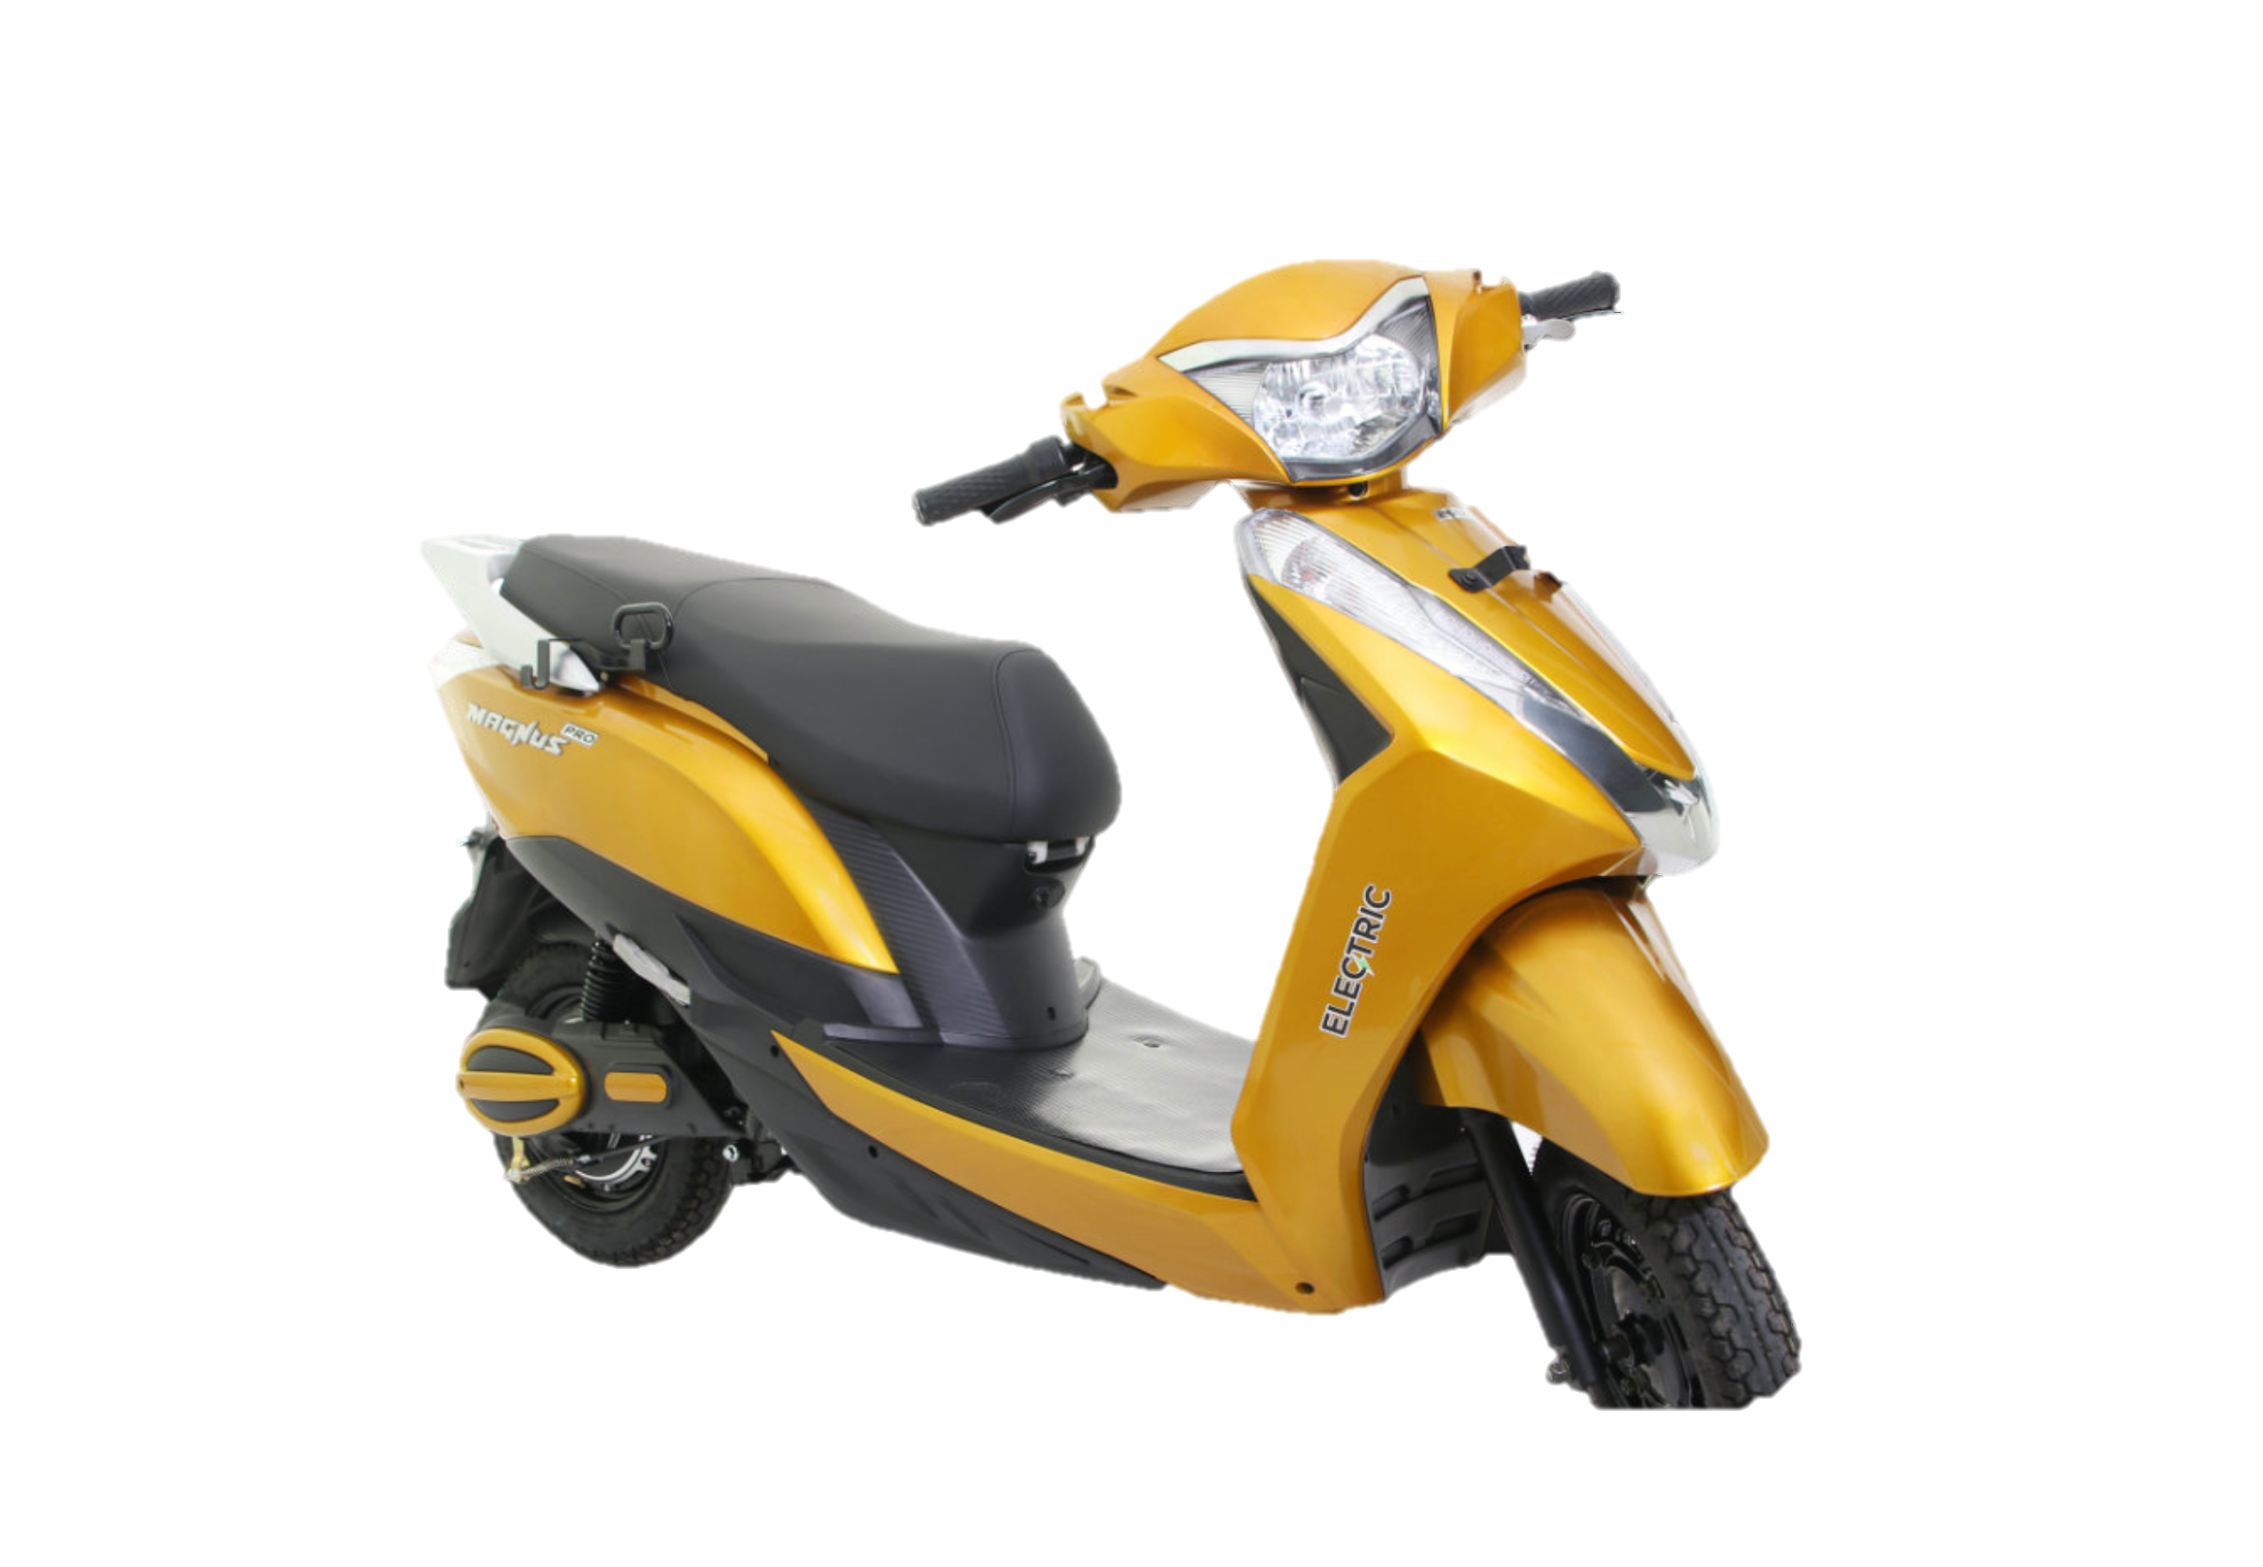
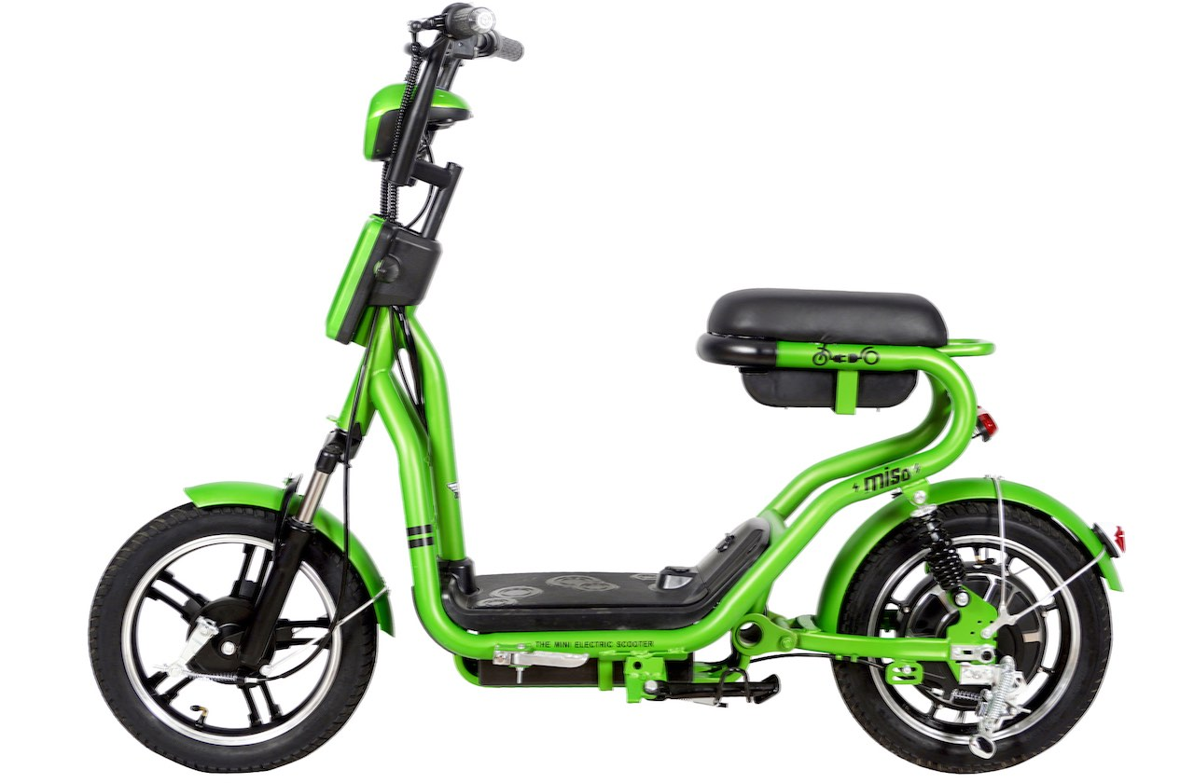
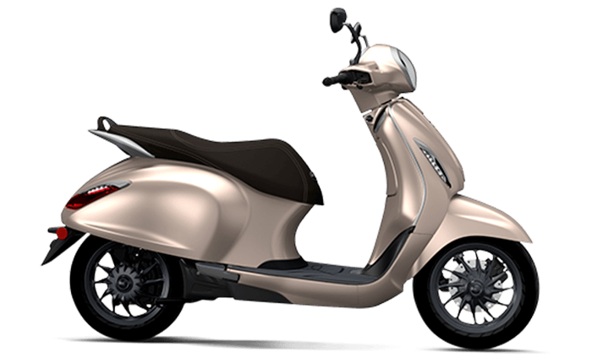
Annexure II: Key electric mobility facts and figures
18
1.49%
1,827
FAME-II target met
9.5–25.0INR/kWh
Public charging stations
as of 21st July 2020
As of December 2019
Note: Target of selling 1,562,000 EVs (2W, 3W, 4W and buses) under FAME-II scheme by FY22
EV charging service fee
Electric cars (4W) per public charging station
Recent electric vehicle launches
6.1
14.0INR/km
Ampere Electric Magnus Pro
Price: INR 73,990
Range: 75 km
Battery capacity: 60 V, 30 Ah
India
6.5
China
Average EV cab tariffs
Gemopal Electric Miso
Price: INR 44,000
Range: 60 - 75 km
Battery capacity: 48 V, 17.5 Ah
6.5
Note: Average internal combustion engine (conventional) cab tariffs are around 16.4 INR/km
Germany
Bajaj Chetek Urbanite
9.7
Price: INR 1,00,000 - 1,15,000
Range: 95 km
Battery capacity: 3 kWh
8.3–10.0Lakh INR
Japan
MG Motors ZS EV
18.7
Price: INR 20,88,000 - 23,58,000
Range: 340 km
Battery capacity: 75 kWh
US
Price range for an electric car (sedan)
Source: Electric Mobility Dashboard, CEEW Centre for Energy Finance
cef.ceew.in

Slide 19
About us: CEEW is among Asia’s leading policy research institutions
19
cef.ceew.in

Slide 20
CEEW Centre for Energy Finance
20
Build evidence
Consistent, reliable, and up to date monitoring & analysis of clean energy markets – investment, payment schedules, market trends, etc.
Create coherence
Periodic convening of multi-stakeholder groups to deliberate on market activities in clean energy
Design solutions
Design and feasibility pilots of fit-for-purpose business models & financial solutions for clean energy solutions
cef.ceew.in

Slide 21
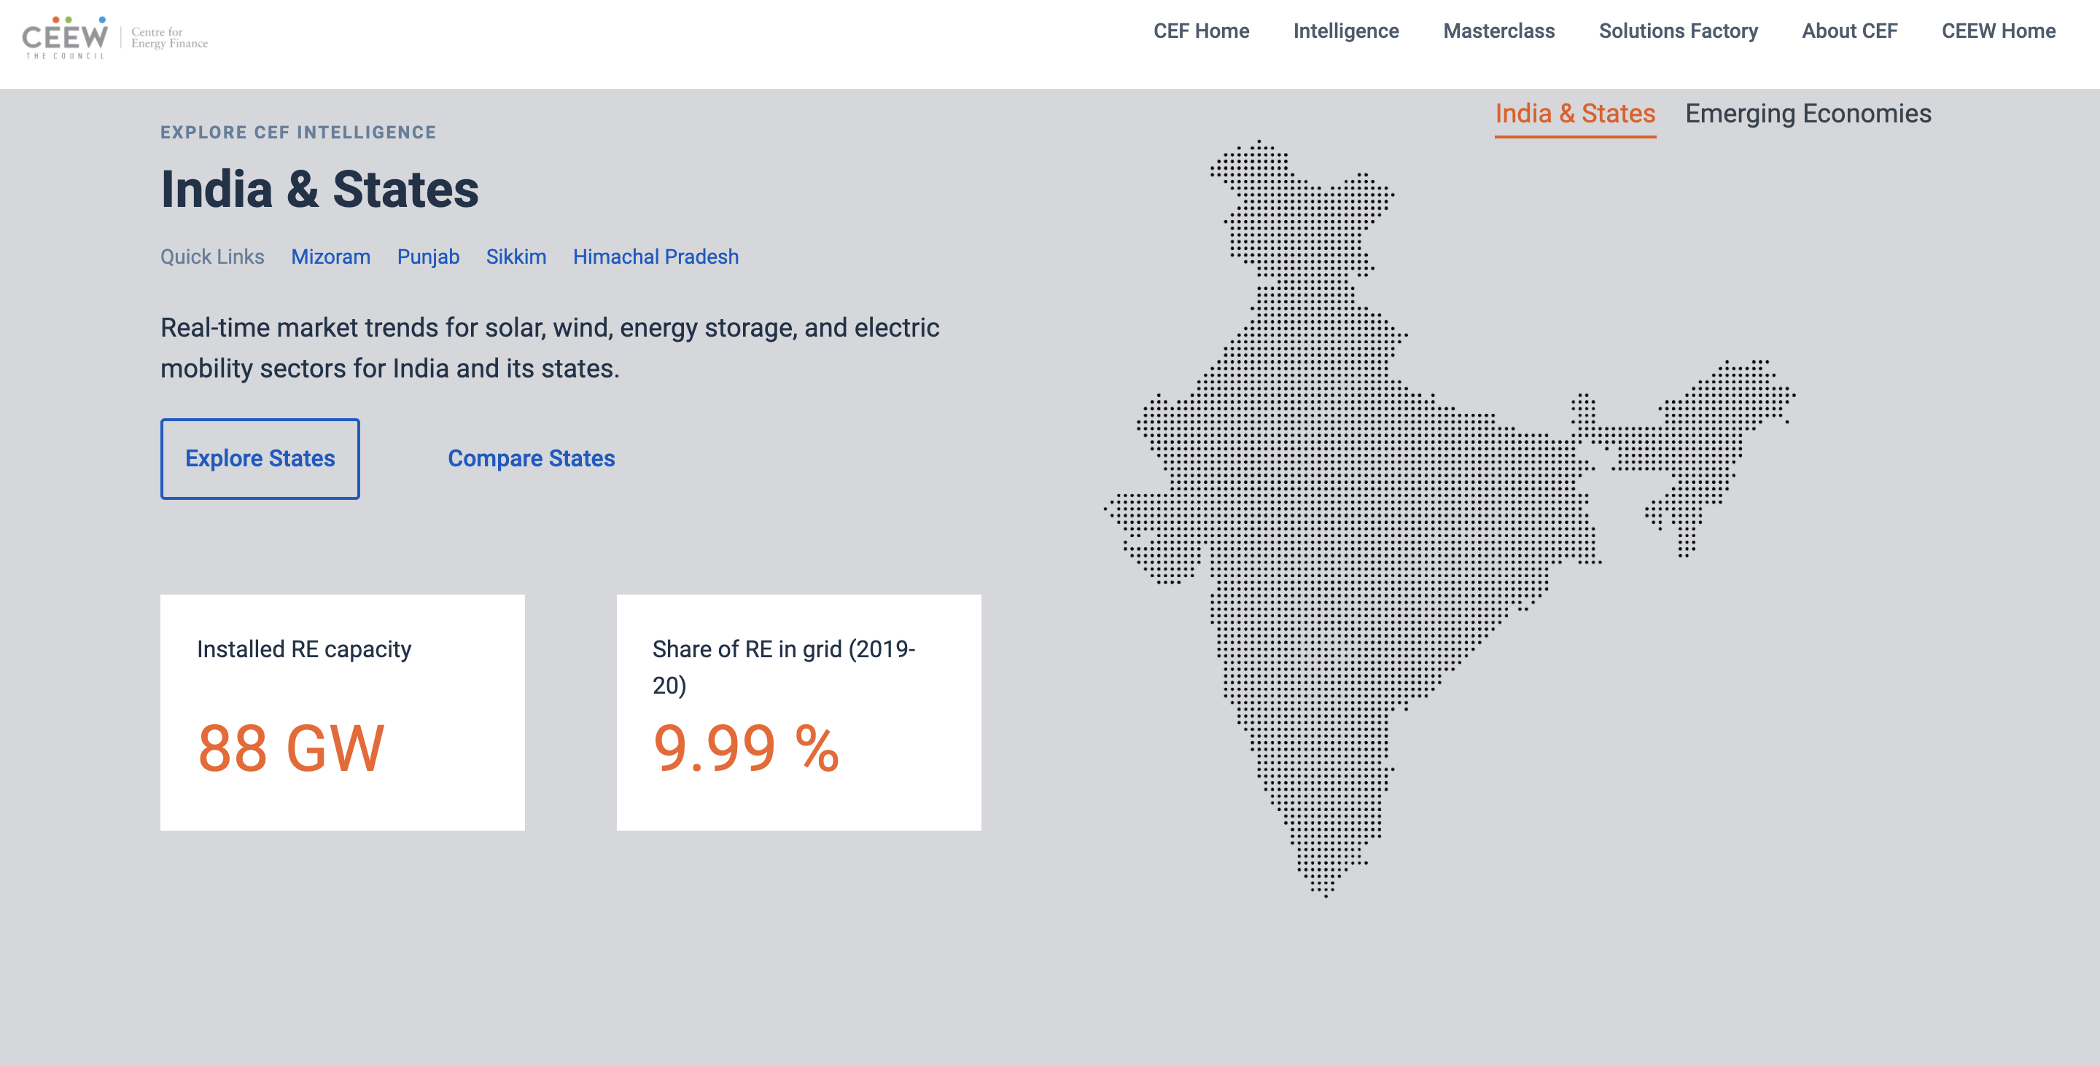
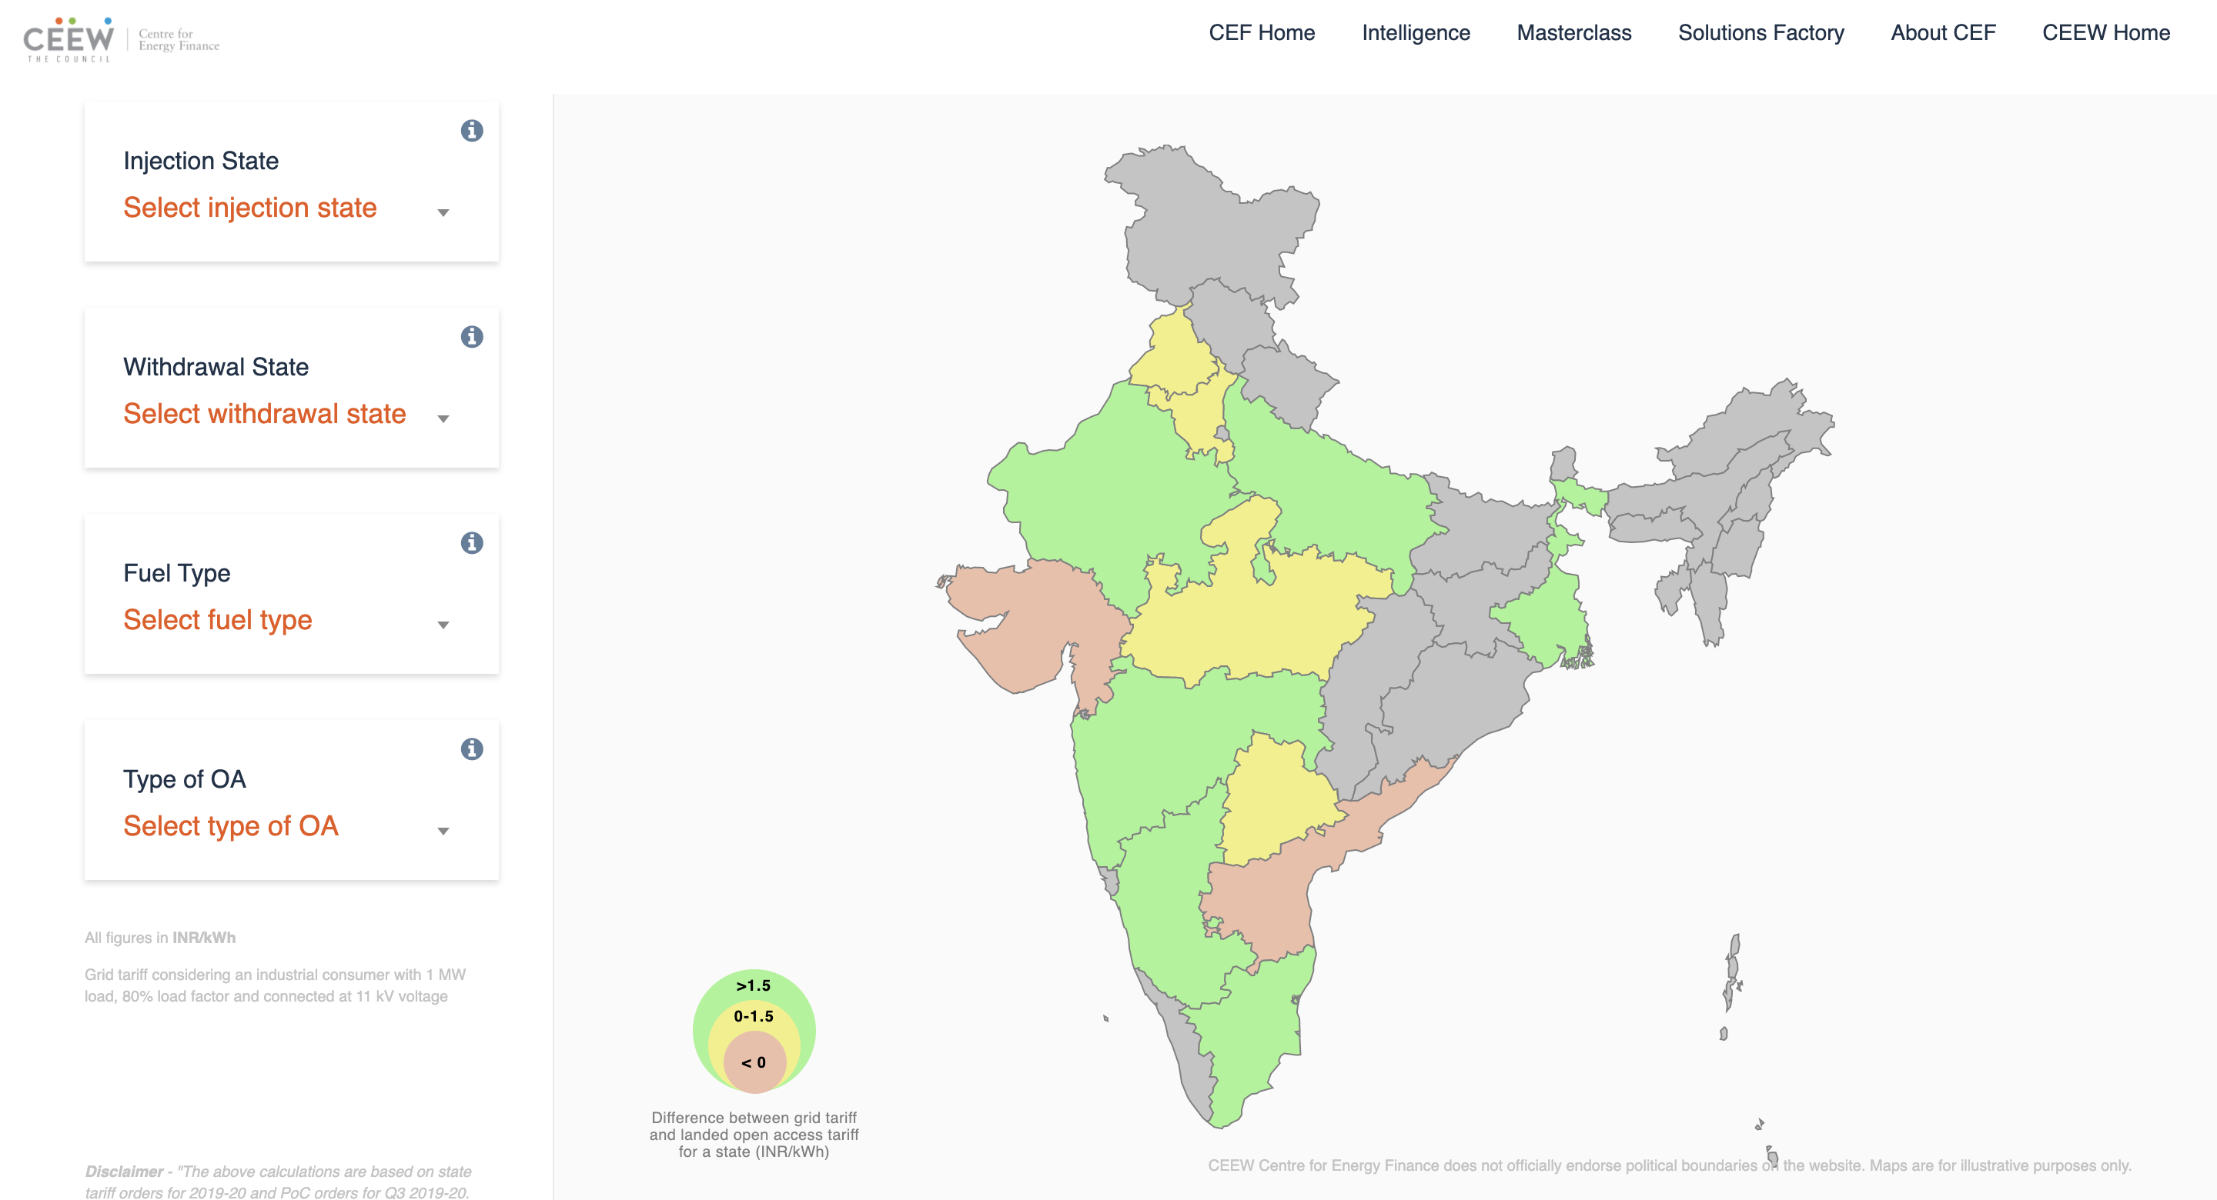
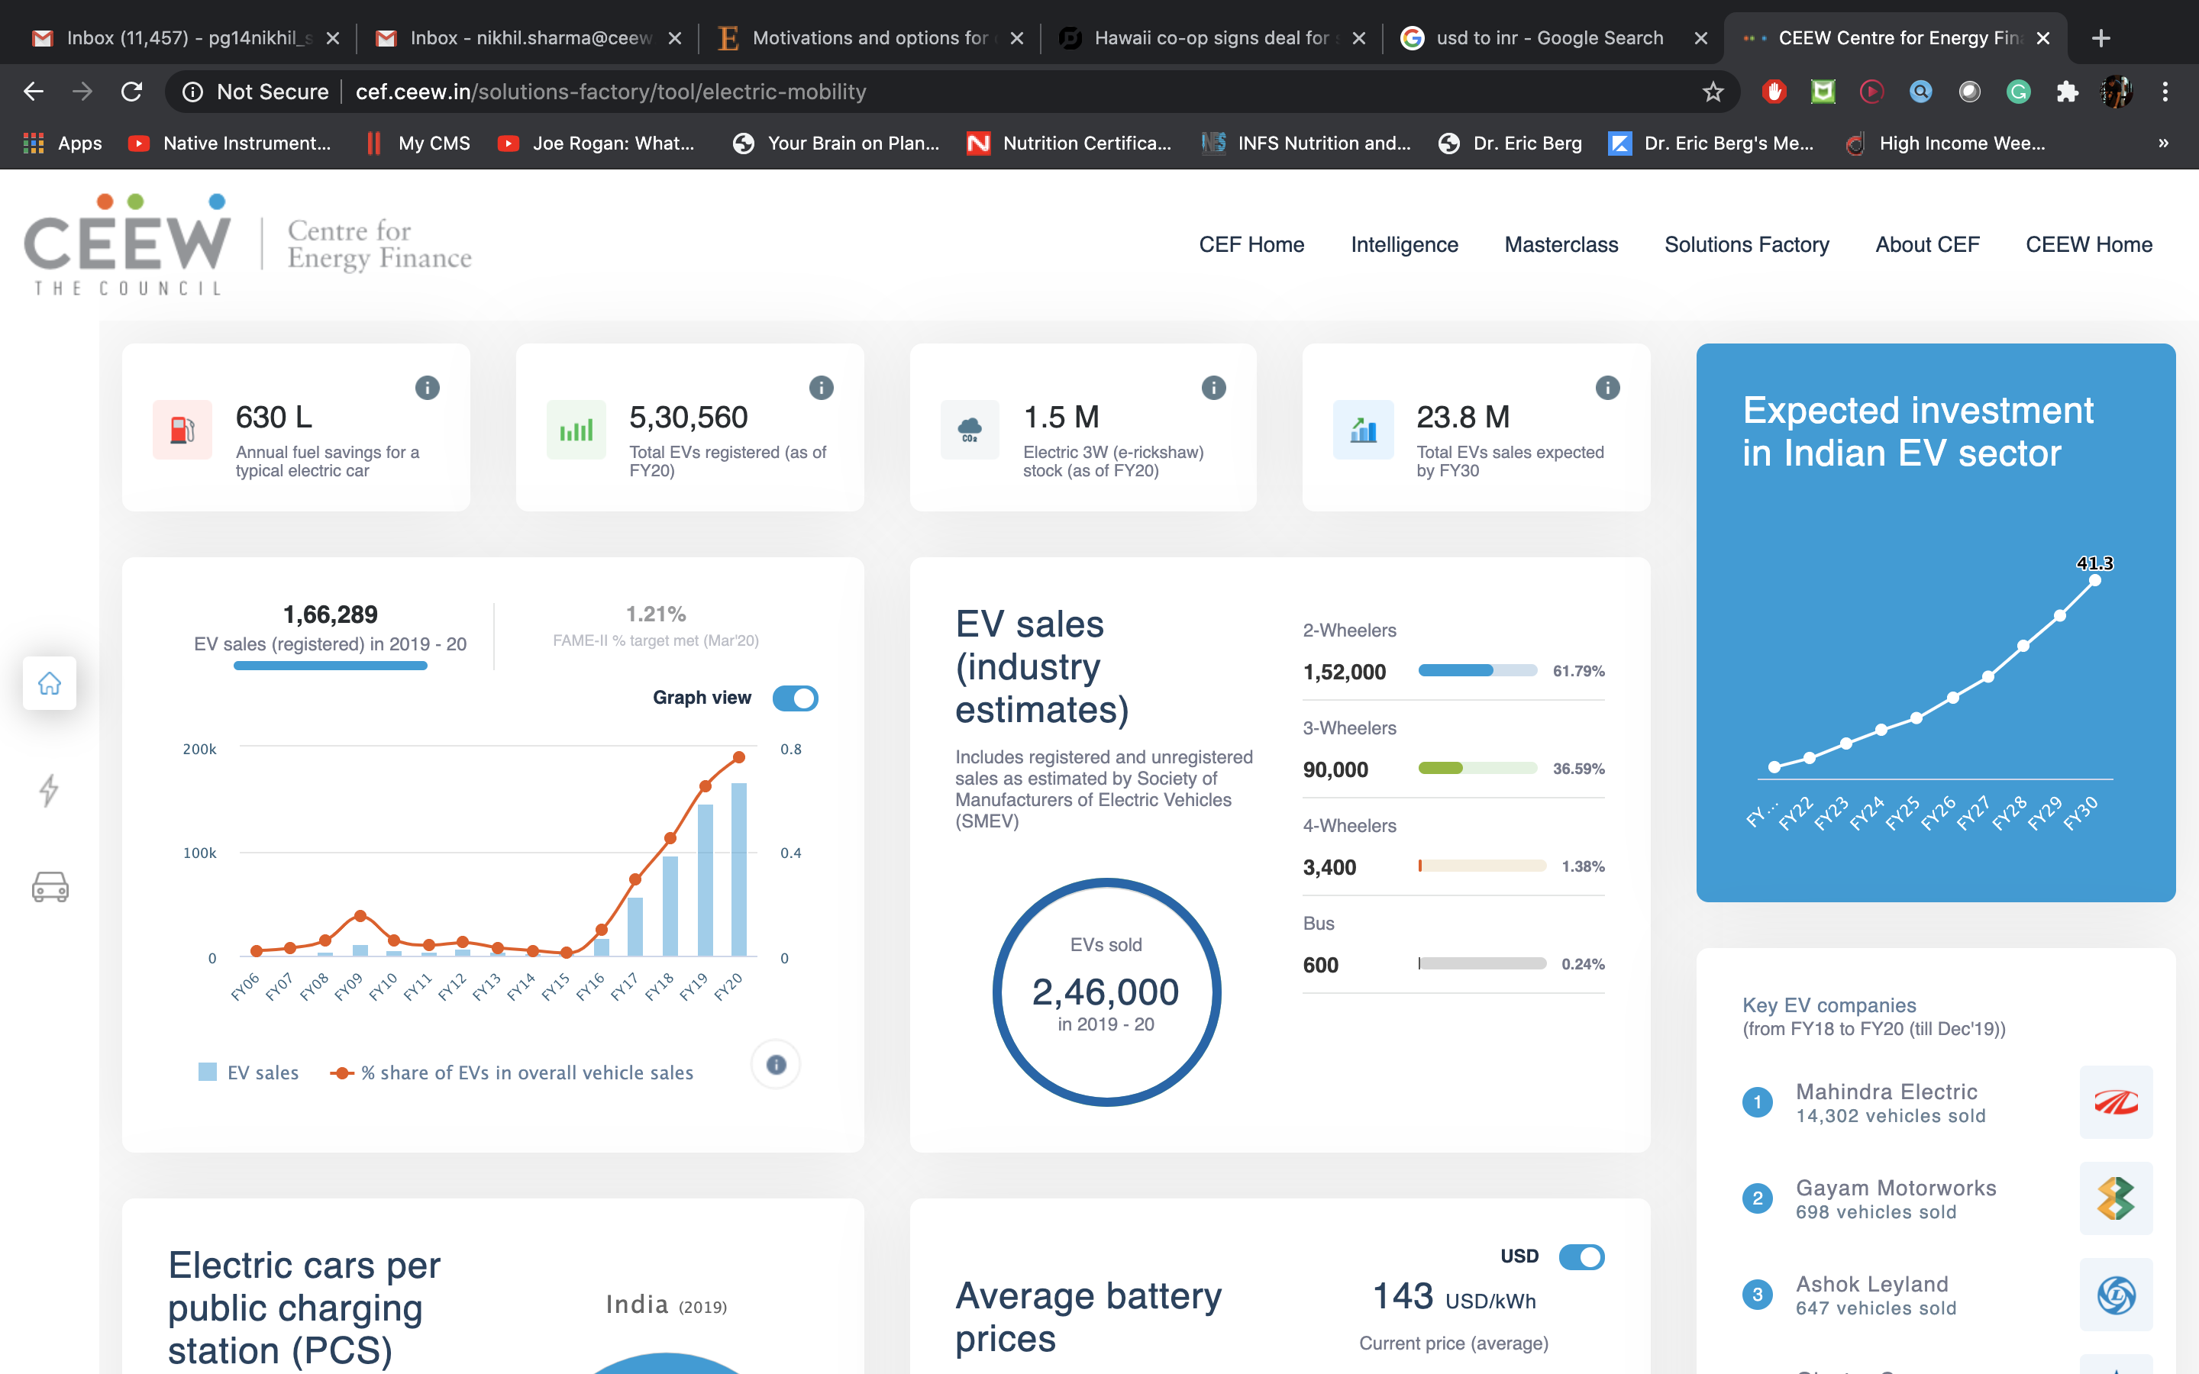
Our recent publications, dashboards and tools
21
Jobs, Growth and Sustainability
Accelerating RE Investments in Sri Lanka
Cheaper Finance is Key to Lowering RE Tariffs in Indonesia
RE-Financing India’s Energy Transition
CEEW-CEF Dashboard
Open Access Tool
Electric Mobility Dashboard
cef.ceew.in

