Slide 1
CEEW-CEF Market Handbook 2020-21 (Annual issue)
Image: iStock
12 May 2021
© Council on Energy, Environment and Water 2021

Slide 2
CEEW-CEF Market Handbook
India is undergoing an energy transition from fossil-based to clean energy. Evidence-based decision-making can accelerate the process.
CEEW Centre For Energy Finance’s Market Handbook aims to help key investors, executives and policymakers with evidence-based decision-making by:
Identifying and analysing trends critical to India’s energy transition
Presenting data-backed evidence based on the most relevant indicators
Connecting the dots and presenting a short-term market outlook
The handbook attempts to comment and answer on some critical questions such as:
What is India’s generation capacity and energy mix?
What are the key trends in renewable energy (RE) tariffs?
What is the current situation of the discom payment delay situation?
How have the power market reforms progressed?
What are key trends in the electric vehicles (EV) and energy storage markets?
cef.ceew.in

Slide 3
Contents
Generation Capacity And Energy Mix
4
Coal Phase-Out
6
RE Auctions
7
Discom Payables
8
Power Markets
9
Policy and Regulatory Developments
10
Renewable Energy Finance
11
Energy Storage
14
Electric Mobility
15
Image: iStock
Annexures
17
20
About Us
cef.ceew.in

Slide 4
Generation capacity: RE dominated generation capacity addition; solar rooftop segment outperformed with 1.8 GW addition in FY21 (till February 2021)
4
Takeaways & Outlook
Around 12.1 GW of total generation capacity was added in FY21, primarily dominated by RE (7.7 GW or 64%) followed by coal/lignite (3.9 GW) segment.
In RE, solar (grid-scale and rooftop) continues to dominate, accounting for 73% (or 5.5 GW) of the capacity added in FY21. FY21 also saw impressive solar rooftop capacity addition at 1.8 GW. This is attributed to favourable policies in states such as Gujarat, which has incentivised rooftop solar for micro-, small- and medium- sized enterprises.
FY21 began with slower RE capacity addition with only 0.9 GW installed in Q1. Q2 continued to be a slow quarter. However, the pace of RE capacity addition began to match that of pre COVID-19 levels in Q3 (1.9 GW capacity addition), attributable to an economic and RE supply chain recovery following the lifting of the nationwide lockdown.
In FY21, around 19.2 GW of RE capacity was auctioned. Grid-scale solar PV (15.3 GW) remained the dominant technology followed by wind-solar hybrid (2.8 GW) and wind (1.2 GW). Q4 saw an increase in auctioned capacity from 2.97 GW in Q3 to 3.9 GW.
Source: Central Electricity Authority (CEA). *Includes solar rooftop capacity.
Source: Ministry of New and Renewable Energy. *Data for solar (grid-scale) and solar (roof-top) available only till February 2021 for Q4 FY21.
cef.ceew.in

Slide 5
Energy mix: share of RE up from 9.4% to 10.1%, large hydro down from 13.2% to 12.3% and coal/lignite remains unchanged in FY21 versus FY20
5
Takeaways & Outlook
Total generation was up by 1.3% in FY21 compared to FY20, owing to a post-lockdown surge in electricity demand in Q3 and Q4.
Q1: Down by 16.0%
Q2: Up by 0.8%
Q3: Up by 7.3%
Q4: Up by 16.6%
Total FY21: Up by 1.3%
Overall RE generation increased by 8.5%, while large hydro generation decreased by 5.8% and coal/lignite generation grew marginally by 1.4% (vs FY20).
As a result, RE’s share in average daily generation saw an increase in FY21 (vs FY20), hydro saw a decline while coal/lignite remained almost constant.
RE: Share up from 9.4% to 10.1%
Hydro: Share down from 13.2% to 12.3%
Coal/lignite: Share constant from 71.0% to 71.1%
RE share snapshot
 | FY19 |  | FY20 |  | FY21
 | RE share % | Day | RE share % | Day | RE share % | Day
Highest | 15.8% | 26 July 2018 | 15.9% | 09 July 2019 | 16.8% | 12 August 2020
Lowest | 5.1% | 29 September 2018 | 5.3% | 24 September 2019 | 6.1% | 02 September 2020
Average (Daily) | 8.9% | NA | 9.4% | NA | 10.1% | NA
Source: POSOCO. Note: RE technologies include solar, wind, biomass, waste-to-energy and small hydro and does not include rooftop solar and large hydro (>25 MW) generation.
cef.ceew.in

Slide 6
Coal phase-out: new coal capacity addition continues in FY21
6
Takeaways & Outlook
Although Q4 FY21 saw a significant increase in coal capacity, net coal capacity addition (addition less retirement) declined by 6% in FY21 compared to FY20.
The share of conventional generation in PFC/REC’s loan book trended downwards in FY21 and substantially declined to 54% in Q3 FY21 (from 58% in Q1 FY21). To compensate, PFC/REC is increasingly focusing on transmission and distribution (T&D) and RE generation projects, which account for 35% and 11% of its total loan book as of Q3 FY21, respectively.
Source: CEA.
Source: PFC investor presentations; figures are derived from the same. Note: Sector-wise break up of PFC loan asset data unavailable for Q4 FY21.
cef.ceew.in

Slide 7
RE auctions: announcement of basic customs duty on solar cells and modules resulted in an 11% hike in tariffs
7
Bid spotlight: GUVNL, Gujarat, solar, 500 MW (Phase XII)
Takeaways & Outlook
A historically low tariff of 1.99 INR/kWh was discovered in FY21 at the Gujarat (GUVNL) solar bid.
The bid was oversubscribed and attracted significant international participation, which indicates a lower risk perception among developers/investors regarding the Indian market. Access to low-cost financing is a major factor driving the discovery of such low tariffs in addition to the attractive credit ratings of the off-taker (Gujarat discoms).
The Ministry of New and Renewable Energy (MNRE) announced the implementation of 40% and 25% basic customs duty (BCD) on solar modules and solar cells, respectively, effective April 2022. This resulted in 11% hike in tariffs discovered for solar auctions conducted at GUVNL from INR 1.99/kWh (in December 2020) to INR 2.20/kWh (in March 2021).
Also, MNRE released the Approved list of Models and Manufacturers (ALMM) of solar photovoltaic modules. A total of 23 module manufacturers are listed under the ALMM order with 150 module variants.
Notable auctions
(FY21)
Capacity allotted (MW)
Least tariff discovered (INR/kWh)
Tariff and winner
Tariff discovered: 2.20 INR/kWh
Key provisions
Comments
First bid post the announcement of imposition of basic customs duty (BCD) on imported solar modules and solar cells Key factors behind the discovery of lowest tariff
Minimum capacity utilization factor (CUF) requirement of 17% on an annual basis
Excess energy generation may be sold in open markets with transmission connectivity
Power purchase assurance due to the PPA signed with GUVNL unlike recent SECI bids that are facing difficulty in signing PPAs
Winners: Sprng Energy Pvt. Ltd., NTPC, Coal India Limited, TP Saurya, SJVN Limited
Power purchase assurance and signing of PPA within 30 days of issuance of LoA
Choice of project location in bidder’s purview i.e. anywhere in Gujarat
Facilitation of land acquisition by state agency and attractive discom credit ratings.
Anticipated fall in module prices and use of bifacial modules
GUVNL, Gujarat, solar, Phase-XII, 500 MW (March 2021)
500
2.20
SECI, pan India, wind, Tranche-X, 1,200 MW (March 2021)
1,200
2.77
Q4
Torrent Power Limited, Gujarat, solar, 300 MW (February 2021)
300
2.22
APGECL, Andhra Pradesh, solar, agricultural sector, 6,400 MW (February 2021)
6,400
2.48
Q3*
GUVNL, Gujarat, solar, Phase-XI, 500 MW (December 2020)
500
1.99
Q2*
SECI, pan India, blended
wind-solar, Tranche-IX, 2,500
MW (August 2020)
970
2.99
SECI, pan India, solar,
Tranche-IX, 2,000 MW (June
2020)
2,000
2.36
Q1*
SECI, pan India, solar-wind - storage, RTC-I, 400 MW (May 2020)
400
2.90
Source: SECI and state renewable agencies. *Note: For Q1, Q2 and Q3 FY21, only unique auctions such as RTC and least tariff auctions have been covered. SECI = Solar Energy Corporation of India; GUVNL = Gujarat Urja Vikas Nigam Limited; APGECL = Andhra Pradesh Green Energy Corporation Limited; RTC = Round the clock
cef.ceew.in

Slide 8
Discom payables: amount overdue by discoms declined by 11% in FY21 as PFC/REC disbursed funds under the liquidity infusion scheme
8
Takeaways & Outlook
The amount overdue payable by discoms to power producers declined by 11% from INR 1,09,304 crore in FY20 to INR 97,020 crore in FY21.
In Q1, PFC/REC sanctioned INR 1,24,999 crore for a liquidity package for discoms to pay off overdues. As of January 2021, around INR 46,000 crore was disbursed under the scheme to the following states: Andhra Pradesh, Bihar, Jammu & Kashmir, Karnataka, Maharashtra, Punjab, Rajasthan, Tamil Nadu, Telangana, Uttar Pradesh and West Bengal.
A three-month moratorium allowed to conventional power producers explains the drastic 30% increase in overdues during Q1. However, the liquidity package caused a 32% reduction in the amount in Q4.
In the Union Budget FY22, the Ministry of Finance (MoF) proposed a revamped, reforms-based, result-linked scheme for the power distribution sector with an outlay of INR 3,05,984 crore over five years to improve the viability of the distribution sector in India.
Q4
↓32%
↓11%
Q3
↑1%
Q2
↑5%
Q1
↑30%
Source: PRAAPTI portal (Based on voluntary disclosure from power producers).
Source: UDAY portal (based on data disclosed by discoms as of 30 December 2020). *Data not available for these states; values derived from 2018–19/ 2019–20 financial reports.
PFC/REC’s liquidity scheme has been utilised by discoms in the states of Andhra Pradesh, Bihar, Jammu & Kashmir, Karnataka, Maharashtra, Punjab, Rajasthan, Tamil Nadu, Telangana, Uttar Pradesh and West Bengal.
cef.ceew.in

Slide 9
Power markets: discoms took advantage of lower prices on power exchanges in Q1 and Q2; trend continued in Q3 and Q4 despite correction in spot prices
9
Takeaways & Outlook
FY21 was marked by a crash in power demand in Q1 as a nationwide lockdown was imposed in March 2021 to curb the spread of the coronavirus. Consequently, there was a surplus supply of energy from thermal plants on power exchanges (PXs), which lowered prices when compared to FY20 levels.
States such as Maharashtra, Andhra Pradesh, Gujarat, Telangana, Punjab, and Uttar Pradesh took this opportunity to substitute power purchases from costlier power plants with PX power.
As power demand bounced back after lockdown was lifted, uncertainty regarding its resilience prompted discoms to continue their reliance on PXs, thereby leading to an increase in spot market prices in Q3 and Q4.
New products such as the RTM launched in June 2020 enabled discoms to manage volatile demand in a cost-effective way. Further, following the suspension of renewable energy certificate (REC) trading in July 2020, GTAM (launched in August 2020) acted as an alternative for discoms and corporate consumers to meet their renewable purchase obligations (RPOs).
FY21
FY20
Source: CEA.
Source: Indian Energy Exchange (IEX). *Day ahead contingency
Peak demand took a hit in Q1 and Q2 FY21; it regained momentum in Q3 with the lifting of lockdown restrictions and consistently surpassed FY20 levels.
Volumes in the green term–ahead market (GTAM) underwent an initial increase and a subsequent decline due to a low solar and wind season from December 2020 to February 2021.
Real time market snapshot (IEX)
FY21 | Volume (million kWh) | Price (INR/kWh)
Q1 | 515.5 | 2.22
Q2 | 2,350.6 | 2.42
Q3 | 2,837.2 | 2.81
Q4 | 3,765.7 | 3.37
Source: IEX.
Source: IEX.
Average day-ahead spot market prices gradually increased over FY21 reaching Q1 FY20 levels owing to a recovery in power demand and an increase in the share of short-term procurement in the overall mix of discoms.
The average price discovered in the real-time market (RTM) increased from 2.22 INR/kWh in Q1 to 3.37 INR/kWh in Q4; this was primarily driven by discoms finding the RTM attractive for cost-effectively meeting volatile electricity demand.
cef.ceew.in

Slide 10
Policy and regulatory developments: Electricity (Amendment) Act, 2021, proposed to delicense distribution; separation of CTU from Powergrid; BCD announced on imported solar cells and modules
10
Takeaways & Outlook
MoP rolled out reforms to promote competition and improve the efficiency of the power sector. CTU’s separation from Powergrid, India’s largest transmission developer, is expected to enhance CTU’s independence, thereby ensuring fair competition in transmission project auctions. The proposed de-licensing of electricity distribution is expected to improve the operational and financial performance of discoms.
MoP also notified a separate HPO to be included in the non-solar RPO to promote the development of large hydro capacity in India. Unlike solar and wind generation which cannot be modulated (unless accompanied by storage), large hydro can be further utilised for its ramping capabilities to balance intermittent RE generation.
MNRE’s notification regarding levying BCDs on imported solar cells and modules with effect from April 2022 is expected to increase solar and hybrid (solar-wind) tariffs.
Levelised tariff for Pradhan Mantri Kisan Urja Suraksha evem Utthan Mahabhiyan (PM KUSUM)
Ministry of Finance (MoF) notified imposition of countervailing duty (CVD) on solar glass
MNRE announced BCD on imported solar cells and modules
The respective state electricity regulatory commissions of Telangana, Jharkhand, Madhya Pradesh, and Uttar Pradesh set levelised tariffs for Component-A of the PM KUSUM programme at INR 3.13/kWh, INR 3.09/kWh, INR 3.07/kWh, and INR 3.1/ kWh respectively for projects with capacity between 500 kW and 2 MW.
MoF notified the imposition of CVD of up to 10.14% on the import of textured and tempered (whether coated or uncoated) glass from Malaysia for five years (unless revoked).
MNRE released an office memorandum suggesting the implementation of 40% and 25% BCD on solar modules and solar cells respectively to be levied from April 2022 to promote domestic manufacturing.
Revision of basic customs duty (BCD) on solar inverter and Li-ion batteries
Ministry of Power (MoP) notified separation of Central Transmission Utility (CTU) from Powergrid
Draft Electricity (Amendment) Act, 2021
In the union budget 2021–22, the government proposed raising the BCD on solar inverters from 5% to 20% and on solar lanterns from 5% to 15% to encourage domestic production.
For manufacturing of Li-ion battery and battery packs, an increase in BCD of 0% to 3% is proposed on parts and sub-parts.
In March 2021, MoP notified the creation of CTU, a government company and wholly owned subsidiary of Powergrid. Powergrid is to continue to be a deemed transmission licensee effective from 1 April 2021.
Proposed retail supply competition by de-licensing electricity distribution in India.
Proposed sharing of power purchase agreements and creation of a universal service obligation fund proposed for managing power purchases, cross-subsidies, etc. in areas with more than one distribution company.
National load despatch centre to ensure optimum grid operations and to exercise supervision/control over regional and state despatch centres.
MoP set RPO and HPO trajectory for Solar and Non-Solar projects
MNRE issued the first batch of Approved list of Models and Manufacturers (ALMM)
In January 2021, MoP announced a solar RPO of 10.5%, non-solar RPO of 10.68% including hydro purchase obligations (HPO) 0.18% for FY22.
MNRE approved the modules and manufacturers List-I (modules) and List-II (cells) on 10 March 2021. The list is valid for two years.
Source: Publicly available information.
cef.ceew.in

Slide 11
Renewable energy finance: market concentration for RE auctions remained high in Q4 but appears moderate when viewed for FY21
11
Notable deals (FY21)
Takeaways & Outlook
In FY21, around 19.2 GW of RE capacity was auctioned. Adani Green Energy, JSW Energy, and ReNew Power accounted for most of the winning bids. Further, public sector companies such as NTPC, SJVN, and Coal India Limited (CIL) also entered and captured the market (with a total auctioned capacity of 1,880 MW in FY21) by bidding aggressively. Other new market entrants included Shirdi Sai Electricals, HES Infra Private Limited, O2 Power and Al Jomaiah Energy and Water Co.
In FY21, deal activities primarily consisted of equity investment and acquisition of RE assets, cumulatively highlighting rampant merger and acquisition (M&A) activities in the clean energy sector. Additionally, in Q4, Adani Green Energy raised a loan worth INR 98,918.5 crore (USD 1.35 billion) to fund its under-construction wind–solar hybrid projects.
Overall market concentration for FY21 stood at 52% with Adani Green Energy winning 4.05 GW RE capacity. Market concentration for Q4 picked up from 81% in Q3 to 86% owing to a surge in tender announcements and a renewed interest by RE investors/developers.
86%
52%
Debt investment
Target: Adani Green Energy Limited (AGEL) Investor: 12 international lenders* Amount: INR 98,918.5 crore (USD 1.35 billion)
Q4 FY21
FY21
March 2021
Market concentration in auctioned RE capacity
Acquisition
Target: Greenko Energy Holdings
Acquirer: Orix Corporation
Amount: INR 7,041.5 crore (USD 961 million)
Note: Market concentration is calculated as the ratio of the top five RE capacities auctioned to the total RE capacity auctioned
.
March 2021
Equity investment
Company: Ayana Renewable Investor: NIIF, CDC Group Amount: INR 2,845.0 crore (USD 390.0 million)
Developer-wise* RE capacity auctioned during FY21 (19,245 MW)
December 2020
Acquisition
Target: Rattan India (306 MW solar assets)
Acquirer: Global Infrastructure Partners
Amount: : INR 1,670.0 crore (USD 222.6 million)
September 2020
April
2020
Pre-series A round funding (April 2020)
Target: Mysun (Rooftop) Acquirer: Existing investors Amount: INR 32.0 crore (USD 4.2 million)
April 2020
Asset sale (5 projects)
Target: Shapoorji Pallonji Infra Capital Acquirer: KKR Amount: INR 1,554 crore (USD 204 million)
Source: Publicly available information. * Standard Chartered Bank, Intesa Sanpaolo S.p.A, MUFG Bank, Sumitomo Mitsui Banking Corporation, Coöperatieve Rabobank U.A., DBS Bank ,Mizuho Bank, BNP Paribas, Barclays Bank PLC, Deutsche Bank AG, Siemens Bank GmbH and ING Bank N.V.
Source: CEEW Centre for Energy Finance. *Note: Includes only top 10 developers in terms of auctioned capacity.
cef.ceew.in

Slide 12
Renewable energy finance: most RE stocks outperformed the market in the latter half of FY21; pure-play developer and solar manufacturing stocks saw a decline in prices in Q4
12
Takeaways & Outlook
In the latter half of FY21, all the listed RE stocks (except EPC player Sterling & Wilson Solar) outperformed the market (Sensex), which was in turn up by 20% as of Q4 (vs December 2019).
The share prices of pure-play RE developers, Adani Green Energy and Azure Power, significantly outperformed the market until Q3. The prices trended downward in Q4 due to reduced investor interest. The share prices of Borosil Renewables, a solar panel glass manufacturing company, also trended downward in Q4 for the same reason.
The stock price of Suzlon Energy, a wind developer–manufacturer, rose in Q1 with the announcement of debt restructuring, but a reported net loss for the same period dashed the hopes of investors in Q2. A reported net profit and loss for Q2 and Q3, respectively, reflected in the share prices in the subsequent quarters.
Further, Inox Wind, a developer–manufacturer, saw a steady rise in its share price as its quarterly revenue increased over FY21 and EBITDA loss turned into profit.
Q1 FY21
Q2 FY21
Q3 FY21
Q4 FY21
Source: Money Control.
cef.ceew.in

Slide 13
Renewable energy finance: around USD 3.3 billion raised through green bonds in FY21 to refinance existing debt; bond yields recovered from a temporary rise due to COVID-19 in Q1
13
Takeaways & Outlook
The twin challenges of low liquidity in the Indian bond market coupled with credit rating constraints (most RE project loans are typically rated below AA, the minimum requirement for local market acceptance) have driven Indian RE developers to tap international debt capital markets.
Key players in India such as Greenko, ReNew Power, CLP Wind Farms, Hero Future Energies and Continuum Green Energy raised nearly INR 24,555 crore (USD 3.3 billion) in FY21 through green bonds to refinance their existing debt (Annexure I).
Bond yields recovered from the economic shock that COVID-19 caused, which led to a temporary increase in yields in Q1. Interestingly, at a time of falling bond prices (or increasing bond yields) for RE developers in Q1, stock prices moved up (previous slide).
With bond yields falling to pre-COVID-19 levels in Q2 and below even that in Q3 and Q4, Indian RE developers began returning to overseas green bond markets.
Q1 FY21
Q2 FY21
Q3 FY21
Q4 FY21
Source: Reserve Bank of India, State Bank of India, Trading Economics, Money Control and BondEvalue. * Current yield.
cef.ceew.in

Slide 14
Energy storage: key RE plus storage auctions in India get multiple extensions
14
Key operational grid-scale battery storage projects in India
India’s energy storage auctions
Takeaways & Outlook
While a handful of pumped storage projects are operational (~3.3 GW as per CEA) in India (in states such as Telangana and Maharashtra), only two notable grid-scale battery storage projects are operational.
They include those deployed by Tata Power discom in Delhi. The most recent one includes a 150 kW / 528 kWh lithium-ion storage facility deployed for energy application, that is, peak shaving and providing a backup (four hours) to local consumers. The other one is a 10 MW battery storage facility for a reliable electricity distribution.
FY21 witnessed a surge in RE plus storage auction announcements, though only one auction came to a closure – a 400 MW round-the-clock bid with solar, wind, and storage for Delhi and Dadra and Nagar Haveli. Other auctions are yet to be concluded due to multiple extensions.
Going forward, RE project auction activity is expected to lean towards innovative project designs with the inclusion of energy storage.
Project location & tender issue date | Application & technology | Details
Tamil Nadu (TANGEDCO), February 2021 | 1 MW (AC) solar power project with a 3MWh battery energy storage system (BESS) | Expected bid conclusion in Q1 FY22
Leh. UT of Ladakh (SECI), December 2020 | 20 MW solar with 50 MWh BESS | Expected bid conclusion in Q1 FY22 (extended)
Chhattisgarh (SECI), September 2020, | 100 MW solar with 120 MWh BESS (capacity reduced) | Expected bid conclusion in Q1 FY22 (extended)
Pan India (SECI), March 2020 | 2,500 MW solar, wind, storage, others (thermal, hydro, etc.) hybrid in RTC manner (capacity reduced) | Expected bid conclusion in Q1 FY22 (extended)
Leh & Kargil (SECI), January 2020 | 14 MW solar with 42 MWh BESS | Expected results in Q1 FY22 (extended)
Andaman & Nicobar Islands (SECI), January 2020 | 4 MW floating solar with 2 MWh BESS | Expected results in Q1 FY22 (extended)
Community-based lithium-ion storage in Delhi (March 2021)
150 kW / 528 kWh lithium-ion battery storage deployed for last-mile electricity distribution by Tata Power discom in Delhi.
Storage to charge during off-peak hours and discharge during peak-hours thereby deferring investment in expensive transformer equipment by ‘peak shaving’.
Storage to also provide four hours of backup at 150 kW to local service providers including hospitals, commercial complexes, and local residential consumers.
Project deployed by Nexcharge, a Joint Venture (JV) between India’s Exide and Switzerland’s Leclanche.
Grid-scale lithium battery storage in Delhi (February 2019)
10 MW lithium-ion battery storage deployed by Tata Power discom in Delhi.
Storage deployed for power applications such as grid stabilisation, peak load management, and enhancing system flexibility and reliability.
Project deployed by AES and Mitsubishi Corporation with technology from Fluence.
Source: Energy Storage News (2021); press release by Tata Power (2019).
Source: SECI and state renewable agencies.
cef.ceew.in

Slide 15
Electric mobility: share of electric vehicles (EVs) and hybrid vehicles sales at an all-time high
15
Takeaways & Outlook
Overall EV and hybrid vehicle sales observed a sharp dip at the beginning of FY21. After the nationwide lockdown was lifted, EV and hybrid vehicle sales as a share of overall vehicle sales went up from 0.38% in April 2020 to 2.29% in March 2021, owing to pent-up demand during the lockdown and increasing petrol/diesel prices.
To promote further uptake of EVs, in January 2021, the Ministry of Road Transport and Highways (MoRTH) approved a green tax on older vehicles thereby phasing out unfit and polluting vehicles.
Ola Electric announced its plans to setup a hypercharger network for its fleet, starting with 5000 chargers across 100 cities primarily for electric two-wheelers.
OEMs with highest EV sales in FY21 were:
2W: Hero Electric (14,763), Okinawa (6,947) and Ampere (5,890)
3W: Y.C. Electric (8,937), Saera Electric (3,937) and Mahindra Electric* (3,431)
4W: Tata Motors* (3,658), Mahindra Electric* (3,249) and MG Motors* (1,102)
Q1 FY21
Q2 FY21
Q3 FY21
Q4 FY21
Source: Vahan Sewa dashboard (Includes only registered vehicles. Unregistered vehicles include low-speed vehicles (< 25 km/hr), e-rickshaws (three-wheelers) and electric two-wheelers), Electric Mobility Dashboard (2021), CEEW Centre for Energy Finance . *Based on sales data for FY21 up to March 2021.
cef.ceew.in

Slide 16
Thank you
You can find us at cef.ceew.in | @CEEW_CEF
Authors
Ruchita Shah (ruchita.shah@ceew.in)
Nikhil Sharma (nikhil.sharma@ceew.in)
Meghna Nair (meghna.nair@ceew.in)
Shreyas Garg (shreyas.garg@ceew.in)
Gagan Sidhu (gagan.sidhu@ceew.in)
cef.ceew.in

Slide 17
Annexure I: Green bond issuances (last 2 years)
17
Date | Company | Size (USD million) | Sector | Coupon rate (%) | Rating | Tenor (Years) | Purpose
March 2021 | ReNew Power | 585 | Solar and wind | 4.50% | BB- (Fitch) | 7.25 | Refinancing of existing debt
March 2021 | Greenko | 940 | Solar and wind | 3.85% | BB (Fitch) | 5 | Redemption of previous fund raise
March 2021 | Hero Future Energies | 363 | Solar and wind | 4.25% | BB- (Fitch) | 6 | Refinancing of existing debt
February 2021 | ReNew Power | 460 | Solar and wind | 4.00% | BB- (Fitch) | 6 | Refinancing of existing debt
February 2021 | Continuum Green Energy | 561 | Solar and wind | 4.50% | BB+ (Fitch) | 6 | Refinancing of existing debt
October 2020 | CLP Wind Farms | 40 | Wind | Not available | AA (India Ratings) | 2 to 3 | Refinancing of existing debt
October 2020 | ReNew Power | 325 | Solar and wind | 5.375% | BB- (Fitch) | 3.5 | Refinancing high-cost local debt
January 2020 | ReNew Power | 450 | Solar and wind | 5.875% | BB-/Stable (Fitch) | 5 | Refinancing of maturing debt
October 2019 | Adani Green Energy | 362.5 | Solar and wind | 4.625% | BBB- (Fitch) | 20 | Repaying foreign currency loans and rupee borrowings
September 2019 | ReNew Power | 90 | Solar and wind | 6.67% | BB (Fitch) | 4.5 | Refinancing of existing debt
September 2019 | Greenko | 85 | Solar and wind | 5.95% | BB- (Fitch) | 6.75 | Refinancing of existing debt
September 2019 | Azure power | 350 | Solar | 5.65% | BB (Fitch) | 5 | Refinancing of existing debt
Source: Climate Bonds Initiative and company press releases.
cef.ceew.in

Slide 18
Annexure I: Green bond issuances (last 2 years)
18
Date | Company | Size (USD million) | Sector | Coupon rate (%) | Rating | Tenor (Years) | Purpose
September 2019 | ReNew Power | 300 | Solar and wind | 6.45% | Ba2 (Moody's) | 5 | Capacity expansion and repaying high cost debt
August 2019 | Greenko | 85 | Solar and wind | 6.25% | Ba1 (Moody’s) | 3.5 | Refinancing of solar and wind projects
August 2019 | Greenko | 350 | Solar and wind | 6.25% | Ba1 (Moody’s) | 3.5 | Refinancing of solar and wind projects
July 2019 | Greenko | 450 | Solar and wind | 5.95% | BB (Fitch) | 7 | Refinancing of solar and wind projects
July 2019 | Greenko | 500 | Solar and wind | 5.55% | BB (Fitch) | 5.5 | Refinancing of solar and wind projects
June 2019 | Adani Green Energy | 500 | Solar | 6.25% | BB+ (Fitch) | 5 | Refinancing of solar projects
March 2019 | ReNew Power | 60 | Solar and wind | 6.67% | BB (Fitch) | 5 | Capex and refinancing of outstanding ECB
March 2019 | ReNew Power | 375 | Solar and wind | 6.67% | BB (Fitch) | 5 | Capex and refinancing of outstanding ECB
January 2019 | Tata Cleantech | 25.6 | Solar and wind | Not available | Not available | Not available | Capacity expansion
Source: Climate Bonds Initiative and company press releases.
cef.ceew.in

Slide 19
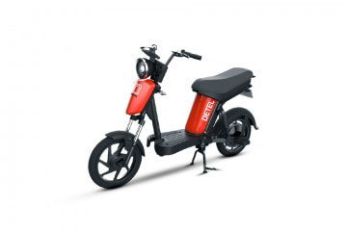
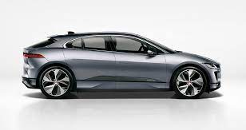
Annexure II: Key electric mobility facts and figures
19
4.25%
442
1240
FAME-II target met
Number of EV OEMs in India
Number of EV dealerships in India
as of 31st March 2021
As of March 2021
As of March 2021
Note: Target of selling 1,562,000 EVs (2W, 3W, 4W and buses) under FAME-II scheme by FY22
EV sales per 1000 non-EV sales
Recent electric vehicle launches
FY21
12.0INR/km
52
Detel Easy Plus
Price: INR 41,999
Range: 60 km
Battery capacity: 20 Ah
Tripura
28
Average EV cab tariffs
Delhi
Note: Average internal combustion engine (conventional) cab tariffs are around 16.4 INR/km
Jaguar I-Pace
22
Price: INR 10,500,000 – 11,200,000
Range: 470 km
Battery capacity: 90 kWh
Assam
15
MG ZS EV 2021
Bihar
Price: INR 2,099,800
Range: 419 km
Battery capacity: 44.5 kWh
14
15.0–28.0Lakh INR
Uttar Pradesh
Piaggio Ape E-Xtra FX
13
Price: INR 3,12,000
Range: 70-80 km
Battery capacity: 8 kWh
Chandigarh
Price range for an electric car (SUV)
Source: Vahan Sewa dashboard, CEEW Centre for Energy Finance, Department of Heavy Industries, CEA.
cef.ceew.in

Slide 20
About us: CEEW is among Asia’s leading policy research institutions
20
cef.ceew.in

Slide 21
CEEW Centre for Energy Finance
21
Build evidence
Consistent, reliable, and up to date monitoring & analysis of clean energy markets – investment, payment schedules, market trends, etc.
Create coherence
Periodic convening of multi-stakeholder groups to deliberate on market activities in clean energy
Design solutions
Design and feasibility pilots of fit-for-purpose business models & financial solutions for clean energy solutions
cef.ceew.in

Slide 22
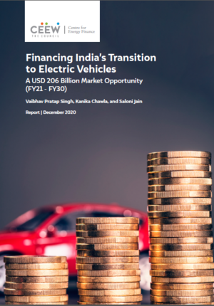
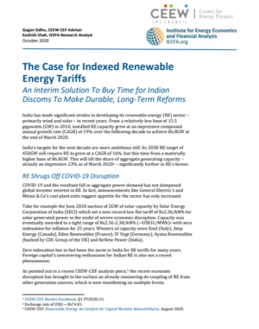
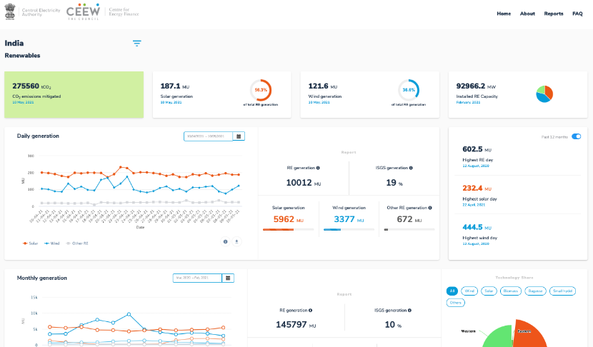
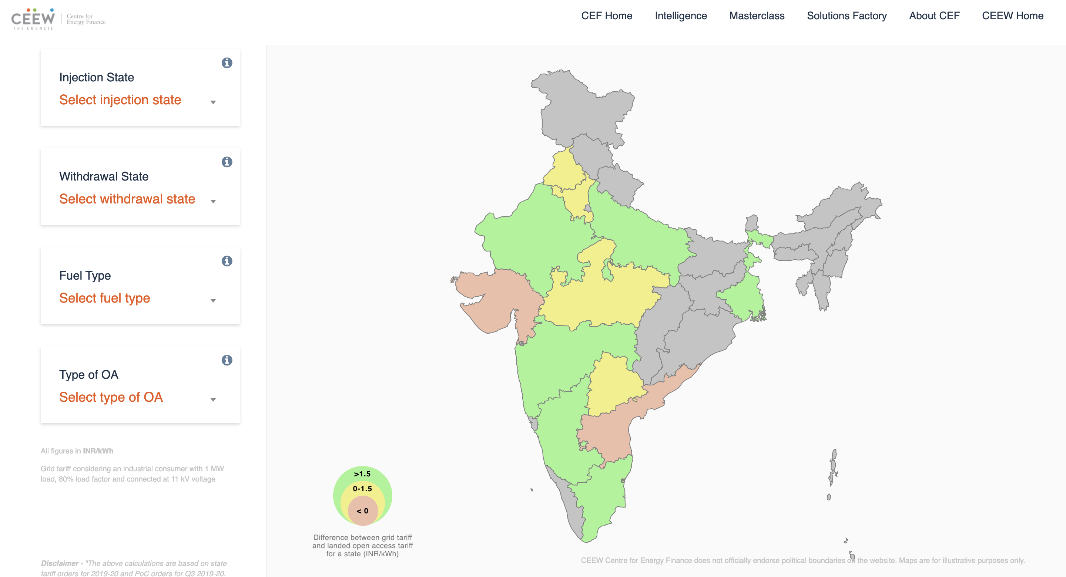
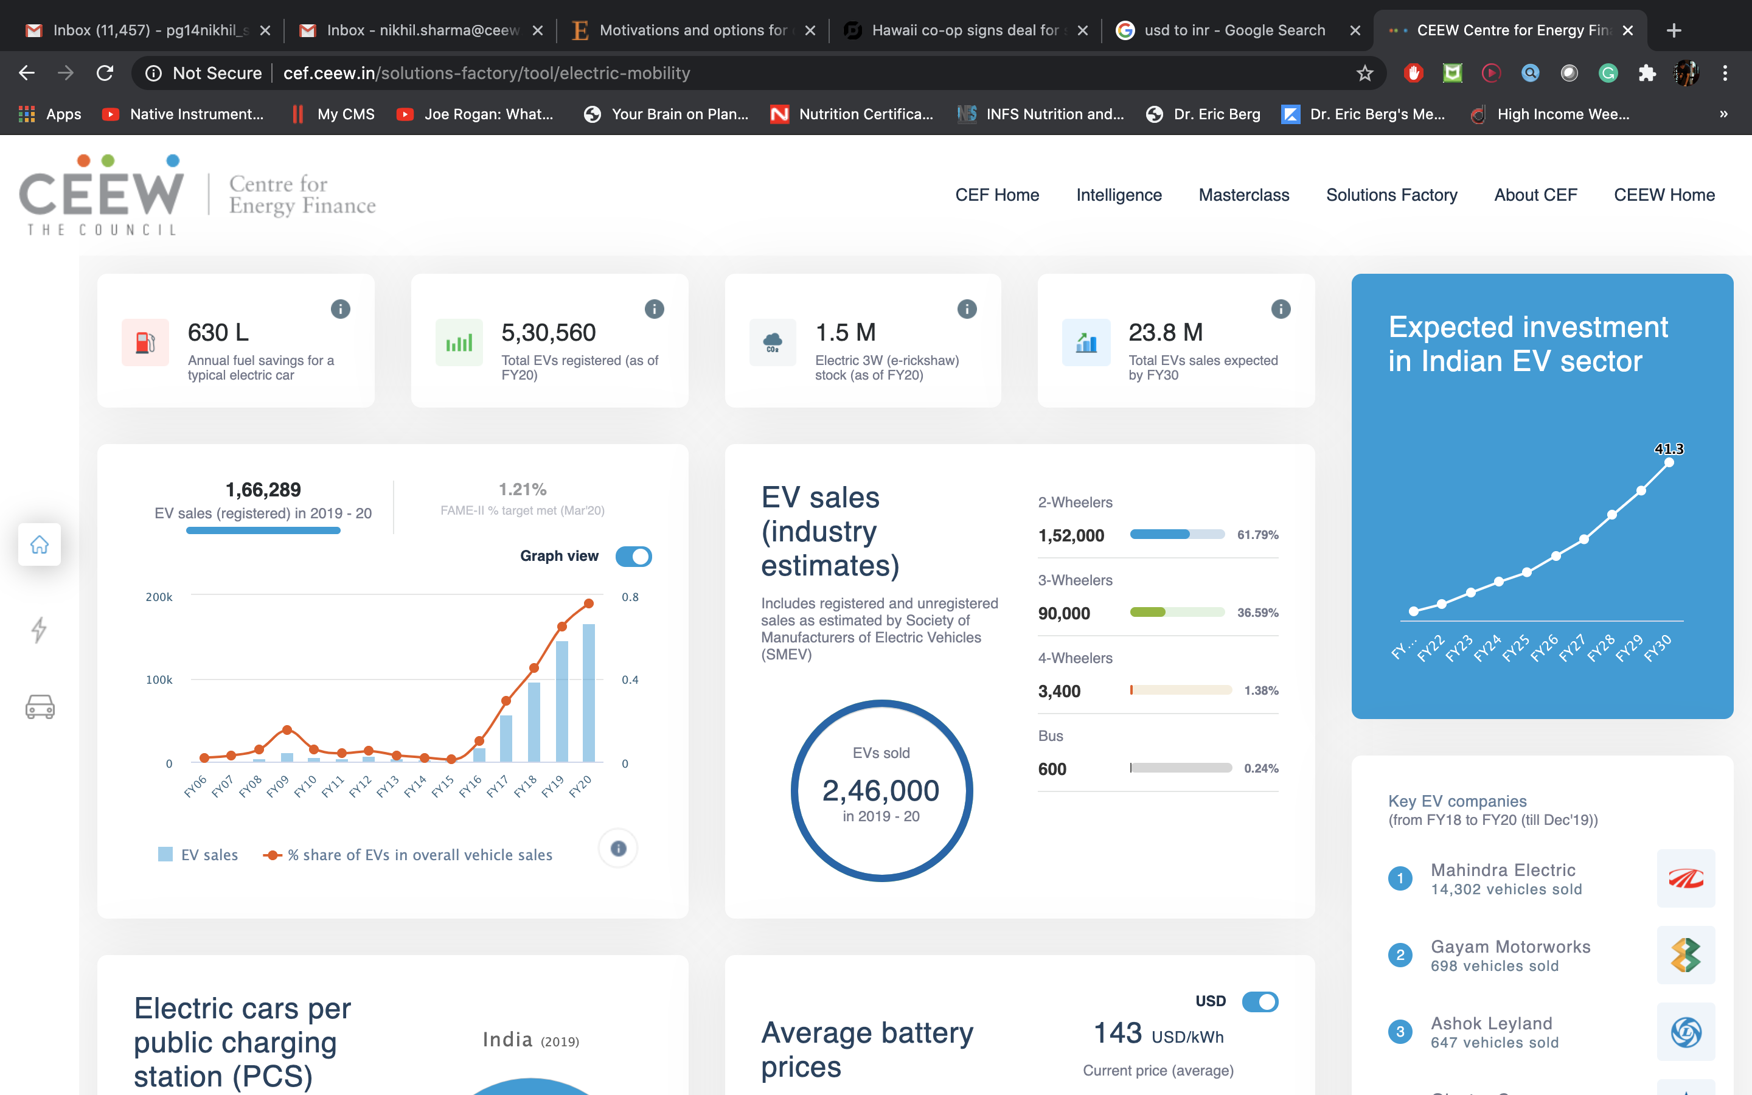
Our recent publications, dashboards and tools
22
Financing India’s Transition to Electric Vehicles
Clean Energy Investment Trends 2020
The Case for Indexed Renewable Energy Tariffs
Scaling Up Solar Manufacturing in India to Enhance India’s Energy Security
India Renewables Dashboard
Open Access Tool
Electric Mobility Dashboard
cef.ceew.in

