Slide 1
CEEW-CEF Market Handbook 2021-22 (Annual issue)
Image: iStock
05 May 2022
© Council on Energy, Environment and Water 2022

Slide 2
CEEW-CEF Market Handbook
India is undergoing an energy transition from fossil-based to clean energy. Evidence-based decision-making can accelerate the process.
CEEW Centre For Energy Finance’s Market Handbook aims to help key investors, executives and policymakers with evidence-based decision-making by:
Identifying and analysing trends critical to India’s energy transition
Presenting data-backed evidence based on the most relevant indicators
Connecting the dots and presenting a short-term market outlook
The handbook attempts to comment and answer on some critical questions such as:
What is India’s generation capacity and energy mix?
What are the key trends in renewable energy (RE) tariffs?
What is the current situation of the discom payment delay situation?
How have the power market reforms progressed?
What are key trends in the electric vehicles (EV) and energy storage markets?
cef.ceew.in

Slide 3
Contents
Generation Capacity And Energy Mix
4
Coal Phase-Out
6
RE Auctions
7
Discom Payables
8
Power Markets
9
Policy and Regulatory Developments
10
Renewable Energy Finance
11
Energy Storage
14
Electric Mobility
15
Image: iStock
Annexures
17
20
About Us
cef.ceew.in

Slide 4
Generation capacity: solar capacity crossed the 50 GW mark in FY22; the share of RE in total power capacity added in FY22 was 89.1%
4
Takeaways & Outlook
In FY22, a net power capacity of 17.3 GW was added (versus 12.1 GW in FY21) It was primarily dominated by renewable energy (RE) (15.5 GW or 89.1%), followed by coal/lignite (1.4 GW or 8.1%) and hydro (0.5 GW or 3.0%).
In RE, solar (grid-scale and rooftop) continued to dominate. It accounted for 13.9 GW (90.0%), more than twice the capacity added in FY21 (5.5 GW). Wind capacity addition remained tepid at 1.1 GW in FY22 (versus 1.6 GW in FY21).
After a slower first quarter, RE capacity addition gained momentum in Q2 FY22 (4.6 GW), Q3 FY22 (3.3 GW) and Q4 FY22 (5.0 GW), consistently surpassing FY20 and FY21 levels. Solar rooftop capacity addition stood at 2.3 GW in FY22 (versus 1.9 GW in FY21).
In FY22, around 17.47 GW of RE capacity was auctioned. Grid-scale solar PV (11.7 GW) emerged as the dominant technology, followed by solar-wind hybrid technologies (4.2 GW, including round-the-clock power).
FY22 witnessed the conclusion of two solar PV with storage capacity (120 MW), and floating solar (15 MW) bids.
Source: Central Electricity Authority (CEA). *Includes solar (rooftop) capacity (6,645.7 MW as of March 2022).
Source: Ministry of New and Renewable Energy.
cef.ceew.in

Slide 5
Energy mix: despite an increase in the share of RE in the generation mix in FY22, the share of RE + hydro remained almost constant; the share of coal/lignite up
5
Takeaways & Outlook
Total electricity generation was up by 8.0% in FY22 compared to FY21. Contributing factors included lower-than-normal monsoons in Q2, the early onset of summer in Q4 (hottest March* in recorded history of 122 years) and continuous improvement in economic activity.
Q1: Up by 17.2%
Q2: Up by 9.1%
Q3: Up by 2.7%
Q4: Up by 4.0%
Total FY22: Up by 8.0%
Overall RE generation in FY22 increased by 15.7%, large hydro generation marginally grew by 1.5%, whereas coal/lignite generation grew significantly by 10.1% (versus FY21).
From an average daily generation perspective, the share of RE and coal/lignite increased, whereas hydro share declined in FY22 compared to FY21.
RE: Share up from 10.1% to 10.8%
Hydro: Share down from 12.3% to 11.5%
RE + Hydro: Almost constant from 22.4% to 22.3%
Coal/lignite: Share up from 71.1% to 72.5%
RE share snapshot
 | FY20 |  | FY21 |  | FY22
 | RE share % | Day | RE share % | Day | RE share % | Day
Highest | 15.9% | 09 July 2019 | 16.8% | 12 August 2020 | 19.2% | 08 August 2021
Lowest | 5.3% | 24 September 2019 | 6.1% | 02 September 2020 | 7.0% | 23 December 2021
Average (daily) | 9.4% | NA | 10.1% | NA | 10.8% | NA
Source: POSOCO. Note: RE technologies include solar, wind, biomass, waste-to-energy and small hydro and do not include rooftop solar and large hydro (>25 MW) generation. *IMD March 2022.
cef.ceew.in

Slide 6
Coal phase-out: net coal capacity addition declined by 33.4% in FY22 compared to FY21
6
Takeaways & Outlook
In FY22, net coal capacity addition [capacity added (4.5 GW) less the capacity retired (1.6 GW)] declined by 33.4% compared to FY21. In Q1 FY22, zero coal capacity was added for the first time in 14 quarters, whereas 670 MW was retired.
PFC/REC, one of India’s largest power sector financiers, continues to reduce its exposure to coal power generation. The share of conventional generation in PFC/REC’s loan book is trending downward and declined to 48% in Q3 FY22 from 51% in Q4 FY21 and 54% in Q3 FY21.
To compensate, PFC/REC has diverted their focus to transmission and distribution (T&D) and RE generation projects (including large hydro). This accounts for around 41% (INR 1,51,023 crore) and 10% (INR 38,215 crore) of its total loan book as of Q3 FY22 versus 35% (INR 1,28,766 crore) and 11% (INR 38,681 crore) as of Q3 FY21, respectively.
PFC/REC’s overall gross loan assets haven’t observed any noticeable change during this period.
Source: CEA.
Source: PFC investor presentations; figures are derived from the same. Note: Sector-wise break up of PFC loan asset data unavailable for Q4 FY22.
cef.ceew.in

Slide 7
RE auctions: SECI’s RE + thermal/hydro round-the-clock (RTC) power, solar + ESS and wind-solar hybrid bids were notable additions to the RE auction formats
7
Bid spotlight: SECI, Karnataka, solar, tranche-X, 1,200 MW
Takeaways & Outlook
Auctioned RE capacity stood at 17.47 GW in FY22, including SECI’s 2.5 GW RE + thermal/hydro RTC-II and 1.2 GW wind-solar hybrid and IREDA’s# 5 GW solar tranche-III. Additionally, auctions for a 20 MW solar PV with 20 MW/50 MWh BESS in Leh and 100 MW solar with 120 MWh BESS in Chhattisgarh were concluded.
Although the COVID-19 second wave slowed down the auction capacity in Q1 FY22, Q2 and Q3 FY22 witnessed notable growth.
Q1: 0.425 GW
Q2: 10.12 GW
Q3: 5.085 GW
Q4: 1.84 GW
Solar module (global) prices** continued to increase during most of FY22 due to an increase in the cost of raw materials. Module prices surged from 16 INR/Wp in Q1 to 22 INR/Wp in Q4 (versus remaining steady at ~15 INR/Wp levels throughout FY21). Rising module prices and an imminent imposition of BCD (basic customs duty) on modules from April 2022, led to higher solar tariffs in FY22 compared to the lowest tariff discovered in FY21 at 1.99 INR/kWh.
Notable auctions
(FY22)
Capacity allotted (MW)
Least tariff discovered (INR/kWh)
Tariff and winner
Tariff discovered: 2.35 INR/kWh
Key provisions
Identification of injection point: ISTS substations in Gadag and Koppal districts in Karnataka.
Comments
Winners: Ayana Renewable and Fortum
Earlier, SECI and KSPDCL were to facilitate the successful bidders to acquire land on a sub-lease basis from KSPDCL. This clause on land acquisition was amended.
Project location: Project (contracted capacity) to be set up at single or multiple locations.
Project commissioning: Part and early commissioning are allowed, SECI to purchase the energy from such early commissioned project at 75% of the PPA tariff (if discom agrees to buy).
This substation-based auction was oversubscribed by 4,930 MW.
GUVNL, Gujarat, solar, phase-XIII, 500 MW (March 2022)
500
2.29
SECI, Himachal Pradesh,
floating solar, 15 MW (February 2022)
15
3.26
Q4
SECI, Karnataka, solar, tranche-X, 1,200 MW (February 2022)
1,200
2.35
UPNEDA, Uttar Pradesh, solar, 200 MW (January 2022)
125
2.98
SECI, pan India, RE + Thermal, RTC-II, 2,500 MW
(October 2021)
2,500
3.01
Q3*
SECI, Chhattisgarh, solar+BESS, 40 MW/120MWh (December 2021)
100
(solar)
NA
Q2*
SECI, pan India, wind-solar hybrid, tranche IV, 1,200 MW (August 2021)
1,200
2.34
RUMSL, Madhya Pradesh, solar, 500 MW (August 2021)
500
2.14
Q1*
MAHAGENCO, Maharashtra, solar, 250 MW (May 2021)
250
2.51
Source: SECI and state renewable agencies. SECI = Solar Energy Corporation of India; GUVNL = Gujarat Urja Vikas Nigam Limited; MSEDCL = Maharashtra State Electricity Distribution Company Limited; RUMSL = Rewa Ultra Mega Solar Limited; PSPCL = Punjab State Power Corporation Limited; RTC = round-the-clock; MAHAGENCO = Maharashtra State Power Generation Company; BESS = battery energy storage system. *Note: For Q1, Q2 and Q3 FY22, only the least tariff auctions as well as unique auctions such as RTC, have been covered. **Cybex import data. # IREDA = Indian Renewable Energy Development Agency.
cef.ceew.in

Slide 8
Discom payables: amount overdue by discoms increased by 32% in FY22
8
Takeaways & Outlook
The overdue amount payable by discoms to power producers increased by 3% in Q4 FY22 (INR 1,27,784 crore) compared to Q3 FY22 (INR 1,23,657 crore) and increased by 32% compared to Q4 FY21 (INR 97,020 crore).
According to the Ministry of Power’s (MoP) Ujwal DISCOM Assurance Yojana (UDAY) platform, discoms in Karnataka, Gujarat, Kerala, Rajasthan and Haryana topped the latest quarterly performance assessment*.
From a payment delay standpoint, discoms in Gujarat, Assam, Madhya Pradesh and Uttarakhand, cleared their power purchase dues within 45 days (as of December 2021). On the other hand, discoms in Telangana, Karnataka, Andhra Pradesh, Uttar Pradesh and Chhattisgarh took more than 120 days to clear their dues.
MoP notified the progress of the RDSS (reforms-based and result-linked) scheme for discoms issued in June 2021 with an outlay of INR 3,03,758 crore over five years. Meghalaya and Assam emerged as frontrunners in terms of announcing their reform plans under the scheme.
↑ 3% 8.1%
Q4 FY22
Q3 FY22
Q2 FY22
↑ 32%
Q1 FY22
Source: PRAAPTI portal (Based on voluntary disclosures from power producers).
Source: UDAY portal (based on data disclosed by discoms as of 31 December 2021). *Data not available for these states; values derived from 2019–20/ 2020–21 financial reports.
Reforms-based and results-linked, revamped distribution sector (RDSS) scheme, approved in June 2021, aims to reduce AT&C losses to pan-India levels of 12-15% by 2024-25, reduce ACS-ARR gap to zero by 2024-25, and develop institutional capabilities for modern discoms.
* As of December 2021.
cef.ceew.in

Slide 9
Power markets: Q4 FY22 witnessed a steep rise in electricity demand similar to Q2 FY22; day-ahead market prices hit a 13-year high on IEX in March 2022
9
Takeaways & Outlook
Peak power demand continued to soar in FY22. It reached a new high of 203 GW in July 2021 and again crossed the 200 GW mark in March 2022. In energy terms, the average monthly electricity demand (met) saw an uptick of 7% in FY22 (versus FY21).
The average prices on IEX’s day-ahead market surged in Q4 FY22 to the highest level since April 2009, owing to a steep rise in electricity demand and high-priced imported coal and gas for the merchant power capacity supplying the market.
On 24 November 2021, IEX and PXIL resumed renewable energy certificates (REC) trading. In total, 2,04,181 solar and 5,45,658 non-solar RECs were traded at an average price of 2.283 INR/kWh and 1.0 INR/kWh in Q4 FY22 on IEX, respectively.
Further, in Q3 FY22, the Central Electricity Regulatory Commission (CERC) approved the green day-ahead contract (GDAC) or green day-ahead market (GDAM) on the IEX and PXIL power exchanges. Since its inception, 921 million kWh of energy was traded on GDAM with 751 participants. In Q4 FY22, hydropower contracts were also introduced in GTAM.
FY22
FY21
Source: CEA.
Source: Indian Energy Exchange (IEX). *Day-ahead contingency.
Quarterly peak power demand in FY22 consistently surpassed FY21 and FY20 levels; it touched the 200 GW mark in Q2 and Q4. With improved economic activity, lower-than-normal monsoons and the early onset of summer, average electricity demand saw an uptick of 7% in FY22 (vs FY21).
Green term–ahead market (GTAM) achieved 3,933 million kWh traded volume in FY22, seeing a 403% growth in FY22 (vs FY21). Q4 FY22 saw a notable increase in prices owing to low supply-side volumes due to the low solar-wind season.
Source: IEX.
Source: IEX.
Day-ahead market (DAM) achieved 65,151 million kWh volume in FY22 registering a 7.8% growth (vs FY21). The year saw a considerable hike in prices with electricity demand rising notably and high-priced imported coal and gas for the merchant power capacity supplying through DAM.
In FY22, the real-time market (RTM) traded 19,910 million kWh, registering a 110% growth in FY22 (vs FY21). Since its inception, discoms have been tapping into the RTM for power demand-supply balancing in real-time.
cef.ceew.in

Slide 10
Policy and regulatory developments: CERC approved the introduction of hydropower contracts in GTAM; MoP notified Green Hydrogen Policy; MNRE revised the ALMM list five times in FY22
10
Takeaways & Outlook
FY22 saw a positive policy signal for the rooftop solar PV market, with the MoP increasing the cap on the net-metering provision from 10 kW to 500 kW. The MoP also extended the waiver of ISTS charges for solar/wind projects till June 2025 and included open access under the ambit of the waiver. In Q2 FY22, MoP issued the amendments to the existing REC mechanism. In Q3, the IREDA announced the winners and waitlist of the Production-Linked Incentive (PLI) scheme for manufacturing solar PV modules. In Q4, the fund allocation for the PLI scheme was increased to INR 19,500 crore.
Further, since its launch in March 2021, the ALMM (solar) has been updated five times to now include 46 domestic module manufacturers. In December 2022, the MNRE released the RLMM of wind turbines (revised time-to-time) that includes 15 manufacturers.
In addition, the implementation period for the FAME II scheme was extended for two years in June 2021. During FY22, four states (Odisha, Goa, West Bengal and Gujarat) notified their electric vehicle policies.
MNRE amended the ALMM* of solar PV modules order, 2019
MoP notified the Green Hydrogen Policy
CERC announced Deviation Settlement Mechanism and Related Matters Regulations, 2022
According to the amended order, only the models and manufacturers included in the ALMM list are eligible for use in open-access and net-metering projects.
The amendment shall be applicable from 1 October 2022.
Previously, only government, government-assisted projects, and projects under government schemes & programmes were included.
Aligned with the announcement of the National Hydrogen Mission in August 2021, on 17 February 2022, the MoP released the Green Hydrogen Policy.
The policy will provide various benefits to green hydrogen/ ammonia manufacturers such as a waiver of ISTS charges for 25 years, grant of open access within 15 days, banking of RE for 30 days, land allotment in RE parks.
Additionally, the RE utilised to generate green hydrogen/ ammonia will be counted under renewable purchase obligation (RPO) compliance.
In March 2022, CERC announced the Deviation Settlement Mechanism and Related Matters Regulations, 2022.
Through a commercial mechanism, it aims to ensure that consumers do not deviate from and adhere to their schedule of drawal and injection of electricity from the grid.
The regulation includes applicable charges for deviation for both over/under injection and over/ under withdrawal.
CERC approved introduction of hydropower contracts in GTAM
In February 2022, CERC approved IEX’s petition seeking approval to introduce the hydropower contracts in GTAM.
It aims to facilitate hydropower purchase obligation compliance.
It will include intra-day hydro contracts, day-ahead contingency hydro contracts, daily hydro contracts and weekly hydro contracts in GTAM.
MNRE updated List – I under ALMM* order for solar PV modules
MNRE issued the framework for the promotion of DRE livelihood applications
In March 2022, the MNRE updated list-1 under the ALMM. it increased the number of manufacturers to 46 with a capacity of 11,415 MW.
New entrants include ECE Energies Pvt. Ltd., Rayzon Green Energies, Lubi Electronics, Kosol Energie Pvt. Ltd., and Citizen Solar Pvt. Ltd.
In February 2022, the MNRE issued the framework to scale up currently available DRE livelihood applications and support the development of new DRE livelihood applications.
Source: CEEW-CEF Compilation. *ALMM = Approved List of Models and Manufacturers; MNRE = Ministry of New and Renewable Energy; DRE = decentralised renewable energy; *FAME=Faster Adoption and Manufacturing of (Hybrid &) Electric Vehicles in India; RLMM = Revised List of Models and Manufacturers of Wind Turbines.
cef.ceew.in

Slide 11
Renewable energy finance: market concentration in RE auctions declined slightly in FY22 compared to FY21
11
Notable deals (FY22)
Takeaways & Outlook
In FY22, around 17.47 GW of RE capacity was auctioned. Public sector undertakings (PSU) such as NTPC and SJVN were among the top developers to capture the RE auctions market in FY22, followed by private sector developers such as ReNew Power, Ayana Renewable, Greenko and Tata Power.
New market entrants such as Hindustan Thermal Projects (250 MW) and Power Mech Projects (550 MW) won capacities in the SECI’s RE + thermal/hydro RTC-II bid.
The market concentration saw a slight decline in FY22 to 51% (versus 52% in FY21), with a diverse set of public and private sector developers participating in the auctions (a total of 27 in FY22).
In FY22, the deal activity primarily consisted of solar and hydro project acquisitions, as well as those in the solar module/cell manufacturing sector. In a historic deal, Adani Green Energy acquired SB Energy’s portfolio (the largest in the RE sector in India till now). In Q4, Reliance Industries acquired a 40% stake in Sterling & Wilson Solar, a solar EPC company. Further, ReNew Power sold its rooftop business to Fourth Partner Energy.
91%
51%
Acquisition
Target: Surya Vidyut Acquirer: Torrent Power Amount: INR 811.5 crore (USD 107 million)
Q4 FY22
FY22
March 2022
Market concentration in auctioned RE capacity
Acquisition
Target: Sterling & Wilson
Acquirer: Reliance Industries
Amount: INR 2,859.13 crore (USD 377 million)
Note: Market concentration is calculated as the ratio of the top five RE capacities auctioned to the total RE capacity auctioned
.
February 2022
Acquisition
Target: ReNew Power
Acquirer: Fourth Energy Partner
Amount: INR 650 crore (USD 87 million)
Developer-wise* RE capacity auctioned during FY22 (17,470 MW)
January 2022
Acquisition
Target: REC Solar Holdings Acquirer: Reliance New Energy Solar Amount: INR 5717.9 crore (USD 771 million)
October 2021
August
2021
Asset acquisition
Target: L&T (Hydro asset), NA (Solar asset)
Acquirer: ReNew Power
Amount: INR 2824.5 crore (USD 384 million)
May
2021
Acquisition
Target: SB Energy
Acquirer: Adani Green Energy
Amount: : INR 26,219.0 crore (USD 3.5 Billion)
Source: CEEW-CEF Compilation.
Source: CEEW-CEF Compilation. *Note: Includes only top 10 developers in terms of auctioned capacity.
cef.ceew.in

Slide 12
Renewable energy finance: most RE stocks notably outperformed the market in FY22; NYSE listed Azure Power’s share price dropped with a widening quarterly net loss in FY22
12
Takeaways & Outlook
In FY22, all the listed RE stocks (except the NYSE listed solar project developer Azure Power) notably outperformed the market (Sensex), which was in turn up by 18% as of March 2022 (versus March 2021).
The share price of the pure-play RE developer, Adani Green Energy, significantly outperformed the market consistently throughout FY22, up by 75% as of March 2022 (versus March 2021). The share price of Borosil Renewables, which holds a monopoly position in India’s solar panel glass manufacturing, was up by 137% as of March 2022 (versus March 2021).
The stock prices of wind developer–manufacturers Inox Wind and Suzlon Energy were up by 60% and 83% in this period, respectively. A consistent expansion of their order books and increasing quarterly profits attracted investor interest.
The widening quarterly net loss being reported by Azure Power during FY22 led to subdued investor interest in the stock.
Q1 FY22
Q2 FY22
Q4 FY22
Q4 FY22
Source: Money Control.
cef.ceew.in

Slide 13
Renewable energy finance: ~USD 4.94 billion raised through green bonds in FY22 to refinance existing costlier debt
13
Takeaways & Outlook
In FY22, India saw a notable rise in green and sustainability-linked bond (SLB)** issuances in the international markets. This includes the USD 4.94 billion (versus USD 3.3 billion in FY21) green bonds issued by RE developers such as Greenko, ReNew Power, Acme Solar, and Adani Green Energy (see Annexure I). In addition, JSW Steel, Adani Electricity Mumbai Ltd., and JSW Infrastructure raised USD 1.7 billion through SLBs.
In Q4 FY22, ReNew Power raised USD 400 million at a 4.50% interest rate for five years, and Greenko raised USD 750 million at 5.50% for three years through green bonds. In FY22, the international bonds market saw the lowest-ever coupon rate achieved by an Indian RE developer at 3.575%, raised by Azure Power.
In addition, Avaada Energy plans to issue domestic green bonds worth INR 1,440 crore (USD 192 million) after Vector Green Energy raised finance through the first-ever green bond in the domestic market.
Key bond yields in India, including the 10-year treasury and NTPC’s 10-year bond yields, saw a spike in Q4 FY22 following expectations of a likely rate hike by the US Federal Reserve.
Q1 FY22
Q2 FY22
Q3 FY22
Q4 FY22
Source: Reserve Bank of India, State Bank of India, Trading Economics, Money Control and BondEvalue. * Current yield. **SLBs are issued with specific sustainability performance targets that include predefined key performance indicators (KPIs) and allow a diverse set of issuers to obtain financing via this route.
cef.ceew.in

Slide 14
Energy storage: four companies (50 GWh) selected under the PLI scheme for battery storage manufacturing
14
Second-life battery ESS projects
India’s recent energy storage tenders
Takeaways & Outlook
Multiple energy storage tenders were announced in FY22. This includes REMCL’s* pan India 150 MW RE with thermal, hydro, gas, or energy storage tender, SECI’s 500 MW/1000 MWh standalone BESS (draft RfS released), and NTPC’s 500 MW wind/solar with 3000 MWh BESS. In FY22, the SECI concluded two notable tenders, namely, a 100 MW solar with 120 MWh BESS in Chhattisgarh and a 20 MW solar with 50 MWh BESS in Leh, Ladakh. In addition, SECI concluded the pan India 2,500 MW RE + thermal/hydro/storage RTC-II auction.
In March 2022, four companies (50 GWh) were selected for incentives under the Production Linked Incentive (PLI) scheme for Advanced Chemistry Cell (ACC) battery storage manufacturing. The PLI scheme for ACC battery storage received an encouraging response from 10 bidders (130 GWh capacity).
In FY22, notable joint ventures (JV)/ investment activities took place in the domestic energy storage market. ReNew Power and Fluence formed a JV, Ayana Renewables partnered with Greenko for pumped hydro storage and Reliance Industries invested in Faradion and Ambri.
Project location & tender issue date | Application & technology | Details
Pan India (NTPC), January 2022 | 500 MW wind/solar with 3000 MWh BESS | Bid conclusion expected in Q1 FY23 (extended)
Pan India (REMCL*), November 2021 | 150 MW RE, thermal, hydro and gas with ESS in RTC manner | Bid conclusion expected in Q1 FY23
Rajasthan (SECI), October 2021 | 500 MW/1000 MWh standalone BESS (ESS-I) | Draft RfS released in Q3 FY22
Gujarat (GSECL) (EPC), September 2021 | 35 MW solar with 57 MWh BESS | Bid conclusion expected in Q1 FY23
Greater Noida, Uttar Pradesh (NTPC), June 2021 | 4 MW solar with 1 MW/1 MWh BESS | Bid conclusion expected in Q1 FY23
Maharashtra (REMCL*), June 2021 | 15 MW solar with 7 MW/14 MWh BESS, (railway land) | Under evaluation, bid conclusion expected in Q1 FY23
Tamil Nadu (TANGEDCO), February 2021 | 1 MW solar with 3 MWh BESS | Bid conclusion expected in Q1 FY23
Leh & Kargil (SECI), January 2020 | 14 MW solar with 42 MWh BESS | Results expected in Q1 FY23 (extended)
Endesa (Enel Group) and Nissan, Spain (March 2022)
Enel’s subsidiary Endesa commissioned a 4 MW / 1.7 MWh second-life battery ESS project.
It combines 78 Nissan electric vehicle (EV) batteries, of which 48 are disused and 30 are new at a conventional power plant in Melilla, Spain.
In the event of plant failure, second-life battery ESS can supply the grid for 15 minutes.
This will help avoid load shedding events and improve grid reliability.
RWE and Audi, Germany (December 2021)
RWE and Audi have commissioned an ESS consisting of used Li-ion batteries from the Audi e-tron EV.
It is a 4.5 MWh pilot project located at RWE’s pumped-storage power plant at the Hengsteysee reservoir, consisting of 60 batteries.
Initially, this pilot project will help maintain the frequency in the electricity grid and later it will be tested for providing grid flexibility.
Source: Press release by Enel (March 2022) and RWE (December 2021).
ESS = energy storage system.
Source: SECI and state renewable agencies. RfS = request for selection. *REMCL = Railway Energy Management Company Limited.
cef.ceew.in

Slide 15
Electric mobility: electric vehicle sales increased by 233% in FY22 versus FY21; 2W segment dominated EV sales in FY22
15
Takeaways & Outlook
FY22 emerged as a historic fiscal year for electric vehicle (EV) and hybrid vehicle sales. EV sales grew by 233% in FY22 (versus FY21). EV sales as a share of overall vehicle sales went up from 0.97% in Q1 FY22 to 4.02% in Q4 FY22.
For 3Ws, the share of electric 3Ws (including e-rickshaws) was 46% in FY22. For buses, the share of e-buses was 9% in FY22.
In the Union Budget 2022-23, the FAME-II scheme received a significant boost in terms of fund allocation, which was increased from INR 800 crores to INR 2,908 crores. Additionally, the government announced a battery swapping policy along with interoperability standards to improve efficiency in the EV ecosystem.
OEMs with the highest EV sales* in FY22 were:
2W: Hero Electric (69,215), Okinawa (51,786) and Ampere (27,523)
3W: Y.C. Electric (17,050), Saera Electric (8,474) and Mahindra Electric (8,000)
4W: Tata Motors (11,062), Mahindra Electric (4,976) and MG Motors (2,041)
Source: Vahan Sewa dashboard (includes only registered vehicles, unregistered vehicles include low-speed vehicles (< 25 km/hr), e-rickshaws (three-wheelers) and electric two-wheelers), Electric Mobility Dashboard (2021), CEEW Centre for Energy Finance. *Based on sales data up to Q4 FY22.
cef.ceew.in

Slide 16
Thank you
You can find us at cef.ceew.in | @CEEW_CEF
Authors
Ruchita Shah (ruchita.shah@ceew.in)
Nikhil Sharma (nikhil.sharma@ceew.in)
Meghna Nair (meghna.nair@ceew.in)
Shreyas Garg (shreyas.garg@ceew.in)
Reviewer
Gagan Sidhu (gagan.sidhu@ceew.in)
cef.ceew.in

Slide 17
Annexure I: Green bond issuances
17
Date | Company | Size (USD million) | Sector | Coupon rate (%) | Rating | Tenor (Years) | Purpose
March 2022 | Greenko | 750 | Energy storage | 5.50% | Ba1 (Moody’s) | 3 | Refinance existing debt and fund the capital expenditures at asset level
January 2022 | ReNew Power | 400 | Solar and wind | 4.50% | BB- (Fitch) | 5.25 | Refinance existing debt and fund capital expenditure
September 2021 | Adani Green Energy | 750 | Solar and wind | 4.375% | Ba3 (Moody’s) | 3 | Fund equity portion of capital expenditure for under-construction projects
August 2021 | Azure Power | 414 | Solar | 3.575% | Not available | 5 | Refinance existing higher cost green bond debt
July 2021 | Acme Solar | 334 | Solar | 4.70% | Not available | 5 | Refinancing of existing debt
July 2021 | Vector Green Energy | 165 | Solar | 6.49% | AAA (CRISIL, India Ratings) | 3 | Refinance existing high-cost debt of solar projects
May 2021 | JSW Hydro | 707 | Hydro | 4.50% | BB+ (EXP) (Fitch) | 10 | Repayment of existing green project-related rupee-denominated debt
April 2021 | ReNew Power | 585 | Solar and wind | 4.50% | BB- (Fitch) | 7.25 | Refinancing of existing debt
March 2021 | Greenko | 940 | Solar and wind | 3.85% | BB (Fitch) | 5 | Redemption of previous fund raise
March 2021 | Hero Future Energies | 363 | Solar and wind | 4.25% | BB- (Fitch) | 6 | Refinancing of existing debt
February 2021 | ReNew Power | 460 | Solar and wind | 4.00% | BB- (Fitch) | 6 | Refinancing of existing debt
February 2021 | Continuum Green Energy | 561 | Solar and wind | 4.50% | BB+ (Fitch) | 6 | Refinancing of existing debt
Source: Climate Bonds Initiative and company press releases.
cef.ceew.in

Slide 18
Annexure I: Green bond issuances
18
Date | Company | Size (USD million) | Sector | Coupon rate (%) | Rating | Tenor (Years) | Purpose
October 2020 | CLP Wind Farms | 40 | Wind | Not available | AA (India Ratings) | 2 to 3 | Refinancing of existing debt
October 2020 | ReNew Power | 325 | Solar and wind | 5.375% | BB- (Fitch) | 3.5 | Refinancing high-cost local debt
January 2020 | ReNew Power | 450 | Solar and wind | 5.875% | BB-/Stable (Fitch) | 5 | Refinancing of maturing debt
October 2019 | Adani Green Energy | 362.5 | Solar and wind | 4.625% | BBB- (Fitch) | 20 | Repaying foreign currency loans and rupee borrowings
September 2019 | ReNew Power | 90 | Solar and wind | 6.67% | BB (Fitch) | 4.5 | Refinancing of existing debt
September 2019 | Greenko | 85 | Solar and wind | 5.95% | BB- (Fitch) | 6.75 | Refinancing of existing debt
September 2019 | Azure power | 350 | Solar | 5.65% | BB (Fitch) | 5 | Refinancing of existing debt
September 2019 | ReNew Power | 300 | Solar and wind | 6.45% | Ba2 (Moody's) | 5 | Capacity expansion and repaying high cost debt
August 2019 | Greenko | 85 | Solar and wind | 6.25% | Ba1 (Moody’s) | 3.5 | Refinancing of solar and wind projects
August 2019 | Greenko | 350 | Solar and wind | 6.25% | Ba1 (Moody’s) | 3.5 | Refinancing of solar and wind projects
July 2019 | Greenko | 450 | Solar and wind | 5.95% | BB (Fitch) | 7 | Refinancing of solar and wind projects
July 2019 | Greenko | 500 | Solar and wind | 5.55% | BB (Fitch) | 5.5 | Refinancing of solar and wind projects
Source: Climate Bonds Initiative and company press releases.
cef.ceew.in

Slide 19
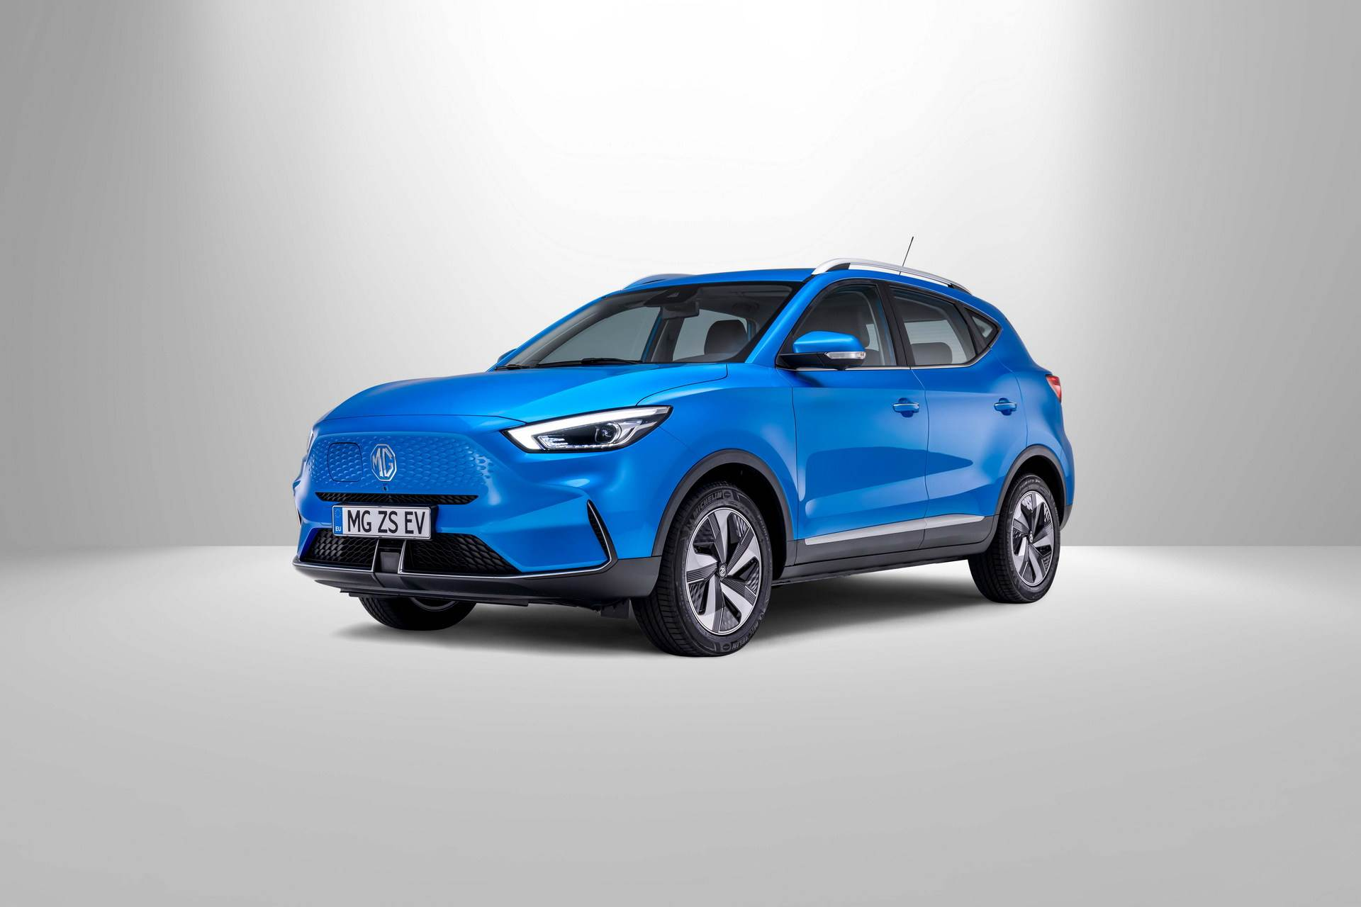
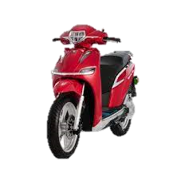
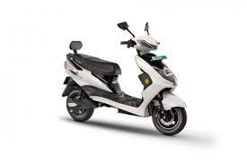
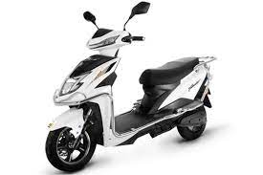
Annexure II: Key electric mobility facts and figures
19
19.28%
468
165
FAME-II target met
Number of EV OEMs in India
Total FAME II approved models
As of FY22
As of FY22
As of FY22
Note: Target of selling 1,562,000 EVs (2W, 3W, 4W and buses) under FAME-II scheme by FY22
EV sales per 1000 non-EV sales
10,66,609
Recent electric vehicle launches
As of FY22
84
MG ZE EV Facelift
Price: INR 21,99,800 onwards
Range: 461 km
Battery capacity: 50.3 kWh
Delhi
EVs sold
63
As of FY22
Tripura
Okinawa OKHI-90
49
Price: INR 1,21,866 onwards
Range: 160 km
Battery capacity: 3.6 kWh
Assam
42
46%
iVOOMi S1
9%
Karnataka
Price: INR 84,000 onwards
Range: 115 km
Battery capacity: 2 kWh
37
Goa
Share of EV Bus and 3W in total bus and 3W sales
AMO Jaunty Plus
in FY22
Price: INR 1,10,000 onwards
Range: 120 km
Battery capacity: 60V/40Ah
For more updates visit CEEW-CEF Electric Mobility Dashboard
Source: Vahan Sewa dashboard, CEEW Centre for Energy Finance Electric Mobility dashboard, Department of Heavy Industries, CEA.
19
cef.ceew.in

Slide 20
About us: CEEW is among Asia’s leading policy research institutions
20
cef.ceew.in

Slide 21
CEEW Centre for Energy Finance
21
Build evidence
Consistent, reliable, and up to date monitoring & analysis of clean energy markets – investment, payment schedules, market trends, etc.
Create coherence
Periodic convening of multi-stakeholder groups to deliberate on market activities in clean energy
Design solutions
Design and feasibility pilots of fit-for-purpose business models & financial solutions for clean energy solutions
cef.ceew.in

Slide 22
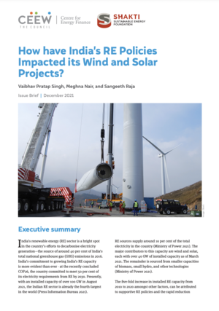
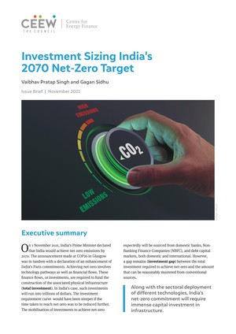
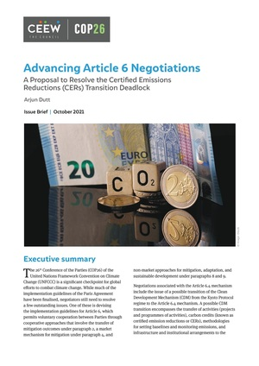
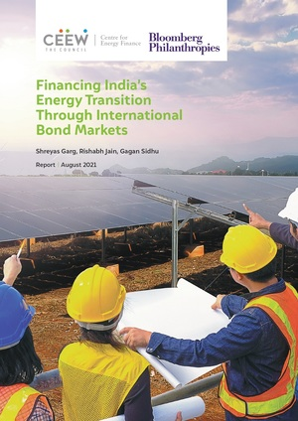
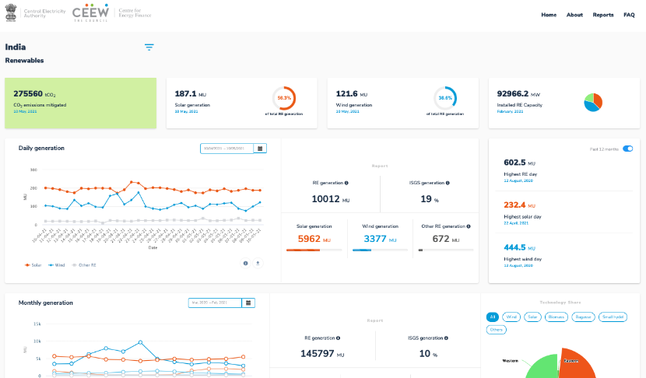
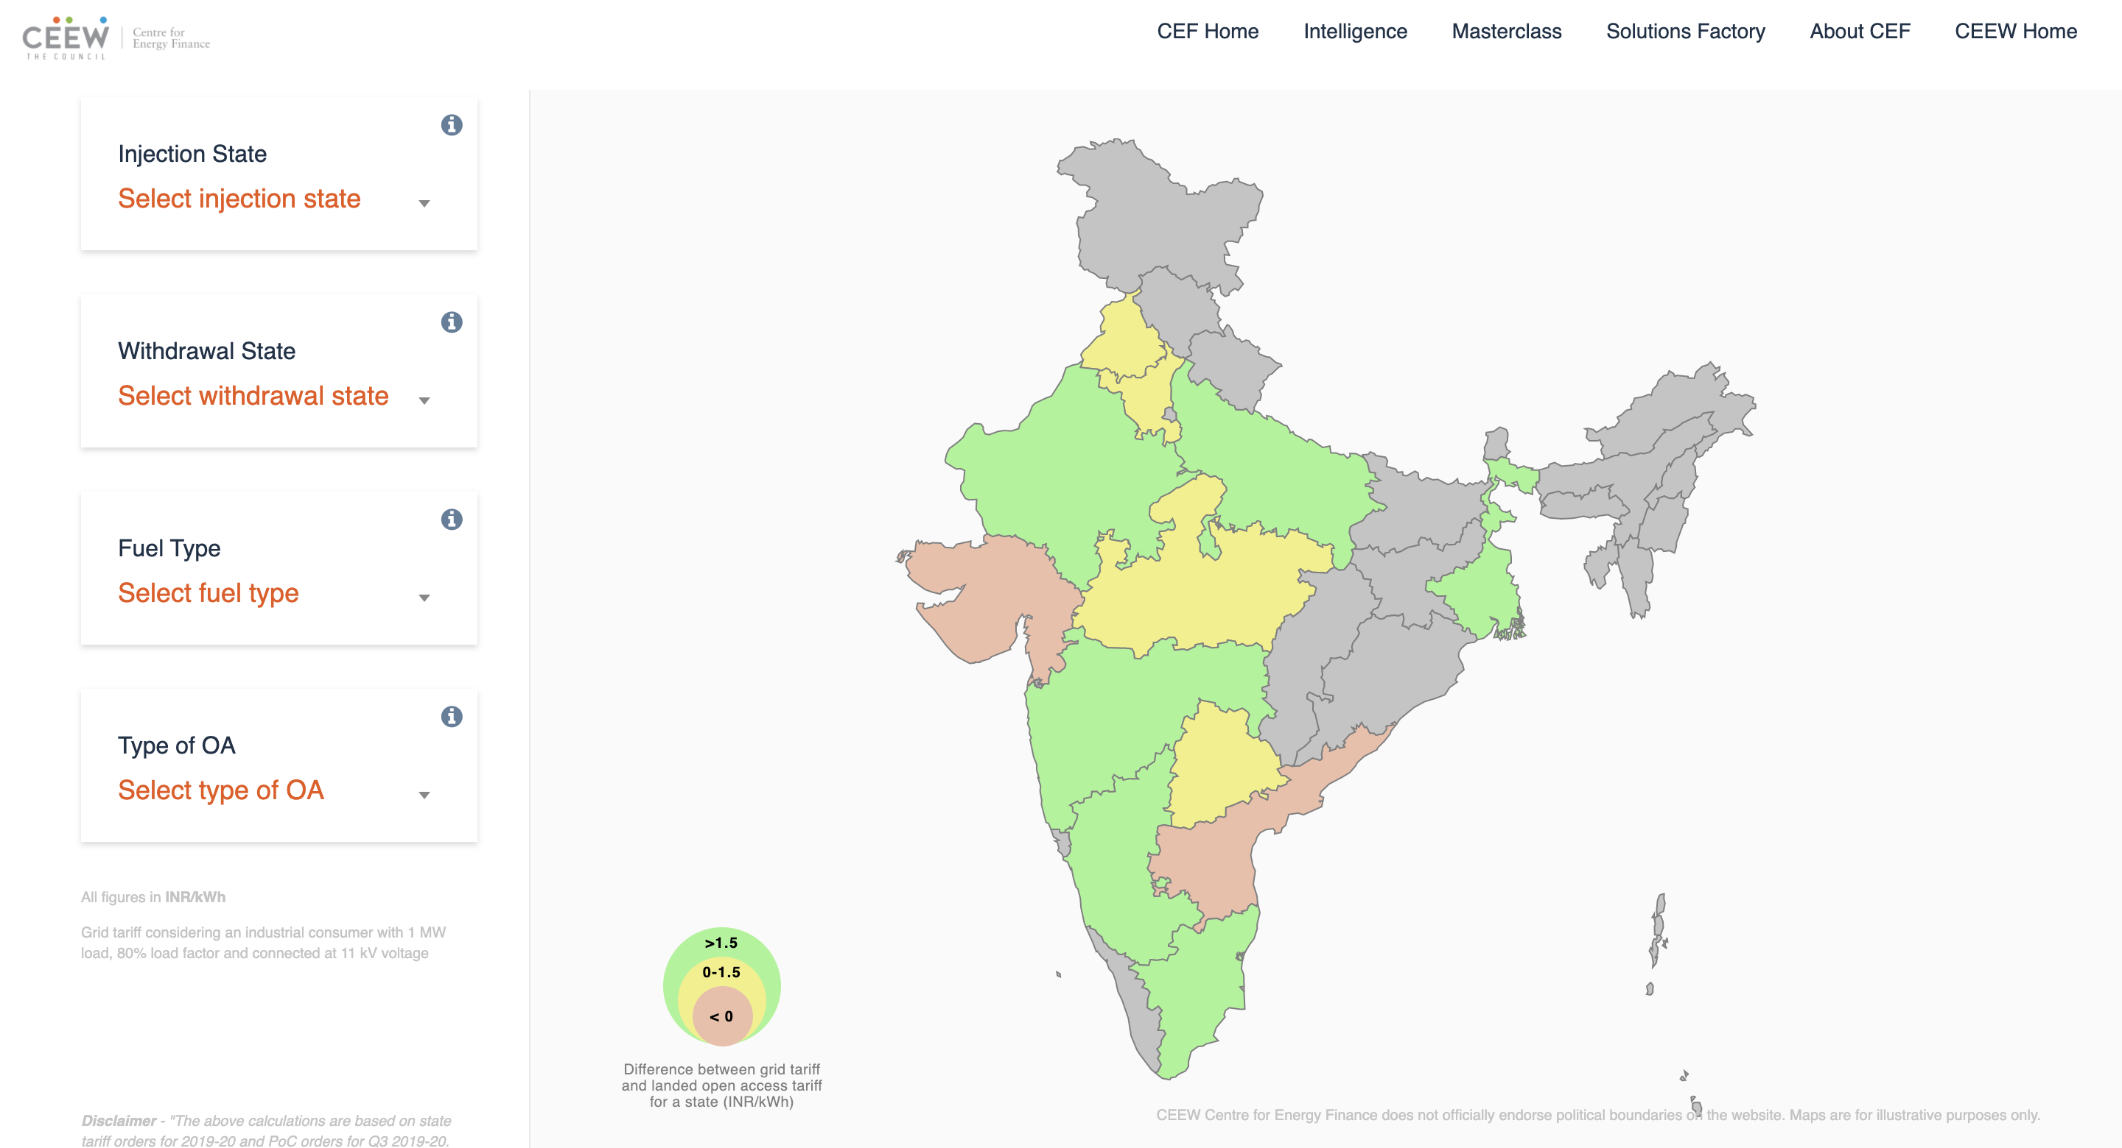
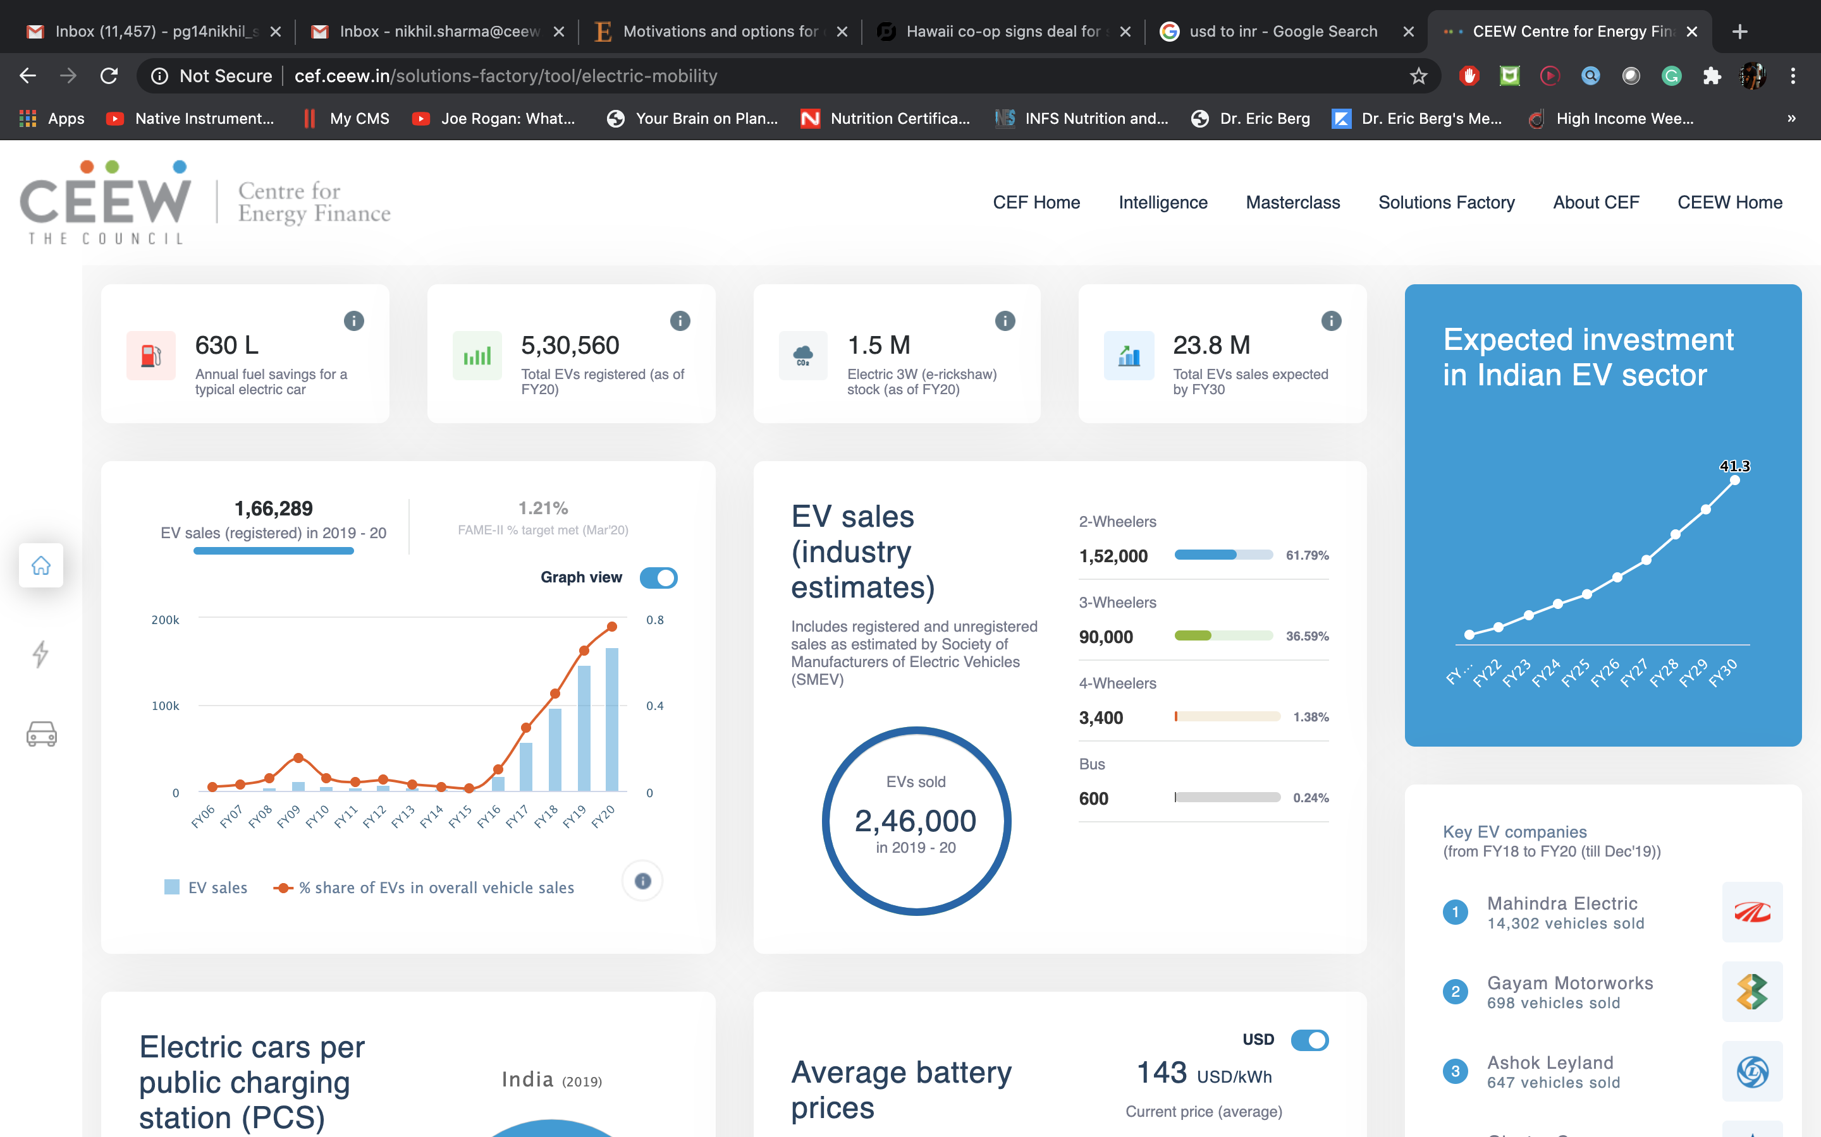
Our recent publications, dashboards and tools
22
How have India’s RE Policies Impacted its Solar and Wind Projects
Investment Sizing India’s 2070 Net-Zero Target
Advancing Article 6 Negotiations
Financing India’s Energy Transition Through International Bond Markets
India Renewables Dashboard
Open Access Tool
Electric Mobility Dashboard
cef.ceew.in

