Slide 1
CEEW-CEF Market Handbook Q3 2022-23
Image: iStock
7 February 2023
© Council on Energy, Environment and Water 2023

Slide 2
CEEW-CEF Market Handbook
India is undergoing an energy transition from fossil-based to clean energy. Evidence-based decision-making can accelerate the process.
CEEW Centre For Energy Finance’s Market Handbook aims to help key investors, executives and policymakers with evidence-based decision-making by:
Identifying and analysing trends critical to India’s energy transition
Presenting data-backed evidence based on the most relevant indicators
Connecting the dots and presenting a short-term market outlook
The handbook attempts to comment and answer on some critical questions such as:
What is India’s generation capacity and energy mix?
What are the key trends in renewable energy (RE) tariffs?
What is the current situation of the discom payment delay situation?
How have the power market reforms progressed?
What are key trends in the electric vehicles (EV) and energy storage markets?
cef.ceew.in

Slide 3
Contents
Generation Capacity and Energy Mix
4
Coal Phase-Out
6
RE Auctions
7
Discom Payables
8
Power Markets
9
Policy and Regulatory Developments
10
Renewable Energy Finance
11
Energy Storage
14
Electric Mobility
15
Image: iStock
Annexures
17
20
About Us
cef.ceew.in

Slide 4
Generation capacity: net generation capacity addition dominated by RE; total installed capacity stood at 410 GW
4
Takeaways & Outlook
In Q3 FY23, a net generation capacity of 2.5 GW was added (vs 4.5 GW in Q3 FY22). The total net capacity addition comprised renewable energy (RE) (2.8 GW), diesel-based (26.8 MW) capacity addition and retirement of coal-based (304 MW) capacity. No new hydropower capacity was added in this quarter.
In RE, solar (grid-scale and rooftop) continued to dominate capacity addition, accounting for 2,489 MW (88.3%) (vs 2,372 MW in Q3 FY22) of total RE addition. Wind capacity addition stood at 264 MW (9.4%) in Q3 FY23 (vs 212 MW in Q3 FY22). Small hydro (36 MW) and biopower (31 MW) contributed 1.3% and 1.1%, respectively.
In Q3 FY23, the total installed RE capacity reached 120.9 GW, with 63.3 GW of solar, 41.9 GW of wind and 10.7 GW of biopower capacity.
In total, 2.4 GW of RE capacity was auctioned in Q3 FY23. Grid-scale solar PV auctions stood at 500 MW and wind at 600 MW. Auctions for 255 MW of wind-solar hybrid and 300 MW of floating solar PV were also concluded.
Source: Central Electricity Authority (CEA). * Includes solar rooftop capacity (8077.1 MW as of December 2022).
Source: Ministry of New and Renewable Energy (MNRE).
cef.ceew.in

Slide 5
Energy mix: the share of RE rose significantly; on the other hand, the share of hydro declined
5
Takeaways & Outlook
The total power generation increased by 10.0% in Q3 FY23 (367 billion kWh) compared to Q3 FY22 (333 billion kWh) but reduced by 9.2% in comparison to Q2 FY23 (404 billion kWh).
October: Up by 3.4%
November: Up by 14.6%
December: Up by 13.7%
Total Q3 FY23: Up by 10.0%
In Q3 FY23, RE generation increased by 25.9% vs the same quarter in the previous fiscal year (Q3 FY22). Coal/lignite-based generation was up by 10.5% and hydro by 3.4% for the same period.
From an average daily generation perspective, the share of RE and coal/lignite increased, whereas hydro share declined in Q3 FY23 compared to Q3 FY22.
RE: Share up from 9.1% to 10.4%
Hydro: Share down from 11.0% to 10.3%
RE + Hydro: Share up from 20.0% to 20.6%
Coal/lignite: Share up from 74.5% to 74.9%
RE share snapshot
 | Q3 FY21 |  | Q3 FY22 |  | Q3 FY23
 | RE share | Day | RE share | Day | RE share | Day
Highest | 12.4% | 27 November 2020 | 12.6% | 18 October 2021 | 13.8% | 2 October 2022
Lowest | 6.5% | 29 October 2020 | 7.0% | 23 December 2021 | 8.0% | 10 October 2022
Average (Daily) | 9.0% | NA | 9.1% | NA | 10.4% | NA
Source: POSOCO. Note: RE technologies include solar, wind, biomass, waste-to-energy and small hydro and do not include rooftop solar and large hydro (>25 MW) generation.
cef.ceew.in

Slide 6
Coal phase-out: no new coal capacity was added in Q3 FY23; the share of conventional generation in the PFC/REC loan book remained at 47% in Q2 FY23
6
Takeaways & Outlook
No new coal capacity was added for the third consecutive quarter, whereas 304 MW of coal capacity was retired from the state and central sector (Obra thermal power plant (TPP) (Unit-7) of UPRVUNL and Durgapur TPP (U-4) of Damodar Valley Corporation).
PFC/REC, which has financed most of the under-construction thermal power projects, has reduced its exposure to coal-based power generation. The share of conventional generation in PFC/REC’s loan book continues to trend downward and has declined from 49% in Q2 FY22 to 47% in Q2 FY23.
To compensate, PFC/REC has shifted its focus to transmission and distribution (T&D) and RE generation projects (including large hydro). This accounts for around 42% (INR 1,59,673 crore) and 10.1% (INR 37,982 crore) of its total loan book as of Q2 FY23 vs 40% (INR 1,49,904 crore) and 10.0% (INR 37,240 crore) in Q2 FY22, respectively.
Source: CEA.
Source: PFC investor presentations; figures are derived from the same. Note: Sector-wise PFC loan asset data break-up is unavailable for Q3 FY23.
cef.ceew.in

Slide 7
RE auctions: MSEDCL’s solar and non-solar generating hour bid concluded; NTPC concluded its first standalone ESS bid
7
Bid spotlight: MSEDCL, Maharashtra, RE with storage, 250 MW
Takeaways & Outlook
RE auctioned capacity stood at 2.36 GW in Q3 FY23 and was dominated by State bidding agencies such as RUMSL’s 300 MW floating solar, MSEDCL’s 500 MW solar and 250 MW RE with storage auctions. SECI awarded 600 MW out of its 1200 MW wind tranche-XIII tender. NTPC concluded its 500 MW/ 3000 MWh BESS storage tender.
Q3 FY23 was a bit slower in total auctioned capacity terms. However, this quarter stood out in terms of innovative auctions. In the total auction mix, 53% came from innovative technologies (floating solar, wind-solar hybrid and energy storage), 26% from wind technology and 21% from solar technology.
Q3 FY23 2.36 GW
Q2 FY23: 3.51 GW
Q1 FY23: 3.15 GW
Q4 FY22: 1.84 GW
The lowest discovered solar tariff in Q3 FY23 (MSEDCL phase IX) was up by ~16% compared to the previous quarter (GUVNL phase XVI). Whereas, for wind, the lowest discovered tariff in Q3 FY23 (SECI tranche XIII) was marginally up by ~0.3% compared to Q1 FY23 (SECI tranche XII).
Notable auctions
Capacity allotted (MW)
Least tariff discovered (INR/kWh)
Tariff and winner
MSEDCL, Maharashtra, RE with storage, 250 MW (December 2022)
250 (RE)
9.0
Tariff discovered: 9.0 INR/kWh (non-solar generation hours)
Winners: Ayana Renewable, NTPC
NTPC, pan India, ESS,
500 MW/3000 MWh
(December 2022)
500 (ESS)
NA
Key provisions
MSEDCL, Maharashtra, solar, phase IX, 500 MW
(December 2022)
500
2.90
Project location: Pan India; The energy generation components of the project may be multi-located and may inject power through multiple Interconnection points.
The storage capacity installed shall be equal to 50% of the contracted capacity of the project.
Power off-take: MSEDCL will buy the entire generation during solar hours and a minimum of two hours off-take period during non-solar hours.
SECI, pan India, wind, tranche XIII, 1200 MW
(December 2022)
600
2.90
Q3 FY23
TPDDL, pan India, wind-solar hybrid, 255 MW
(December 2022)
255
3.0
RUMSL, Madhya Pradesh, floating solar, phase II, 300 MW (November 2022)
300
3.69
Comments
RUMSL, Madhya Pradesh, wind-solar hybrid, 750 MW (September 2022)
750
3.03
SECI, Rajasthan, BESS, 500 MW/1000 MWh (August 2022)
500 (BESS)
NA
MSEDCL has fixed the tariff for solar generation hours at INR 2.42/ kWh.
Solar, wind, hydro/ hydro pumped storage plants or their combination, along with any commercially established energy storage technology, are eligible for this project.
The annual CUF declared at the time of signing the PPA should be at least 19%.
Q2 FY23
GUVNL, Gujarat, wind, phase III, 500 MW (July 2022)
500
2.84
Source: SECI and state renewable agencies. SECI = Solar Energy Corporation of India; GUVNL = Gujarat Urja Vikas Nigam Limited; RUMSL = Rewa Ultra Mega Solar Limited; MSEDCL = Maharashtra State Electricity Distribution Co. Ltd.; TPDDL = Tata Power Delhi Distribution Limited; BESS = Battery Energy Storage System; PPA = Power Purchase Agreement.
cef.ceew.in

Slide 8
Discom payables: discoms in Karnataka, Rajasthan, Haryana, Madhya Pradesh, and Uttar Pradesh topped the MoP’s latest quarterly performance assessment
8
Takeaways & Outlook
In December 2022, discoms overdue amount to power producers stood at INR 27,393 crore.
According to the Ministry of Power’s (MoP) Ujwal Discom Assurance Yojana (UDAY) platform, discoms in Karnataka, Rajasthan, Haryana, Madhya Pradesh, and Uttar Pradesh topped the latest quarterly performance assessment**.
Under the RDSS scheme, 173 million prepaid smart meters, 5 million DT meters and 0.2 million feeder meters have been sanctioned across 23 states (40 discoms with a total approved cost of INR 1,15,493 crore.
As per the performance of the power utilities report 2020-21, pan-India AT&C losses stood at 22.32%. As reported on the UDAY portal, the ACS-ARR gap stood at INR 0.54/unit as of December 2022.
Source: PRAAPTI portal (based on voluntary disclosures from power producers). Note: Data for Q2 FY23, Q3 FY23 (except December) is unavailable as PRAAPTI portal was under upgradation.
Source: Report on performance of power utilities.
Source: UDAY portal (based on data disclosed by discoms as of 31 March 2022). *Data not available for these states; values derived from 2019–20/ 2020–21 financial reports.
Reforms-based and results-linked, revamped distribution sector scheme (RDSS), approved in June 2021, aims to reduce AT&C losses at pan-India levels to 12-15% by 2024-25, reduce ACS-ARR gap to zero by 2024-25, and develop institutional capabilities for modern discoms.
**As of September 2022.
cef.ceew.in

Slide 9
Power markets: Q3 FY23 witnessed a hike in peak power demand; October witnessed the highest single-day participants in GTAM
9
Takeaways & Outlook
After a slight dip in peak power demand (met) in the previous quarter, in Q3 FY23, it reached a high of 205.0 GW in December 2022 (vs 183.4 GW in December 2021) with the onset of the winter season and cold waves in later part of December 2022. In energy terms, the average monthly electricity demand (met) saw an uptick of 6.8% in Q3 FY23 (vs Q3 FY22).
In October 2022, the Central Electricity Regulatory Commission (CERC) invited stakeholders’ comments and suggestions on the power market pricing staff paper. CERC also extended the duration to cap the price range of MCP at INR 12/kWh till December 2022.
In Q3 FY23, 0.49 million solar and 0.24 million non-solar RECs were traded at an average price of INR 1.0/kWh on IEX. In contrast, in Q2 FY23, 0.99 million solar RECs and 0.92 million non-solar RECs were traded at an average price of INR 1.033/kWh and INR 1.0/kWh on IEX, respectively.
Source: CEA.
Source: Indian Energy Exchange (IEX). *Day-ahead contingency.
Peak demand met in Q3 FY23 increased compared to Q2 FY23 with the onset of winters leading to the use of heating appliances. In terms of electricity demand met, there was an uptick of 6.8% vs that of Q3 FY22.
Volumes traded in the green term–ahead market (GTAM) remained flat in Q3 FY23 (vs Q3 FY22). It witnessed the highest number of single-day participants at 621 on 9 October 2022. MCP has declined compared to Q2 FY23 levels.
Source: IEX.
Source: IEX.
Continued high spot coal prices and supply-side constraints led to the higher average clearing price in the day-ahead market (DAM). However, the MCP has declined compared to Q2 FY23 but remained on the higher side compared to Q2 FY22 (except October 2021).
Real-time market (RTM) achieved a cumulative trade of 5435 MU in Q3 FY23, increasing 13% compared to Q3 FY22. Increasing volumes indicate the growing reliance of discoms and industries on RTM to achieve demand-supply balancing in real time efficiently.
cef.ceew.in

Slide 10
Policy and regulatory developments: MNRE issued the draft repowering policy for wind projects and the National Bioenergy Programme with a budget outlay of INR 858 crore
10
Takeaways & Outlook
In October 2022, MNRE issued the draft repowering policy for wind projects. The estimated repowering potential is ~25 GW. The projects repowered under this policy will have an enhanced RPO multiplier.
Considering the significant impact of the COVID-19 pandemic and other implementation challenges, the rooftop solar program phase II is extended till March 2028 and is expected to achieve 4000 MW of rooftop installed capacity.
In October 2022, UPNEDA released the draft green hydrogen policy. One of the key targets is to achieve 20% of green hydrogen blending in the total hydrogen consumption of the state by 2028.
In addition, the anti-dumping probe regarding solar cells, whether or not assembled imported from China, Vietnam and Thailand, was terminated in November 2022.
In the electric vehicle (EV) segment, Uttar Pradesh notified an updated EV policy in October 2022; with this, 21 Indian states have announced their EV policies.
MNRE issued draft repowering policy for wind power projects
HERC and PSERC notified RPO trajectory
Odisha released renewable energy policy, 2022
In October 2022, MNRE notified the draft repowering policy for wind power projects.
It includes wind turbines (WT) of rated capacity below 2 MW, WTs that have completed their design life.
Additional power can be sold to the incumbent discom(s) or through open access.
To incentivise, an enhanced RPO multiplier will be provided to the repowered project.
In Q3 FY23, HERC (FY30) and PSERC (FY30) notified their renewable purchase obligation (RPO) trajectory following the RPO trajectory notification by the MoP in the previous quarter.
It has three categories, Wind RPO, hydro purchase obligation, other RPO and energy storage obligation.
Wind RPO shall be met by projects commissioned after 31 March 2022, and the energy consumed over and above 7% from projects commissioned till 31 March 2022.
In November 2022, Odisha’s energy department notified the Odisha Renewable Energy Policy, 2022.
It includes large and small hydro, ground-mounted, rooftop, floating, and canal-top solar, wind, biomass, energy storage, waste-to-energy and green hydrogen/ green ammonia projects.
The policy provides exemption on electricity duty, cross-subsidy surcharges, wheeling charges and state transmission charges, among others, to open access to consumers. It also provides a banking facility on a monthly basis.
MNRE notified the National Bioenergy Programme (phase I)
8th Revision of ALMM list - 1
In November 2022, National Bioenergy Programme (phase I: FY2022 – FY2026) was approved with three sub-schemes: waste-to-energy, biomass, and biogas.
The Programme is recommended to be implemented in two phases, and the budget outlay for phase I is INR 858 crore.
Rooftop Solar Program Phase II extended till March 2026
In October 2022, MNRE notified revision – VIII of ALMM list – 1 to include 75 manufacturers with a cumulative capacity of 20,156 MW.
ITI Limited with 30 MW, Goldi Sun with 1037 MW, SunField Energy with 29 MW, SASA Energy with 91 MW, and SUNBOND Energy with 93 MW are some new entrants.
MNRE has announced an extension of the timeline for the rooftop solar programme Phase-II till 31st March 2026.
It was first launched on 8 March 2019 with a total central financial support of INR 11,814 crore.
Source: CEEW-CEF Compilation. CSERC = Chhattisgarh State Electricity Regulatory Commission; PM-KUSUM = Pradhan Mantri Kisan Urja Suraksha evam Utthaan Mahabhiyan Yojana; ALMM = Approved List of Models and Manufacturers; REIL = Rajasthan Electronics & Instruments Limited; WBERC = West Bengal Electricity Regulatory Commission; UPNEDA = Uttar Pradesh New and Renewable Energy Agency.
cef.ceew.in

Slide 11
Renewable energy finance: market concentration in RE auctions saw an uptick in Q3 FY23; green hydrogen company Hygenco received an INR 210 crore investment
11
Notable deals (Q3 FY23)
78%
Takeaways & Outlook
In Q3 FY23, 2.4 GW of RE capacity was auctioned. In the private sector, developers such as Greenko, Tata Power, O2 Power, and Scatec (which entered the Indian market in 2021) emerged as winners. Among public sector undertakings (PSU), NTPC and SJVN continued to emerge as winning bidders.
Market concentration saw an uptick in Q3 FY23 to 78% (vs 57% in Q2 FY23 and 76% in Q3 FY22), with a decline in the diversity of private sector developers participating in the auctions (a total of 9 in Q3 FY23).
In Q3 FY23, the deal activity primarily consisted of debt and equity investments in solar manufacturing, RE project development, green hydrogen and electric mobility sector. Waaree Energies will utilise the received investment to expand its solar manufacturing capacity.
In addition, Jakson Green has signed a memorandum of understanding (MOU) with the government of Rajasthan to invest INR 22,400 crore in setting up the green hydrogen and green ammonia project. Sembcorp Green Infra Limited has signed an agreement to acquire Vector Green Energy.
Debt Investment
Target: SJVN Green Energy Ltd.
Investor: IREDA
Amount: INR 4,445 crore ~(USD 537 million)
December
2022
Q3 FY23
Market concentration in auctioned RE capacity
December
2022
Acquisition
Target: Vayudoot Solarfarms
Acquirer: Aries Renewables
Amount: INR 14.2 crore ~(USD 1.73 million)
Note: Market concentration is calculated as the ratio of the top five RE capacities awarded to the total RE capacity auctioned
.
Investment
Target: MoEVing
Investor: JSW Ventures
Amount: INR 20 crore ~(USD 2.5 million)
Developer-wise* RE capacity auctioned during Q3 FY23 (2,358 MW)
November
2022
Debt Investment
Target: Orb Energy Investor: Development Finance Corporation (DFC) Amount: ~INR 164.8 crore (USD 20 million)
October 2022
October 2022
Investment
Target: Waaree Energies Ltd
Investor: NA
Amount: INR 1,000 crore ~(USD 122.4 million)
October
2022
Investment
Target: Hygenco
Investor: Neev Fund
Amount: INR 210.2 crore ~(USD 25 million)
Source: CEEW-CEF Compilation.
Source: CEEW-CEF Compilation. *Note: Includes all the developers in terms of auctioned capacity. **Including hydro capacity.
cef.ceew.in

Slide 12
Renewable energy finance: most RE stocks trended downwards
12
Takeaways & Outlook
In Q3 FY23, most listed RE stocks (except Suzlon Energy) trended downwards, whereas the Sensex was up by 7% in December 2022 (vs September 2022).
The share price of RE developer Adani Green Energy was down by 14%, and that of Sterling and Wilson was down by 13% as of December 2022 (vs September 2022).
The share price of wind developer–manufacturers Inox Wind was down by 26%, whereas Suzlon Energy’s share price was up by 20% in December 2022 (vs September 2022). In October 2022, Suzlon announced Q2 FY23 results with a consolidated net profit of INR 56.47 crore and its INR 1,200 crore rights issue (October 2022) was oversubscribed by 1.8 times.
The share price of Borosil Renewables, which holds a near monopoly position in India’s solar panel glass manufacturing, was down by 12% at the end of Q3 FY23 (vs Q2 FY23).
Q2 FY23
Q3 FY23
Source: Money Control.
Note: Share prices are the last traded value in each month.
cef.ceew.in

Slide 13
Renewable energy finance: MoF approved the sovereign green bonds framework; another hike in the repo rate this quarter
13
Takeaways & Outlook
In November 2022, the Ministry of Finance (MoF) approved India’s sovereign green bonds framework. The core components of the framework are around the use of proceeds, project evaluation and selection, management of proceeds and reporting. In the previous quarter, the Government of India announced its plans to borrow INR 16,000 crores (USD 1.94 billion) through sovereign green bonds (SGrBs) in the second half of the fiscal year 2022-23.
In December 2022, the Reserve Bank of India (RBI) increased the policy repo rate from 5.9% to 6.25%. In the previous quarter, the policy repo rate was increased twice.
Key bond yields in India, including the 10-year treasury bond yield, slightly fluctuated over the quarter after witnessing a continued uptick in the previous quarter.
Q2 FY23
Q3 FY23
Source: Reserve Bank of India, State Bank of India, Trading Economics, Money Control and BondEvalue. Note: Bond prices are the last traded value in each month; * Current yield.
cef.ceew.in

Slide 14
Energy storage: two energy storage auctions concluded, and two new tenders were announced in this quarter
14
NTPC’s 500 MW/3000 MWh Energy Storage System (ESS)
India’s recent energy storage tenders
Takeaways & Outlook
Two new energy storage tenders were announced in Q3 FY23. This includes SECI’s pan India 1200 MW wind-solar with ESS (tranche VI) and AEML’s 1500 MW RE RTC tenders, whereas deadlines for multiple ESS tenders announced in the previous quarters have been extended.
However, NTPC Renewable Energy’s 500 MW/ 3000 MWh BESS tender and MSEDCL’s 250 MW RE with storage were concluded in this quarter.
Greenko quoted INR 2.79 million (USD 33,985) per MWh per year to win the NTPC Renewable Energy tender. NTPC and Ayana Renewables quoted INR 9.0/kWh for non-solar generation hours to win the MSEDCL’S tender.
Project location & tender issue date | Application & technology | Details
Pan India (AEML), December 2022 | 1500 MW, RE RTC | RfS released in Q3 FY23
Pan India (SECI), November 2022 | 1200 MW, Wind Solar Hybrid with ESS (Tranche VI) | RfS released in Q3 FY23
Pan India (SECI), September 2022 | 2250 MW, RE with storage (RTC III) | RfS released in Q2 FY23; deadline extended
Gujarat (GUVNL), August 2022 | 500 MW/1000 MWh standalone BESS phase – I | RfS released in Q2 FY23; deadline extended
Maharashtra (MSEDCL), August 2022 | 250 MW RE with BESS | RfS released in Q2 FY23; deadline extended
Gujarat (GUVNL), June 2022 | 500 MW RE/250 MWh ESS phase XV | RfS released in Q1 FY23; deadline extended
Rajasthan (NTPC), April 2022 | 250 MW/500 MWh BESS | RfS released in Q1 FY23
NTPC’s 500 MW/3000 MWh ESS
(December 2022),
Pan India.
In January 2022, NTPC Renewable Energy Limited announced a tender to meet its ESS requirement to complement wind/solar for RE RTC (round-the-clock) generation profile.
The conversion loss (CL) of the energy storage projects shall not be more than 25%, and the minimum annual availability of the project should be 95%.
In terms of round-trip efficiency, a minimum round-trip efficiency of 75% for each charging-discharging cycle is expected.
In December 2022, Greenko won the entire capacity of 3000 MWh ESS. Greenko proposed using pumped hydro energy storage (PHES) technology for this project.
The bid price was quoted at INR 2.79 million (USD 33,985) per MWh per year.
Source: SECI and state renewable agencies. RfS = request for selection; AEML = Adani Electricity Mumbai Ltd.
Source: NTPC RfS document.
cef.ceew.in

Slide 15
Electric mobility: EV sales increased by 30% in Q3 FY23 vs Q2 FY23; the share of EV in overall vehicle sales stood at 5.36%
15
Takeaways & Outlook
EV sales continued to grow in Q3 FY23, with an increase of 30% compared to Q2 FY23 and a gain of 156% compared to the same quarter in the previous fiscal year. EV sales were above one lakh in all three months of this quarter. For Q3 FY23, the share of EVs in overall vehicles sale stood at 5.36%.
Ministry of Heavy Industries (MHI), w.e.f. October 2022, decided to implement an application programming interface (API) to ensure fulfilment of minimum local value addition criteria from 2W EV original equipment manufacturers (OEMs).
In addition, in November 2022, MHI released the guidelines on the testing parameter of EVs incentivised under FAME-II and PLI schemes.
OEMs with the highest EV sales* in Q3 FY23 were:
2W: Ola Electric (50,036), Okinawa (29,286) and Ampere (26,735)
3W: YC Electric Vehicle (8,594), Saera Electric (5,830), Mahindra REVA Electric Vehicles (4,991)
4W**: Tata Motors (9,100), MG Motors (1,609) and Hyundai Motors (263)
Source: Vahan Sewa dashboard (includes only registered vehicles, unregistered vehicles include low-speed vehicles (< 25 km/hr), e-rickshaws (three-wheelers) and electric two-wheelers), Electric Mobility Dashboard (2021), CEEW Centre for Energy Finance. #As of Q3 FY23; * Based on sales data up to Q3 FY23; **4W represents Light motor vehicles and Light passenger vehicles.
cef.ceew.in

Slide 16
Thank you
You can find us at cef.ceew.in | @CEEW_CEF
Authors
Ruchita Shah (ruchita.shah@ceew.in)
Meghna Nair (meghna.nair@ceew.in)
Reviewer
Gagan Sidhu (gagan.sidhu@ceew.in)
Vaibhav Pratap Singh (vaibhav.singh@ceew.in)
cef.ceew.in

Slide 17
Annexure I: Green bond issuances
17
Date | Company | Size (USD million) | Sector | Coupon rate (%) | Rating | Tenor (Years) | Purpose
March 2022 | Avaada Energy | 192 | Solar | 6.75 | AAA (CRISIL, India Ratings) | 3 | Refinancing of existing debt
March 2022 | Greenko | 750 | Energy storage | 5.50% | Ba1 (Moody’s) | 3 | Refinance existing debt and fund the capital expenditures at asset level
January 2022 | ReNew Power | 400 | Solar and wind | 4.50% | BB- (Fitch) | 5.25 | Refinance existing debt and fund capital expenditure
September 2021 | Adani Green Energy | 750 | Solar and wind | 4.375% | Ba3 (Moody’s) | 3 | Fund equity portion of capital expenditure for under-construction projects
August 2021 | Azure Power | 414 | Solar | 3.575% | Not available | 5 | Refinance existing higher cost green bond debt
July 2021 | Acme Solar | 334 | Solar | 4.70% | Not available | 5 | Refinancing of existing debt
July 2021 | Vector Green Energy | 165 | Solar | 6.49% | AAA (CRISIL, India Ratings) | 3 | Refinance existing high-cost debt of solar projects
May 2021 | JSW Hydro | 707 | Hydro | 4.50% | BB+ (EXP) (Fitch) | 10 | Repayment of existing green project-related rupee-denominated debt
April 2021 | ReNew Power | 585 | Solar and wind | 4.50% | BB- (Fitch) | 7.25 | Refinancing of existing debt
March 2021 | Greenko | 940 | Solar and wind | 3.85% | BB (Fitch) | 5 | Redemption of previous fund raise
March 2021 | Hero Future Energies | 363 | Solar and wind | 4.25% | BB- (Fitch) | 6 | Refinancing of existing debt
February 2021 | ReNew Power | 460 | Solar and wind | 4.00% | BB- (Fitch) | 6 | Refinancing of existing debt
Source: Climate Bonds Initiative and company press releases.
cef.ceew.in

Slide 18
Annexure I: Green bond issuances
18
Date | Company | Size (USD million) | Sector | Coupon rate (%) | Rating | Tenor (Years) | Purpose
February 2021 | Continuum Green Energy | 561 | Solar and wind | 4.50% | BB+ (Fitch) | 6 | Refinancing of existing debt
October 2020 | CLP Wind Farms | 40 | Wind | Not available | AA (India Ratings) | 2 to 3 | Refinancing of existing debt
October 2020 | ReNew Power | 325 | Solar and wind | 5.375% | BB- (Fitch) | 3.5 | Refinancing high-cost local debt
January 2020 | ReNew Power | 450 | Solar and wind | 5.875% | BB-/Stable (Fitch) | 5 | Refinancing of maturing debt
October 2019 | Adani Green Energy | 362.5 | Solar and wind | 4.625% | BBB- (Fitch) | 20 | Repaying foreign currency loans and rupee borrowings
September 2019 | ReNew Power | 90 | Solar and wind | 6.67% | BB (Fitch) | 4.5 | Refinancing of existing debt
September 2019 | Greenko | 85 | Solar and wind | 5.95% | BB- (Fitch) | 6.75 | Refinancing of existing debt
September 2019 | Azure power | 350 | Solar | 5.65% | BB (Fitch) | 5 | Refinancing of existing debt
September 2019 | ReNew Power | 300 | Solar and wind | 6.45% | Ba2 (Moody's) | 5 | Capacity expansion and repaying high cost debt
August 2019 | Greenko | 85 | Solar and wind | 6.25% | Ba1 (Moody’s) | 3.5 | Refinancing of solar and wind projects
August 2019 | Greenko | 350 | Solar and wind | 6.25% | Ba1 (Moody’s) | 3.5 | Refinancing of solar and wind projects
July 2019 | Greenko | 450 | Solar and wind | 5.95% | BB (Fitch) | 7 | Refinancing of solar and wind projects
Source: Climate Bonds Initiative and company press releases.
cef.ceew.in

Slide 19
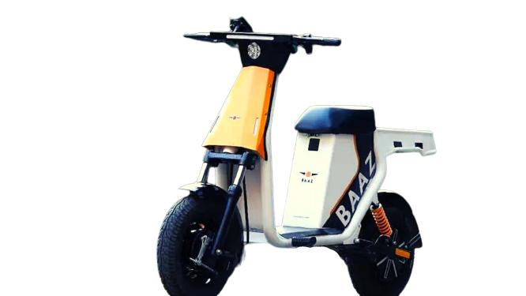
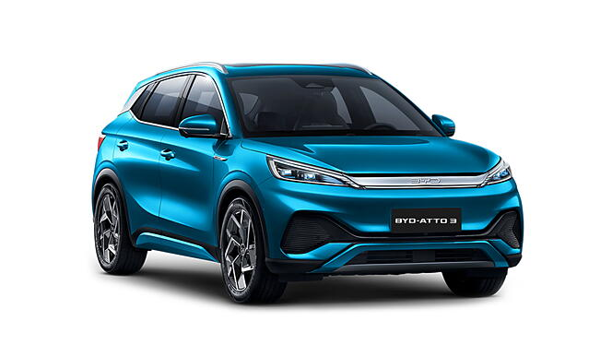
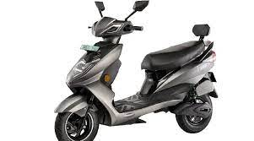
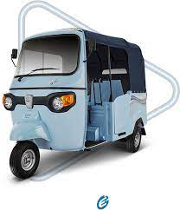
Annexure II: Key electric mobility facts and figures
19
540
135
53.90%
Number of EV OEMs in India
Total FAME II approved models
FAME-II target met
As of Q3 FY23
As of Q3 FY23
As of Q3 FY23
Note: Target of selling 1,562,000 EVs (2W, 3W, 4W and buses) under FAME-II scheme by FY22.
Recent electric vehicle launches
337,924
Baaz Bikes
EV penetration
Price: INR 35,000 onwards
Range: 100 km
Battery capacity: -
In Q3 FY23
4.63%
EVs sold
in Q3 FY23
BYD Atto 3
Price: INR 30,00,000 onwards
Range: 420 km
Battery capacity: 60.48 kWh
2W sold were EV
21
iVOOMi S1 240
52.23%
Price: INR 1,21,000 onwards
Range: 240 km
Battery capacity: 4.2 kWh
States notified EV policies
As of Q3 FY23
3W sold were EV
HOP Oxo
Price: INR 3,25,000 onwards
Range: 68 km
Battery capacity: 4.5 kWh Lithium-ion
For more updates visit CEEW-CEF Electric Mobility Dashboard
19
Source: Vahan Sewa dashboard, CEEW Centre for Energy Finance Electric Mobility dashboard, Department of Heavy Industries, CEA.
cef.ceew.in

Slide 20
About us: CEEW is among Asia’s leading policy research institutions
20
cef.ceew.in

Slide 21
CEEW Centre for Energy Finance
21
Build evidence
Consistent, reliable, and up to date monitoring & analysis of clean energy markets – investment, payment schedules, market trends, etc.
Create coherence
Periodic convening of multi-stakeholder groups to deliberate on market activities in clean energy
Design solutions
Design and feasibility pilots of fit-for-purpose business models & financial solutions for clean energy solutions
cef.ceew.in

Slide 22
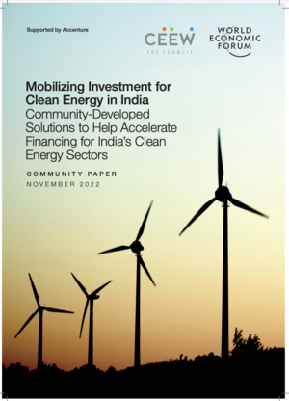
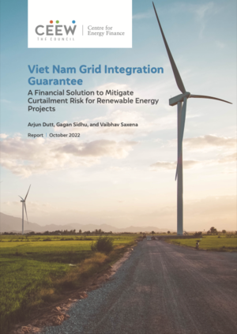
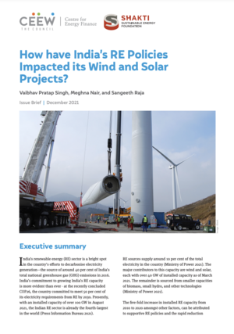
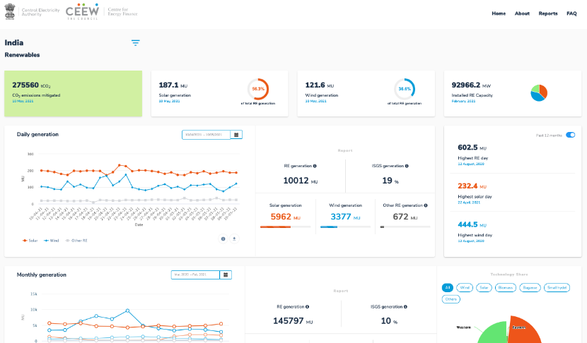
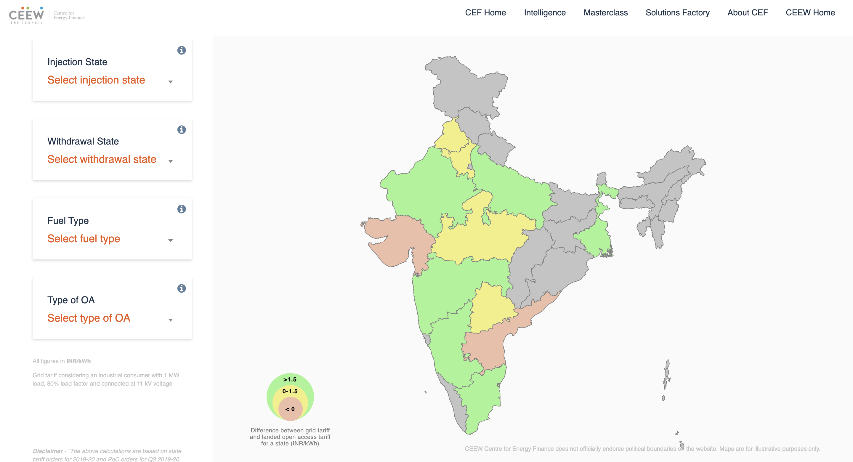
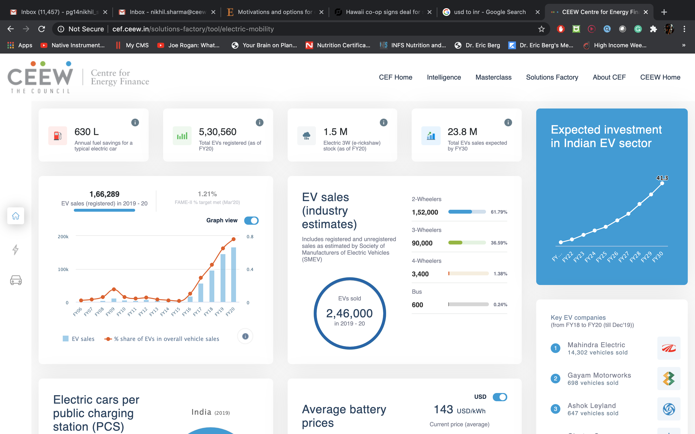
Our recent publications, dashboards and tools
22
Mobilizing Investment For Clean Energy In India
Viet Nam Grid Integration Guarantee
Making India A Leader in Solar Manufacturing
How have India’s RE Policies Impacted its Solar and Wind Projects
India Renewables Dashboard
Open Access Tool
Electric Mobility Dashboard
cef.ceew.in

