Slide 1
CEEW-CEF Market Handbook 2022-23 (Annual issue)
Image: iStock
10 May 2023
© Council on Energy, Environment and Water 2023

Slide 2
CEEW-CEF Market Handbook
India is undergoing an energy transition from fossil-based to clean energy. Evidence-based decision-making can accelerate the process.
CEEW Centre For Energy Finance’s Market Handbook aims to help key investors, executives and policymakers with evidence-based decision-making by:
Identifying and analysing trends critical to India’s energy transition
Presenting data-backed evidence based on the most relevant indicators
Connecting the dots and presenting a short-term market outlook
The handbook attempts to comment and answer on some critical questions such as:
What is India’s generation capacity and energy mix?
What are the key trends in renewable energy (RE) tariffs?
What is the current situation of the discom payment delay situation?
How have the power market reforms progressed?
What are key trends in the electric vehicles (EV) and energy storage markets?
cef.ceew.in

Slide 3
Contents
Generation Capacity And Energy Mix
4
Coal Phase-Out
6
RE Auctions
7
Discom Payables
8
Power Markets
9
Policy and Regulatory Developments
10
Renewable Energy Finance
11
Energy Storage
14
Electric Mobility
15
Image: iStock
Annexures
17
20
About Us
cef.ceew.in

Slide 4
Generation capacity: share of RE + hydro in total installed capacity crossed 40% in FY23; wind capacity addition doubled in FY23 vs FY22
4
Takeaways & Outlook
In FY23, a net power generation capacity of 16.6 GW was added (vs 17.3 GW in FY22). It was primarily dominated by renewable energy (RE) (15.3 GW, 92.2%), followed by coal/lignite (1.2 GW, 7.0%) and hydro (0.1 GW, 0.8%).
In RE, solar (grid-scale and rooftop) continued to dominate RE capacity addition, accounting for 12.8 GW (83.7%) (vs 13.9 GW in FY22). Wind capacity addition in FY23 doubled compared to FY22 and stood at 2.3 GW (14.9%) (vs 1.1 GW in FY22). The share of small hydro and bio-power stood at 0.6% and 0.8%, respectively.
In FY23, the total installed capacity reached 416 GW, of which 125.2 GW (30.1%) was RE, and 46.9 GW (11.3%) came from hydro. As per MNRE, another 82.6 GW of RE is under implementation as of February 2023.
In FY23, 9.91 GW of RE capacity was auctioned (vs 17.47 GW in FY22). It consisted of six plain vanilla solar, five plain vanilla wind, three floating solar and three wind-solar hybrid tenders. In addition, auctions for 1000 MW pumped hydro storage, 500 MW/1000 MWh battery energy storage and 500 MW/ 3000 MWh energy storage were concluded.
Source: Central Electricity Authority (CEA). * Includes solar rooftop capacity (8877.93 MW as of March 2023).
Source: Ministry of New and Renewable Energy (MNRE).
cef.ceew.in

Slide 5
Energy mix: share of RE in the generation mix stood at 11.8% in FY23; share of RE + hydro and coal/lignite were up in FY23 compared to FY22
5
Takeaways & Outlook
Total electricity generation was up by 11.5% in FY23 compared to FY22. Contributing factors included a higher number of heat wave days and the absence of active western disturbances in Q1 FY23 and higher colder-than-usual days in December 2022 and January 2023.
Q1: Up by 16.0%
Q2: Up by 6.8%
Q3: Up by 10.0%
Q4: Up by 11.8%
Total FY22: Up by 11.5%
Overall RE generation in FY23 increased by 21.8%, the large hydro generation grew by 6.1%, whereas coal/lignite generation grew significantly by 12.0% (versus FY22).
From an average daily generation perspective, RE and coal/lignite share increased, whereas hydro share declined in FY23 compared to FY22.
RE: Share up from 10.8% to 11.8%
Hydro: Share down from 11.5% to 11.0%
RE + Hydro: Share up from 22.3% to 22.8%
Coal/lignite: Share up from 72.5% to 73.1%
RE share snapshot
 | FY21 |  | FY22 |  | FY23
 | RE share % | Day | RE share % | Day | RE share % | Day
Highest | 16.8% | 12 August 2020 | 19.2% | 08 August 2021 | 21.3% | 22 May 2022
Lowest | 6.1% | 02 September 2020 | 7.0% | 23 December 2021 | 7.5% | 30 August 2022
Average (daily) | 10.1% | NA | 10.8% | NA | 11.8% | NA
Source: POSOCO. Note: RE technologies include solar, wind, biomass, waste-to-energy and small hydro and do not include rooftop solar and large hydro (>25 MW) generation.
cef.ceew.in

Slide 6
Coal phase-out: net coal capacity addition declined by 60.2% in FY23 compared to FY22; share of conventional generation in PFC/REC’s loan book declined to 45%
6
Takeaways & Outlook
In FY23, 1,460 MW of new coal capacity was added, and 304 MW was retired. Net capacity addition (1,156 MW) declined by 60.2% (vs FY22). New coal capacities include NTPC’s north Karanpura and APGENCO’s Damodaran Sanjeevaiah thermal power stations.
PFC/REC, one of India’s largest power sector financiers, continues to reduce its exposure to conventional power generation. The share of conventional generation in PFC/REC’s loan book continued to trend downward and declined to 45% in Q3 FY23 from 47% in Q2 FY23 and 48% in Q3 FY22.
The share of transmission and distribution (T&D) and RE generation (including large hydro) projects continued to increase. They accounted for ~44% (INR 1,73,769 crore) and ~10.1% (INR 39,634 crore) of the total loan book as of Q3 FY23 vs ~41% (INR 1,51,023 crore) and ~10.3% (INR 38,215 crore) in Q3 FY22, respectively.
There was no noticeable change in PFC/REC’s overall gross loan assets in Q1 and Q2; however, it increased by 5% in Q3 FY23 (vs Q4 FY22).
Source: CEA.
Source: PFC investor presentations; figures are derived from the same. Note: Sector-wise PFC loan asset data break-up is unavailable for Q4 FY23.
cef.ceew.in

Slide 7
RE auctions: multiple standalone energy storage auctions concluded in FY23; 9.91 GW RE capacity auctioned in FY23; another 40.89 GW RE capacity is under tendering process
7
Bid spotlight: PCKL, Karnataka, PHS, 1000 MW*8 hours
Takeaways & Outlook
Auctioned RE capacity stood at 9.91 GW in FY23, of which plain vanilla solar and wind stood at 3.25 GW (33%) and 2.55 GW (26%), respectively. 3.11 GW (31%) of auctioned capacity was in innovative power procurement formats, and 1.00 GW was from pumped hydro storage. In addition, 4,020 MWh of standalone energy storage tenders were concluded in FY23.
Auctioned capacity in Q1 and Q2 was moderate; however, amidst deadline extensions for multiple tenders, the auctioned capacity in Q3 and Q4 reduced significantly. As per MNRE, 40.89 GW of RE capacity is under tendering process.
Q4 FY23: 1.80 GW
Q3 FY23: 1.96 GW
Q2 FY23: 3.00 GW
Q1 FY23: 3.15 GW
In March 2023, MNRE directed renewable energy implementing agencies (REIAs) to conduct bids for 50 GW RE annually until FY28. The 50 GW target will spread across four quarters, with a minimum issuance of 15 GW in the first two quarters and 10 GW in the third and fourth quarters.
Notable auctions
(FY23)
Capacity allotted (MW)
Least tariff discovered (INR/kWh)
Winners
PCKL, Karnataka, pumped hydro storage (PSH), 1000 MW
(March 2023)
1000
NA
Annual cost of storage: INR 147.5 lakh/MW/year
Winners: JSW Energy and Greenko Group
GUVNL, Gujarat, wind phase-IV, 300 MW
(January 2023)
300
2.96
Q4
Key provisions
GUVNL, pan India, solar phase-XVIII, 500 MW
(January 2023)
500
2.51
Project location: Karnataka; single or multiple locations
Power purchase agreement (PPA) duration: 40 years
Scheduled commissioning period: 36 months; part commissioning is allowed
Energy procurement by discoms: 8 million units daily
Under construction, yet to commission and existing projects without PPA can participate
MSEDCL, Maharashtra, RE with storage, 250 MW (December 2022)
250 (RE) non-solar hours
9.0
Q3*
NTPC, pan India, ESS,
500 MW/3000 MWh
(December 2022)
500 (ESS)
NA
RUMSL, Madhya Pradesh, floating solar, phase II, 300 MW (November 2022)
300
3.69
Comments
RUMSL, Madhya Pradesh, wind-solar hybrid, 750 MW (September 2022)
750
3.03
Q2*
Award criteria include annual fixed cost (AFC) and cost of cycle loss (CCL). Input energy for pumping shall be provided by the discom up to the declared cycle loss.
The storage will be used for time-shifting/ peak-off peak load management by Karnataka discoms.
Response time: to reach maximum contract capacity (5 minutes), ramp-up and down (30% in 60 seconds), and cold start (30 minutes).
GUVNL, Gujarat, wind, phase-III, 500 MW
(July 2022)
500
2.84
Q1*
SECI, pan India, wind-solar hybrid tranche-V, 1,200 MW (May 2022)
1,200
2.53
Source: SECI and state renewable agencies. SECI = Solar Energy Corporation of India; GUVNL = Gujarat Urja Vikas Nigam Limited; RUMSL = Rewa Ultra Mega Solar Limited; MSEDCL = Maharashtra State Electricity Distribution Co. Ltd.; PCKL = Power Company of Karnataka Limited; ESS = energy storage system. *Note: For Q1, Q2 and Q3 FY23, only the least tariff auctions and unique auctions, such as RE with storage or hybrid projects, have been covered.
cef.ceew.in

Slide 8
Discom payables: legacy dues of discoms to generating companies reduced from INR 1,38,378 crore to INR 91,061 crore
8
Takeaways & Outlook
As of March 2023, legacy dues# of discoms to generating companies reduced from INR 1,38,378 crore to INR 91,061 crore and the current dues# stood at INR 28,449 crore.
According to the Ministry of Power’s (MoP) Ujwal DISCOM Assurance Yojana (UDAY) platform, discoms in Karnataka, Haryana, Madhya Pradesh, Uttar Pradesh and Assam topped the latest quarterly performance assessment*.
Under the RDSS scheme, 204.6 million prepaid smart consumer meters, 5.4 million smart DT meters and 0.19 million smart feeder meters have been sanctioned across 28 states/UTs (46 discoms).
As per the performance of the power utilities report 2021-22, pan-India AT&C losses stood at 16.5% vs 21.5% in 2020-21.
Source: PRAAPTI portal (based on voluntary disclosures from power producers; PIB Press Release.
Source: Integrated rating and ranking of power distribution utilities.
Source: UDAY portal (based on data disclosed by discoms as of 31 December 2022). *Data not available for these states; values derived from 2019–20/ 2020–21 financial reports.
Reforms-based and results-linked, revamped distribution sector scheme (RDSS), approved in June 2021, aims to reduce AT&C losses at pan-India levels to 12-15% by 2024-25, reduce ACS-ARR gap to zero by 2024-25, and develop institutional capabilities for modern discoms.
* As of December 2022.; #Legacy dues are already past their due date and remain partially or completely unpaid. Current dues are partially or completely unpaid but are still within their respective due dates.
cef.ceew.in

Slide 9
Power markets: trading of ESCerts under PAT cycle II resumed on IEX; traded volumes across all segments were down except for real-time and GDAM market
9
Takeaways & Outlook
Peak power demand continued to rise in FY23. It reached a new high of 211.9 GW in Q1 FY23 and again crossed the 200 GW mark in Q4 FY23. In energy terms, the average monthly electricity demand (met) saw an uptick of 9.6% in FY23 (versus FY22).
In Q4 FY23, CERC approved the launch of high-price day-ahead market (HP-DAM) under the integrated day-ahead market segment of IEX. This will enable high variable cost generators to trade on the energy exchange. In addition, CERC also extended the duration to cap the price range of MCP at INR 12/kWh until further notice.
In FY23, 5.97 million RECs were traded at a price of INR 1.0/kWh on IEX. Trading of energy saving certificates (ESCerts) under PAT cycle II resumed on the IEX platform on 14 February 2023. In February and March 2023, 0.18 million ESCerts were traded.
FY22
FY23
Source: CEA.
Source: Indian Energy Exchange (IEX).
Quarterly peak power demand in FY23 consistently surpassed FY22 and FY21 levels; it was above the 200 GW mark in Q1 and Q4 due to a higher number of heatwaves days and colder-than-usual days. In terms of average electricity demand met in FY23, there was an uptick of 9.6% vs that of FY22.
Green day-ahead market (GTAM) achieved 3,814 million kWh traded volume in FY23 vs 921 million kWh in FY22. It continued to grow since its inception in October 2021.
Source: IEX.
Source: IEX.
Day-ahead market (DAM) achieved 51,151 million kWh volume in FY23, registering a fall of 21% (vs FY22) due to higher prices. The average market clearing price (MCP) stood at INR 5.90/ kWh in FY23, 35% higher than in FY22 due to a demand-supply mismatch.
In FY23, the real-time market (RTM) traded 24,174 million kWh, registering a 21% growth in FY23 (vs FY22). Since its inception, discoms have been tapping into the RTM to efficiently balance the power demand and supply in real time.
cef.ceew.in

Slide 10
Policy and regulatory developments: CERC approved launch of HP-DAM on IEX; bidding trajectory for RE projects released; allotment under PLI for solar modules (tranche-II) concluded
10
Takeaways & Outlook
Various announcements in FY23 presented positive policy signals for the wind energy sector; MoP introduced a separate wind energy purchase obligation, MNRE released the draft repowering policy for wind projects, MNRE moved to scrap the competitive bidding mechanism for wind power procurement, and most recently, MNRE directed the REIAs to conduct 10 GW of wind bids every year till FY28.
In addition, MoP notified the Electricity (Amendment) Rules, 2022; through that, the implementing agency is directed to compute uniform renewable energy tariffs for each RE category in the central pool.
In Q4 FY23, the solar sector witnessed two key developments: 39,600 MW of domestic solar PV module manufacturing capacity was allotted to 11 companies, with a total outlay of INR 14,007 crore under the PLI scheme for solar modules (tranche-II). In addition, MNRE exempted the ALMM solar modules requirement for solar projects until March 2024.
In addition, MoP waived ISTS charges on electricity generated from new hydropower projects.
Union Cabinet approved the National Green Hydrogen Mission
CERC approved launch of high price day ahead market (HP-DAM)
MNRE declared bidding trajectory for renewable energy projects
In January 2023, Union Cabinet approved the National Green Hydrogen Mission.
It aims to make India a global hub for producing, utilising and exporting green hydrogen and its derivatives.
Key expected outcomes are green hydrogen production capacity of at least 5 MMT per annum, total investments of ~ INR 8 lakh crore, creation of ~6 lakh jobs, and cumulative reduction of ~ 1 lakh crore fossil fuel imports and abatement of ~50 MMT greenhouse gas emissions annually.
In February 2023, CERC approved the introduction of HP-DAM in the integrated day ahead market segment of IEX.
It will provide a new avenue to the high variable cost generators who could not participate in DAM due to the existing price ceiling of INR 12/kWh.
The gas and imported coal-based generators and BESS can sell the electricity with a price range of INR 0 - 50/kWh.
In March 2023. MNRE announced a bidding trajectory to achieve 500 GW of RE capacity by 2030.
The REIAs (SECI, NTPC, NHPC and SJVN) are directed to cumulatively conduct bids for 50 GW of RE annually till FY28, including 10 GW of wind.
Bids can be vanilla solar and wind, solar-wind hybrid, or round-the-clock RE power, all with/without storage, depending on the procurers’ requirements.
Review of competitive bidding mechanism for power procurement from wind projects
MNRE updated the RLMM of wind turbine
MNRE updated List – I under ALMM* order for solar PV modules
In January 2023, MNRE notified the review and announced that 8GW bids will be issued each year starting 2023 till 2030.
Bids will be in single-stage two envelop closed bid format.
Every bid will comprise state-specific sub-bids in the eight wind-resource-rich states with a size cap of 2 GW in each state.
In March 2023, MNRE notified the updated RLMM to include 14 manufacturers.
The wind turbine capacities in this list vary between 225 kW – 3600 kW.
The list is based on the new procedure.
In January 2023, MNRE notified revision – IX of ALMM list – 1 to include 89 manufacturers with a cumulative capacity of 21,681 MW.
Later, in February 2023, it was further updated to include 91 manufacturers with a cumulative capacity of 22,389 MW.
Source: CEEW-CEF Compilation. *ALMM = Approved List of Models and Manufacturers; CERC = Central Electricity Regulatory Commission; PLI = Production Linked Incentive; RLMM = Revised List of Models and Manufacturers of Wind Turbines; MMT = Million Metric Tonnes; ISTS = interstate transmission system.
cef.ceew.in

Slide 11
Renewable energy finance: overall market concentration in RE auctions declined slightly in FY23 compared to FY22; SJVN received INR 915 crore debt investment
11
Notable deals (FY23)
Takeaways & Outlook
In FY22, 9.91 GW of RE capacity was auctioned. Public sector undertakings (PSU) such as NTPC and SJVN were among the top developers to capture the RE auctions market in FY23. Tata Power, Greenko Energy and JSW Energy were among the top private developers.
The market concentration saw a slight decline in FY23 to 50% (vs 51% in FY22), with a diverse set of public and private sector developers participating in the auctions (a total of 27 in FY23).
In FY23, the deal activity primarily consisted of debt and equity investments and asset acquisition in the solar and wind sector.
JSW Energy concluded the acquisition of 1.75 GW of wind and solar portfolio of Mytrah Energy, and ThomasLloyd Energy Impact Trust Plc completed the acquisition of SolarArise. SJVN received INR 915 crore from JBIC to finance its 90 MW floating solar (Madhya Pradesh) and 100 MW solar project (Gujarat).
In addition, Virescent Renewable Energy Trust is in discussion with Jakson Group to acquire 100 MW of solar assets.
81%
50%
Debt Investment
Target: SJVN Ltd.
Investor: Japan Bank for International Corporation (JBIC)
Amount: INR 915 crore ~(USD 111.2 million)
Q4 FY23
FY23
March 2023
Market concentration in auctioned RE capacity
March 2023
Acquisition (started in May 2022 and concluded in March 2023)
Target: Mytrah Energy (1.75 GW)
Acquirer: JSW Energy
Amount: INR 10,530 crore ~(USD 1200 million)
Note: Market concentration is calculated as the ratio of the top five RE capacities awarded to the total RE capacity auctioned.
Acquisition
Target: SolarArise (434 MW)
Acquirer: ThomasLloyd Energy Impact Trust Plc
Amount: INR 314.7 crore ~(USD 38.5 million)
Developer-wise* RE capacity auctioned during FY23 (9,908 MW#)
January 2023
Debt Investment
Target: SJVN Green Energy Ltd. Investor: IREDA Amount: INR 4,445 crore ~(USD 537 million)
December 2022
September 2022
Equity Investment
Target: Mahindra Susten Pvt Ltd. (30% stake) Investor: Ontario Teachers’ Pension Plan Board Amount: INR 2,371 crore (~USD 300 million)
May
2022
Asset Acquisition
Target: Rays Power (solar asset) Acquirer: Two Global Investors (NA) Amount: INR 713.9 crore (~USD 90 million)
Source: CEEW-CEF Compilation.
Source: CEEW-CEF Compilation. *Note: Includes only top 10 developers in terms of auctioned capacity. #Includes pump hydro storage; **Including hydro capacity.
cef.ceew.in

Slide 12
Renewable energy finance: RE stocks trended downwards throughout FY23 except for a few peaks in Q2 and Q3
12
Takeaways & Outlook
In FY23, most of the listed RE stocks trended downwards, barring a few peaks in Q2 and Q3 FY23. The market (Sensex) remained mostly stagnant throughout the year.
The share price of RE developer Adani Green Energy saw a sharp plunge in Q4 FY22, down by 53.9% in March 2023 (vs March 2022). In the case of Sterling and Wilson Solar, the share price was down by 8.32% in March 2023 (vs March 2022). The share price of Borosil Renewables, which holds a near monopoly position in India’s solar panel glass manufacturing, was down by 29.2% in March 2023 (vs March 2022).
The share price of wind developer–manufacturers Inox Wind was down by 15.7%, whereas Suzlon Energy was down by 13.6% in March 2023 (vs March 2022).
Q1 FY23
Q2 FY23
Q3 FY23
Q4 FY23
Source: Money Control.
Note: Share prices are the last traded value in each month.
cef.ceew.in

Slide 13
Renewable energy finance: first-ever sovereign green bonds auctioned in FY23; repo rate was hiked six times in FY23
13
Takeaways & Outlook
Reserve Bank of India (RBI) conducted the first sovereign green bond (SGrB) auction worth INR 16,000 crore in two tranches; on 25 January and 9 February 2023. It had two SGrB offerings (a) 5-year (SGrB 2028) and (b) 10-year (SGrB 2033). Both tranches were oversubscribed; the 5-year offering received 96 and 62 bids, and the 10-year offering received 170 and 91 bids in tranche I and II, respectively. The proceeds will be used to finance and/or refinance expenses of eligible green projects as per the sovereign green bonds framework.
In FY23, the repo rate was hiked six times from 4.0% (April 2022) to 6.50% (March 2023). FY23 witnessed a gradual increase in the SBI MCLR (1-year) rate, from 7.1% (April 2022) to 8.5% (March 2023).
Key bond yields, including the 10-year treasury and NTPC’s 10-year bond yields, fluctuated throughout the year. In FY23, ReNew Power refinanced the dollar-denominated green bonds issued in 2019 (6.67%, 5-year) to cut the bonds' INR interest cost by 200 basis points and push the maturity to December 2027. It became the first Indian RE developer to refinance a dollar-denominated bond from an Indian non-banking financial corporation.
Q1 FY23
Q2 FY23
Q3 FY23
Q3 FY23
Source: Reserve Bank of India, State Bank of India, Trading Economics, Money Control and BondEvalue. Note: Bond prices are the last traded value in each month; * Current yield.
cef.ceew.in

Slide 14
Energy storage: MoP announced the draft guidelines to promote pump storage projects; PCKL concluded its 1000 MW PSP tender
14
Highlights of draft guidelines on pump storage projects
India’s recent energy storage tenders
Takeaways & Outlook
FY23 was a favourable year for the energy storage sector. Five energy storage tenders (including RE + storage, standalone, and PSP) were concluded in FY23, including NTPC’s 500 MW with 3000 MWh ESS and PCKL’s 1000 MW PSP in Karnataka.
In addition, central and state bidding agencies announced eight other energy storage (with or without RE) tenders in FY23. This includes RUVNL’s 1500 ME wind-solar hybrid with ESS, SECI’s 1200 MW wind-solar hybrid with ESS and GUVNL’s 500 MW/1000 MWh standalone BESS tenders.
In the Union Budget 2023-24, a scheme on viability gap funding (VGF) formulated by the MoP to develop 4,000 MWh of BESS was announced.
In FY23, Jindal Steel and Power Limited (JSP) and Greenko Group entered into a memorandum of understanding (MoU) where Greenko Group agreed to provide 1000 MW energy storage capacity from its pumped storage project (located in Madhya Pradesh and Rajasthan) to JSP. In addition, SJVN and Indian Oil are planning to form a joint venture to develop RE with ESS projects to supply round-the-clock (RTC) power.
Project location & tender issue date | Application & technology | Details
Pan India (RUVNL), Jan 2023 | 1500 MW, wind-solar hybrid with storage | RfS released in Q4 FY23
Pan India (AEML), December 2022 | 1500 MW, RE RTC | RfS released in Q3 FY23, deadline extended
Pan India (SECI), November 2022 | 1200 MW, wind-solar hybrid with ESS (Tranche VI) | RfS released in Q3 FY23, deadline extended
Pan India (SECI), September 2022 | 2250 MW, RE with storage (RTC III) | RfS released in Q2 FY23; deadline extended
Gujarat (GUVNL), August 2022 | 500 MW/1000 MWh standalone BESS phase – I | RfS released in Q2 FY23; deadline extended
Maharashtra (MSEDCL), August 2022 | 250 MW RE with BESS | RfS released in Q2 FY23; deadline extended
Gujarat (GUVNL), June 2022 | 500 MW RE/250 MWh ESS phase XV | RfS released in Q1 FY23; deadline extended
Rajasthan (NTPC), April 2022 | 250 MW/500 MWh BESS | RfS released in Q1 FY23
Draft guidelines to promote the development of pump storage projects (PSP) in India, Feb 2023
Guidelines issued for the promotion of pumped storage are:
Allotment of project sites: the state governments may allot project sites to (a) CPSUs and state PSUs on a nomination basis, (b) private developers through a two-stage competitive bidding process or (c) via tariff-based competitive bidding (TBCB).
No upfront charges to be paid by the developer.
Appropriate commission is guided to undertake favourable market reforms to support PSP projects.
Financial Viability: Central Government may notify a benchmark cost of storage to ensure only financially viable PSPs projects are taken up.
PSPs (net consumers) will be exempted from free power obligation.
No requirement to create a local area development fund as PSPs have a minimal environmental impact.
Source: Ministry of Power
Source: SECI and state renewable agencies. RfS = request for selection. *RUVNL = Rajasthan Urja Vikas Nigam Limited.
cef.ceew.in

Slide 15
Electric mobility: electric vehicle sales crossed the one million mark in FY23; Budget 2023-24 allocation for the FAME-II scheme nearly doubled
15
Takeaways & Outlook
EV sales continued to grow exponentially in FY23, recording a growth rate of 170% (compared to FY22), and it crossed the one million mark in FY23. The share of EVs in overall vehicle sales went up to 5.35% (vs 2.53% in FY22). More than two lakh EVs were sold in each quarter of FY23.
As of FY23, 25 states and union territories (UT) have notified their EV policies. Punjab, Chandigarh, Haryana, Chhattisgarh, UT of Ladakh, Rajasthan, Jharkhand, Manipur and Tripura are the new entrants, whereas Tamil Nadu and Uttar Pradesh released their revised policies.
In the Union Budget 2023-24, budget allocation for the FAME-II scheme significantly increased from INR 2,908 crores to INR 5,172 crores.
OEMs with the highest EV sales* in FY23 were:
2W: Ola Electric (1,52,506), Okinawa (94,610) and Hero Electric (87,961)
3W: YC Electric Vehicle (29,903), Saera Electric (21,261) and Piaggio vehicles (21,875)
4W**: Tata Motors (36,824), MG Motors (4,511) and Hyundai Motors (786)
Source: Vahan Sewa dashboard (includes only registered vehicles, unregistered vehicles include low-speed vehicles (< 25 km/hr), e-rickshaws (three-wheelers) and electric two-wheelers), Electric Mobility Dashboard (2023), CEEW Centre for Energy Finance.* Based on sales data up to Q4 FY23; **4W represents Light motor vehicles and Light passenger vehicles.
cef.ceew.in

Slide 16
Thank you
You can find us at ceew.in/cef/ | @CEEW_CEF
Authors
Ruchita Shah (ruchita.shah@ceew.in)
Riddhi Mukherjee (riddhimukherjee00@gmail.com)
Meghna Nair (meghna.nair@ceew.in)
Reviewer
Gagan Sidhu (gagan.sidhu@ceew.in)
Vaibhav Pratap Singh (vaibhav.singh@ceew.in)
cef.ceew.in

Slide 17
Annexure I: Green bond issuances
17
Date | Company | Size (USD million) | Sector | Coupon rate (%) | Rating | Tenor (Years) | Purpose
March 2022 | Greenko | 750 | Energy storage | 5.50% | Ba1 (Moody’s) | 3 | Refinance existing debt and fund the capital expenditures at asset level
January 2022 | ReNew Power | 400 | Solar and wind | 4.50% | BB- (Fitch) | 5.25 | Refinance existing debt and fund capital expenditure
September 2021 | Adani Green Energy | 750 | Solar and wind | 4.375% | Ba3 (Moody’s) | 3 | Fund equity portion of capital expenditure for under-construction projects
August 2021 | Azure Power | 414 | Solar | 3.575% | Not available | 5 | Refinance existing higher cost green bond debt
July 2021 | Acme Solar | 334 | Solar | 4.70% | Not available | 5 | Refinancing of existing debt
July 2021 | Vector Green Energy | 165 | Solar | 6.49% | AAA (CRISIL, India Ratings) | 3 | Refinance existing high-cost debt of solar projects
May 2021 | JSW Hydro | 707 | Hydro | 4.50% | BB+ (EXP) (Fitch) | 10 | Repayment of existing green project-related rupee-denominated debt
April 2021 | ReNew Power | 585 | Solar and wind | 4.50% | BB- (Fitch) | 7.25 | Refinancing of existing debt
March 2021 | Greenko | 940 | Solar and wind | 3.85% | BB (Fitch) | 5 | Redemption of previous fund raise
March 2021 | Hero Future Energies | 363 | Solar and wind | 4.25% | BB- (Fitch) | 6 | Refinancing of existing debt
February 2021 | ReNew Power | 460 | Solar and wind | 4.00% | BB- (Fitch) | 6 | Refinancing of existing debt
February 2021 | Continuum Green Energy | 561 | Solar and wind | 4.50% | BB+ (Fitch) | 6 | Refinancing of existing debt
Source: Climate Bonds Initiative and company press releases.
cef.ceew.in

Slide 18
Annexure I: Green bond issuances
18
Date | Company | Size (USD million) | Sector | Coupon rate (%) | Rating | Tenor (Years) | Purpose
October 2020 | CLP Wind Farms | 40 | Wind | Not available | AA (India Ratings) | 2 to 3 | Refinancing of existing debt
October 2020 | ReNew Power | 325 | Solar and wind | 5.375% | BB- (Fitch) | 3.5 | Refinancing high-cost local debt
January 2020 | ReNew Power | 450 | Solar and wind | 5.875% | BB-/Stable (Fitch) | 5 | Refinancing of maturing debt
October 2019 | Adani Green Energy | 362.5 | Solar and wind | 4.625% | BBB- (Fitch) | 20 | Repaying foreign currency loans and rupee borrowings
September 2019 | ReNew Power | 90 | Solar and wind | 6.67% | BB (Fitch) | 4.5 | Refinancing of existing debt
September 2019 | Greenko | 85 | Solar and wind | 5.95% | BB- (Fitch) | 6.75 | Refinancing of existing debt
September 2019 | Azure power | 350 | Solar | 5.65% | BB (Fitch) | 5 | Refinancing of existing debt
September 2019 | ReNew Power | 300 | Solar and wind | 6.45% | Ba2 (Moody's) | 5 | Capacity expansion and repaying high cost debt
August 2019 | Greenko | 85 | Solar and wind | 6.25% | Ba1 (Moody’s) | 3.5 | Refinancing of solar and wind projects
August 2019 | Greenko | 350 | Solar and wind | 6.25% | Ba1 (Moody’s) | 3.5 | Refinancing of solar and wind projects
July 2019 | Greenko | 450 | Solar and wind | 5.95% | BB (Fitch) | 7 | Refinancing of solar and wind projects
July 2019 | Greenko | 500 | Solar and wind | 5.55% | BB (Fitch) | 5.5 | Refinancing of solar and wind projects
Source: Climate Bonds Initiative and company press releases.
cef.ceew.in

Slide 19
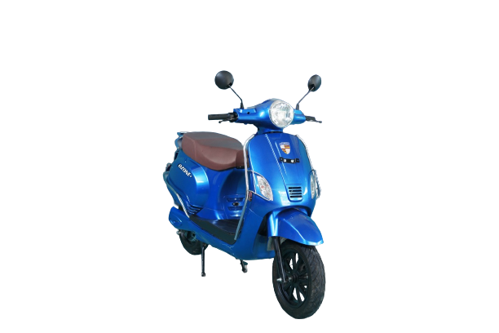
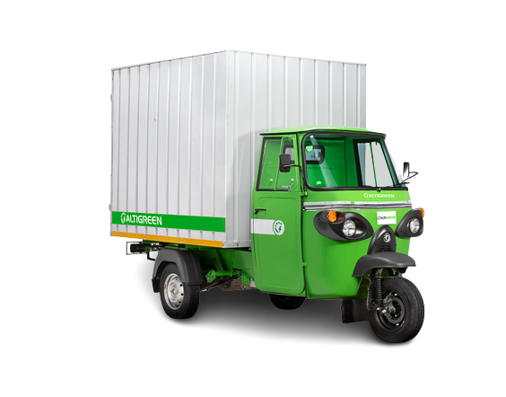
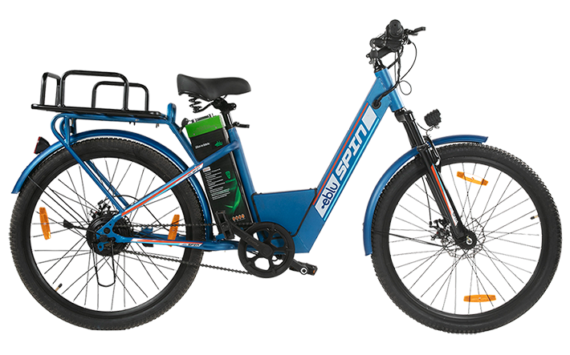
Annexure II: Key electric mobility facts and figures
19
591
152
65.90%
Number of EV OEMs in India
Total FAME II approved models
FAME-II target met
As of FY23
As of FY23
As of FY23
Note: Target of selling 1,562,000 EVs (2W, 3W, 4W and buses) under FAME-II scheme by FY24.
Recent electric vehicle launches
11,59,319
EV penetration
Fujiyama Ozone+
In FY23
Price: INR 99,999 onwards
Range: 140 km
Battery capacity: 60V 42Ah li-ion
EVs sold
4.53%
As of FY23
Altigreen neEV Tez
Price: INR 3,55,000 onwards
Range: 98 km
Battery capacity: 8.2kWh
2W sold were EV
25
Hyundai Ioniq 5
52.38%
Price: INR 44,95,000 onwards
Range: 631 km
Battery capacity: 72.6 kWh
States and UTs notified EV policies
As of FY23
Godawari Eblu Spin
3W sold were EV
Price: INR 20,000 onwards
Range: 40 km
Battery capacity: 36V/12Ah, 36V/18Ah
For more updates visit CEEW-CEF Electric Mobility Dashboard
19
Source: Vahan Sewa dashboard, CEEW Centre for Energy Finance Electric Mobility dashboard, Department of Heavy Industries, CEA.
cef.ceew.in

Slide 20
About us: CEEW is among Asia’s leading policy research institutions
20
cef.ceew.in

Slide 21
CEEW Centre for Energy Finance
21
Build evidence
Consistent, reliable, and up to date monitoring & analysis of clean energy markets – investment, payment schedules, market trends, etc.
Create coherence
Periodic convening of multi-stakeholder groups to deliberate on market activities in clean energy
Design solutions
Design and feasibility pilots of fit-for-purpose business models & financial solutions for clean energy solutions
cef.ceew.in

Slide 22
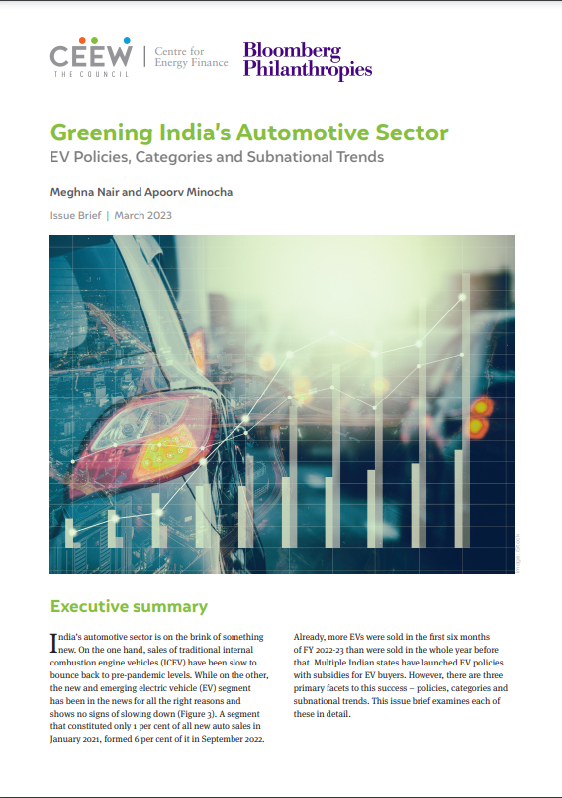
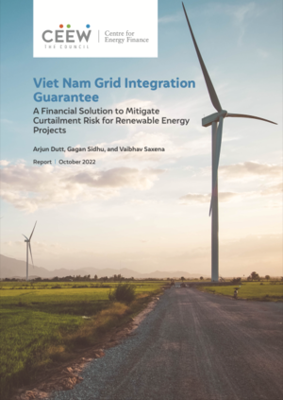
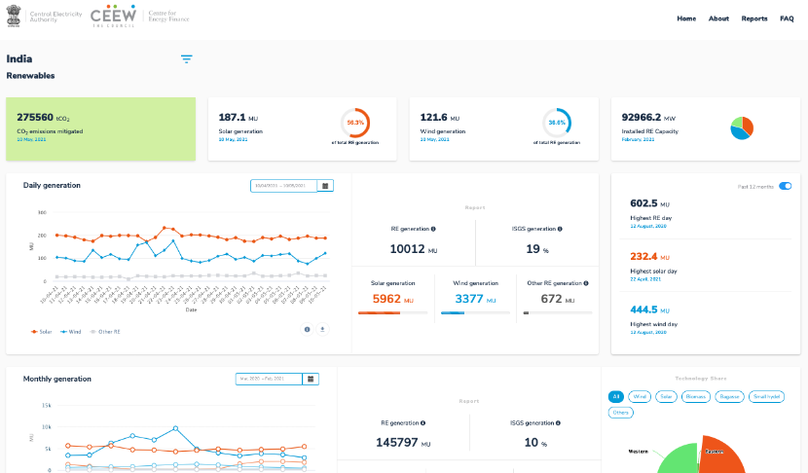
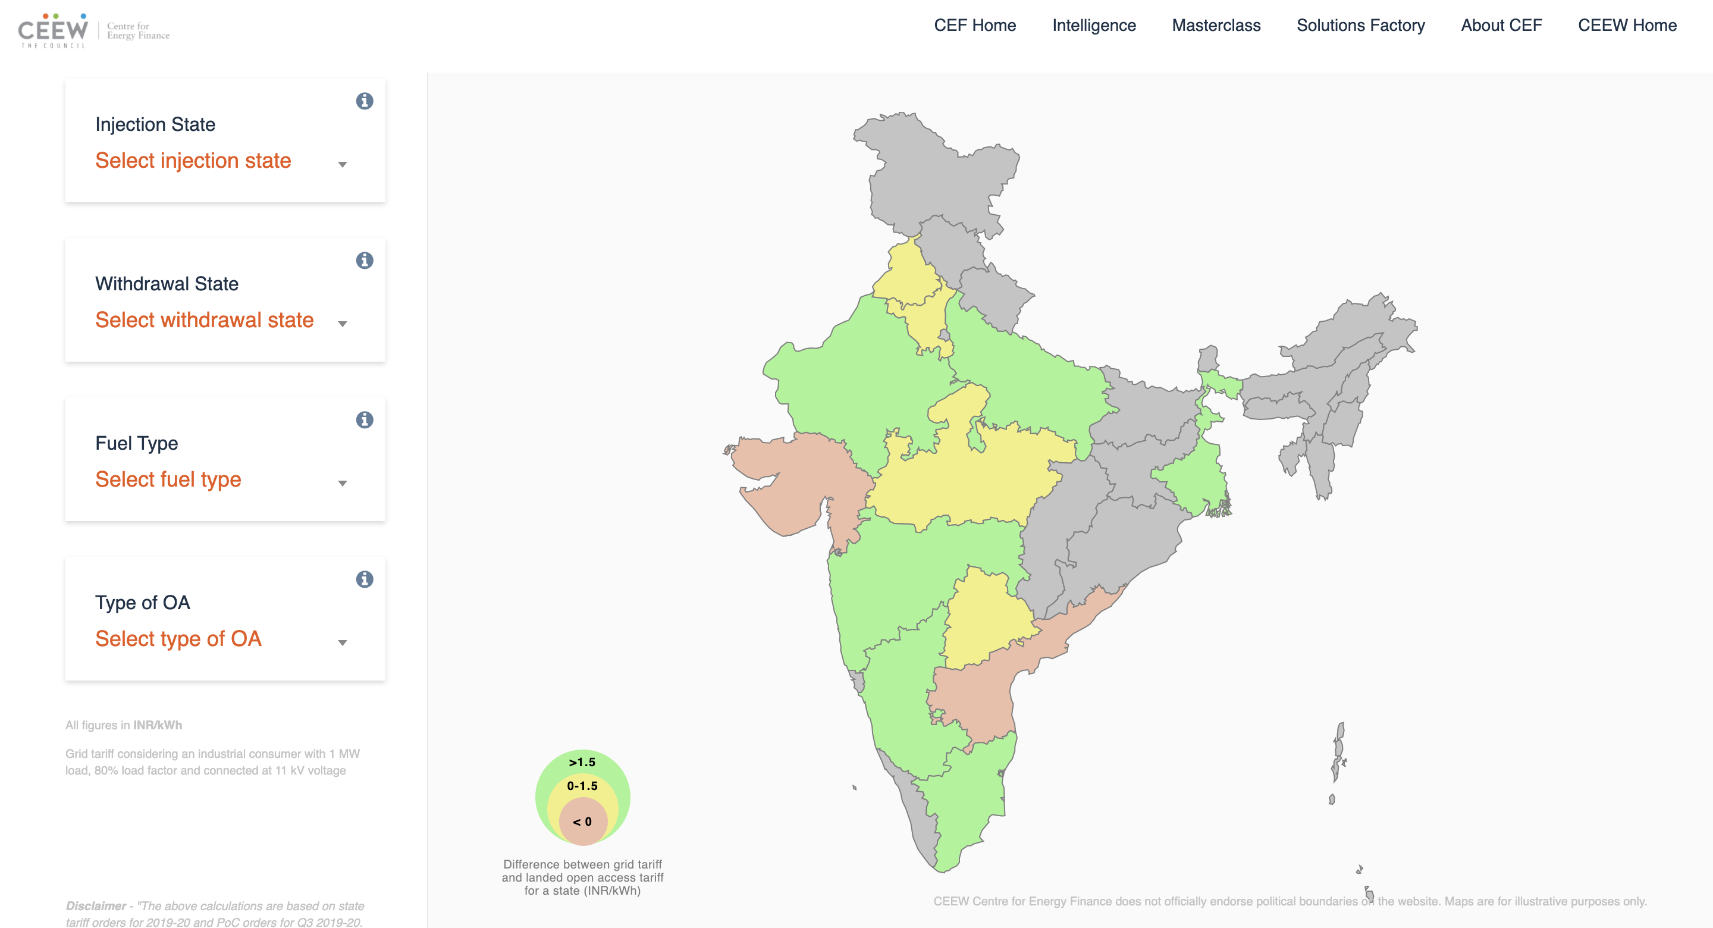
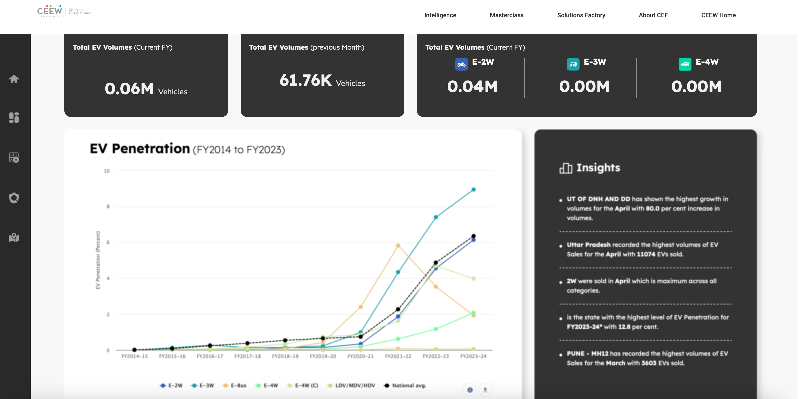
Our recent publications, dashboards and tools
22
Greening India’s Automotive Sector
Mobilizing Investment For Clean Energy In India
Viet Nam Grid Integration Guarantee
Making India A Leader in Solar Manufacturing
India Renewables Dashboard
Open Access Tool
Electric Mobility Dashboard
cef.ceew.in

