Slide 1
CEEW-CEF Market Handbook Q3 2023–24
Image: iStock
8 February 2024
© Council on Energy, Environment and Water 2024

Slide 2
CEEW-CEF Market Handbook
India is undergoing an energy transition from fossil-based to clean energy. Evidence-based decision-making can accelerate the process.
CEEW Centre For Energy Finance’s Market Handbook aims to help key investors, executives and policymakers with evidence-based decision-making by:
Identifying and analysing trends critical to India’s energy transition
Presenting data-backed evidence based on the most relevant indicators
Connecting the dots and presenting a short-term market outlook
The handbook attempts to comment and answer on some critical questions such as:
What is India’s generation capacity and energy mix?
What are the key trends in renewable energy (RE) tariffs?
What is the current situation of the discom payment delay situation?
How have the power market reforms progressed?
What are key trends in the electric vehicles (EV) and energy storage markets?
cef.ceew.in

Slide 3
Contents
Generation Capacity and Energy Mix
4
Coal Phase-Out
6
RE Auctions
7
Discom Payables
8
Power Markets
9
Policy and Regulatory Developments
10
Renewable Energy Finance
11
Energy Storage
15
Electric Mobility
16
Image: iStock
Annexures
17
About Us
21
cef.ceew.in

Slide 4
Generation capacity: total non-fossil fuel-based capacity inches closer to the 200 GW mark
4
Takeaways & Outlook
In Q3 FY24, a net generation capacity of 2.9 GW was added (vs 2.5 GW in Q3 FY23). The total net capacity addition comprised renewable energy (RE) (2.1 GW), coal-based (730 MW) and large hydro-based (60 MW) capacity. No new gas, diesel or nuclear capacity was added in this quarter.
In RE, solar (grid-scale and rooftop) continued to dominate capacity addition, accounting for 1,538 MW (73.1%) in Q3 FY24 (vs 2,489 MW in Q3 FY23). Wind capacity addition stood at 552 MW (26.2%) in Q3 FY24 (vs 264 MW in Q3 FY23). Small hydro (4 MW) and biopower (9 MW) contributed 0.2% and 0.4%, respectively.
Q3 FY24: 2.1 GW
Q2 FY24: 2.2 GW
Q1 FY24: 5.8 GW
Q4 FY23: 4.3 GW
In Q3 FY24, the total installed RE capacity reached 133.9 GW, with 73.3 GW of solar, 44.7 GW of wind, 10.8 GW of biopower, and 4.9 GW of small hydro capacity.
As of October 2023, 78.9 GW of RE capacity was under-construction, which comprised 50.1 GW solar, 16.2 GW wind,12.3 GW hybrid, and 85 MW small hydro projects.
Source: Central Electricity Authority (CEA). * Includes solar rooftop capacity (11078.95 MW as of December 2023).
Source: Ministry of New and Renewable Energy (MNRE).
cef.ceew.in

Slide 5
Energy mix: share of RE and coal/lignite increased whereas hydro share decreased significantly
5
Takeaways & Outlook
The total power generation increased significantly by 13.5% in Q3 FY24 (416 billion kWh) compared to Q3 FY23 (366 billion kWh) and decreased by 10.5% in comparison to Q2 FY24 (464 billion kWh), owing to lower-than-expected rainfall in October 2023, and above normal temperatures in November 2023, resulting in hot weather conditions vs the same period in the previous fiscal year.
October: Up by 24.6%
November: Up by 10.5%
September: Up by 5.8%
Total Q3 FY24: Up by 13.5%
In Q3 FY24, RE generation increased significantly by 26.6% vs the same quarter in the previous fiscal year (Q3 FY23). Coal/lignite-based generation was up by 19.6%; however, hydro decreased by 29.7% for the same period.
From an average daily generation perspective, the RE and coal/lignite share increased in Q3 FY24 compared to Q3 FY23, whereas the hydro share significantly decreased.
RE: Share up from 10.4% to 11.6%
Hydro: Share down from 10.3% to 6.4%
RE + Hydro: down from 20.6% to 18.0%
Coal/lignite: Share up from 74.9% to 76.9%
RE share snapshot
 | Q3 FY22 |  | Q3 FY23 |  | Q3 FY24
 | RE share % | Day | RE share % | Day | RE share | Day
Highest | 12.6% | 18 October 2021 | 13.8% | 2 October 2022 | 13.3% | 18 December 2023
Lowest | 7.0% | 23 December 2021 | 8.0% | 10 October 2022 | 7.1% | 9 November 2023
Average (Daily) | 9.1% | NA | 10.4% | NA | 11.6% | NA
Source: POSOCO. Note: RE technologies include solar, wind, biomass, waste-to-energy and small hydro and do not include rooftop solar and large hydro (>25 MW) generation.
cef.ceew.in

Slide 6
Coal phase-out: 950 MW of new coal capacity added, PFC/REC’s exposure to conventional generation falls below 40%
6
Takeaways & Outlook
In Q3 FY24, 950 MW of new coal capacity was added, while 220 MW of coal capacity was retired. New coal capacity includes 800 MW TPS in Vijayawada, Andhra Pradesh, and 150 MW in Shirpur, Maharashtra. 220 MW of UPRVUNL’s Parichha TPS was retired in October 2023.
The share of conventional generation in the PFC/REC loan book further declined to 39% in Q2 FY24 from 47% in Q2 FY23. In Q2 FY24, transmission and distribution projects accounted for ~47% (INR 2,11,715 crore) and RE projects (including large hydro) accounted for 11.6% (INR 52,126 crore), vs 42% and 10.1% in Q2 FY23, respectively.
In October 2023, REC committed INR ~40,000 crore to financing two green hydrogen initiatives (with Acme and Avaada to set up green hydrogen and ammonia facilities) and a conventional power project (660 MW x 2 with OPGC) in Odisha.
In December 2023, REC, the nodal agency to implement the Revamped Distribution Sector (RDSS) programme signed a loan agreement of USD ~215 million with KfW development bank to propel reforms in India’s distribution sector.
Source: CEA.
Source: PFC investor presentations; figures are derived from the same. Note: Sector-wise PFC loan asset data break-up is unavailable for Q3 FY24.
cef.ceew.in

Slide 7
RE auctions: 8.84 GW of RE auctioned in this quarter
7
Bid spotlight: SJVN, pan India, FDRE (RE with ESS), 1500 MW (November 2023)
Takeaways & Outlook
RE auctioned capacity stood at 8.84 GW in Q3 FY24 and was dominated by the renewable energy implementation agencies such as NHPC’s 3000 MW solar, SJVN’s 1500 MW FDRE and NTPC’s 1500 MW wind-solar hybrid tenders. State bidding agencies RRVUNL and GUVNL concluded solar tenders (1,310 MW) in this quarter. PFC Consulting was a new entrant, concluding 1,250 MW of solar auction.
Q3 FY24 witnessed a significant uptick in total auctioned capacity compared to previous quarters.
Q3 FY24: 8.84 GW
Q2 FY24: 5.41 GW
Q1 FY24: 7.65 GW
Q4 FY23: 1.80 GW
The share of vanilla solar (72.9%) dominated the auctioned capacity this quarter, followed by FDRE and wind-solar hybrid (innovative procurement formats) contributing to 26% of total auctioned capacity in Q3 FY24.
In Q3 FY24, the lowest discovered solar and wind tariff stood at INR 2.52/kWh (NHPC, 3000 MW and SECI, 1000 MW) and INR 3.58/kWh (RECPDCL, 100 MW) respectively.
Notable auctions
Capacity awarded (MW)
Least tariff discovered (INR/kWh)
Tariff and winners
RRVUNL, Rajasthan, solar, 810 MW (October 2023)
810
2.64
Tariff discovered: 4.38 INR/kWh.
Winners: ACME, Hero Solar, Juniper Green, Renew Power, Bluepine, Tata Power RE, and O2 Power.
NHPC, pan India, solar, 3000 MW (November 2023)
3,000
2.52
SJVN, pan India, FDRE, 1500 MW (November 2023)
1,184
4.38
Key provisions
Q3 FY24
RECPDCL, pan India, wind, 100 MW (November 2023)
100
3.58
Annual CUF: Minimum 40%
Criteria for power supply: Any generating system including solar, wind or any other RE resource, combined with ESS keeping an availability of minimum 90% during peak hours.
Number of peak hours: RE projects with firm delivery of power for four hours.
Identification of injection point: Energy would be injected at a minimum of 220 kV, with the arrangement being made by the renewable power developer.
SECI, pan India, solar ISTS XII,1000 MW (December 2023)
1,000
2.52
PFC Consulting, pan India, solar, 1250 MW (December 2023)
1,250
2.53
GUVNL, pan India, solar, 500 MW (December 2023)
390
2.63
Comments
NTPC, pan India, wind–solar hybrid, 1500 MW (December 2023)
1,104
3.35
FDRE provides firm and dispatchable RE power as per discoms’ requirement.
The energy storage system (ESS) component charged with RE sources bought under this RfS shall be eligible for RPO compliance.
Q2 FY24
SECI, pan India, solar ISTS XI,
2000 MW (July 2023)
2,000
2.6
Source: SECI and state renewable agencies. SECI = Solar Energy Corporation of India; RRUVNL = Rajasthan Rajya Vidyut Utpadan Nigam; NHPC = National Hydroelectric Power Corporation; SJVN = Satluj Jal Vidyut Nigam, RECPDCL= REC Power Development and Consultancy Limited; PFC = Power Finance Corporation; GUVNL = Gujarat Urja Vikas Nigam Limited; FDRE = Firm and Dispatchable Renewable Energy #Auctioned capacity = Awarded capacity.
cef.ceew.in

Slide 8
Discom payables: discoms legacy dues reduced by 17% from INR 91,061 crore to INR 75,535 crore in June 2023
8
Takeaways & Outlook
As of June 2023, legacy dues# of discoms to generating companies reduced by 17% to INR 75,535 crore from INR 91,061 crore after the implementation of Electricity (Late Payment Surcharge and Related Matters) Rules, 2022. The current dues# stood at INR 44,386 crore.
Maharashtra, Tamil Nadu, Karnataka, Rajasthan and Jammu & Kashmir were among the states with the highest legacy dues.
Additionally, according to the Ministry of Power’s (MoP) Ujwal DISCOM Assurance Yojana (UDAY) platform, discoms in Karnataka, Andhra Pradesh, Madhya Pradesh, Uttar Pradesh and Assam topped the latest quarterly performance assessment*.
Under the RDSS scheme, ~230 million prepaid smart consumer meters, 5.4 million smart DT meters and 0.19 million smart feeder meters have been sanctioned across 28 states/UTs (46 discoms).
Source: PRAAPTI portal (based on voluntary disclosures from power producers; PIB Press Release.
Source: Integrated rating and ranking of power distribution utilities.
Source: UDAY portal (based on data disclosed by discoms as of 31 March 2022). *Data not available for these states; values derived from 2019–20/ 2020–21 financial reports.
Reforms-based and results-linked, revamped distribution sector scheme (RDSS), approved in June 2021, aims to reduce AT&C losses at pan-India levels to 12-15% by 2024-25, reduce ACS-ARR gap to zero by 2024-25, and develop institutional capabilities for modern discoms.
* As of March 2023.; #Legacy dues are already past their due date and remain partially or completely unpaid. Current dues are partially or completely unpaid but are still within their respective due dates.
cef.ceew.in

Slide 9
Power markets: peak power demand continued to exceed the 200 GW mark in Q3 FY24, PAT Cycle-II trading concluded
9
Takeaways & Outlook
In Q3 FY24, India’s peak power demand continued to cross the 200 GW mark, owing to below–average rainfall in October 2023 followed by above–normal temperatures in November and the onset of winter in December 2023. The average monthly electricity demand (met) in Q3 FY24 saw an uptick of 11.1% vs Q3 FY23, standing at 127.08 billion units.
In Q3 FY24, 2.02 million solar RECs were traded at an average price of INR 0.76/kWh on IEX. There was no trading of non-solar RECs.
In October 2023, 5,814 energy saving certificates (ESCerts) were traded at the average floor price of INR 1,840/ESCert. This marked the conclusion of trading of ESCerts for PAT Cycle-II, with a total of 13.2 lakh ESCerts being traded during this cycle.
Source: CEA.
Source: Indian Energy Exchange (IEX). *Day-ahead contingency.
Peak demand met in Q3 FY24 increased compared to Q3 FY23 due to government interventions that ensured supply-side liquidity. The unprecedented demand surge in October is due to an increase in electricity consumption and below-average rainfall.
Volumes traded in the green day–ahead market (GDAM) were significantly lower in Q3 FY24 (vs Q3 FY23). GDAM achieved a volume of 579.6 MU in Q3 FY24, with October 2023 witnessing 194 market participants – highest for the quarter.
Source: IEX.
Source: IEX.
The high market clearing prices (MCP) and trade volumes on the day-ahead market (DAM) in October 2023 are due to the electricity demand uptick. November–December experienced downward trends in MCP, allowing their consumers to optimise their power procurement costs.
Higher volumes were traded on the real-time market (RTM) in Q3 FY24 (vs Q3 FY23). This signals a higher reliance of the discoms and industries on the market to balance their power demand–supply on a real-time basis.
cef.ceew.in

Slide 10
Policy and regulatory developments: MERC amended rooftop solar regulations; a fresh push for the wind energy sector; Rajasthan RE policy targets 90 GW installation by 2030
10
Takeaways & Outlook
Q3 FY24 provided a fresh push for both the onshore and offshore wind energy sectors through the release of a repowering policy for old wind projects in India and the notification of lease rules for offshore wind energy project development.
In October 2023, the Cabinet Committee approved Green Energy Corridor (GEC) phase-II for evacuation from a 13 GW RE Project in Ladakh.
In addition to Rajasthan’s RE policy release, in November 2023, Haryana issued its draft of Solar Power policy, 2023 with a target of installing 6 GW of solar capacity by 2030.
On the green hydrogen front, in October 2023, Maharashtra issued the Green Hydrogen Policy, 2023, with a target of producing 500 tonnes of green hydrogen per annum by 2030. In addition, MNRE issued the final R&D roadmap for the green hydrogen ecosystem in India.
MoP approved procedure for implementation of uniform renewable energy tariff
MERC amended Grid-interactive Rooftop Renewable Energy System Regulations 2023
MNRE released National Repowering and Life Extension Policy for wind power projects
In October 2023, MoP approved the procedure for implementation of a uniform renewable energy tariff (URET).
The procedure is applicable to the central pool of projects connected to interstate transmission systems (ISTS).
The commencement date for each category of the central pool will be notified by the central government and will have a five-year duration.
It aims to incentivise discoms to purchase RE power and stimulate the growth of the RE sector.
MERC, through the Grid Interactive Rooftop Renewable Energy Generating Systems (first amendment) Regulations, 2023, has increased the net-metering cap for rooftop solar projects from 1 MW to 5 MW.
MERC also introduced the concept of Group Net Metering in the amended regulation.
It also stated that no grid support charges shall be levied on rooftop projects until Maharashtra’s rooftop installed capacity reaches 5000 MW.
In December 2023, MNRE issued the National Repowering and Life Extension Policy for wind power projects to supersede the ‘Policy for repowering of the wind power projects’ issued in 2016.
The objective of the policy is to optimise the utilisation of wind energy resources by maximising energy yield per km² of the project area and utilising the latest state-of-the-art onshore wind turbine technologies.
The National Institute of Wind Energy has estimated the repowering potential of ~25 GW.
Rajasthan Renewable Energy Policy, 2023 released
MNRE updated ALMM list
MEA notified offshore wind energy lease rules, 2023
In October 2023, the Energy Department, Government of Rajasthan, notified the RE policy 2023. It superseded solar, wind and hybrid policies, 2019.
It aims to reach 90 GW RE installed capacity by 2029-30.
The policy has outlined technology-based provisions and incentives.
In October, MNRE updated the ALMM list with a total enlisted capacity of 20,339 MW till 27 October 2023.
In November, three new manufacturers were added to the ALMM list.
The Ministry of External Affairs (MEA) has notified offshore wind energy lease rules, 2023.
These rules will regulate the grant of lease of offshore areas for installation and commissioning of offshore wind energy projects.
Source: CEEW-CEF Compilation.; MoP = Ministry of Power; ALMM = Approved List of Models and Manufacturers; MERC = Maharashtra Electricity Regulatory Commission; MEA = Ministry of External Affairs.

Slide 11
Renewable energy finance: 20 RE developers emerged as bid winners in this quarter
11
Notable deals (Q3 FY24)
54%
Takeaways & Outlook
The market concentration saw a decline in Q3 FY24 to 54% (vs 78% in Q3 FY23). 20 RE developers emerged as winners in Q3 FY24, with 17 private sector players accounting for ~80% of the auctioned RE capacity. Three public sector players accounted for the remaining ~20% in this quarter.
In the private sector, among other developers, Avaada Energy, Acme, Sprng Energy, Renew Power, Juniper Green and Jakson Power emerged as winners. Among the public sector undertakings (PSU), NTPC, SJVN and NLC India emerged as winning bidders.
In Q3 FY24, the deal activity consisted of both debt and equity investments from domestic and international sources for RE project development.
In November 2023, IREDA conducted its IPO which witnessed a 5x oversubscription.
Waaree plans on raising around USD 300–350 million through an IPO, following the ~ USD 121 million (INR 1,000 crore) raised in August 2023 to fund 6 GW of solar module manufacturing capacity.
Equity investment
Target: KPI Green Energy
Investor: Qualified institutions placement (QIP) route
Amount: ~INR 299.8 crore (~USD 36.08 million)
Q3 FY24
December
2023
Market concentration in auctioned RE capacity
Equity investment
Target: Sterling & Wilson
Investor: Qualified institutions placement (QIP) route
Amount: INR 1,500 crore (~USD 180.5 million)
Note: Market concentration is calculated as the ratio of the top five RE capacities awarded to the total RE capacity awarded
.
December
2023
Developer-wise* RE capacity awarded during Q3 FY24 (8,838 MW)
Equity investment
Target: IREDA Investor: IPO with 58 anchor investors Amount: ~INR 640.1 crore (USD 77 million)
November
2023
Operational RE capacity in India (MW)
5,000
3,364
Debt investment
Target: Radiance Renewables
Investor: Axis Bank and Standard Chartered Bank
Amount: ~INR 748.2 crore (USD 90 million)
1,500
November
2023
1,431
2,132
October
2023
Equity investment
Target: Freyer Energy
Investor: EDFI Electrifi, Schneider Electric Energy Asia Fund, Lotus Capital, Maybright Ventures and VT Capital
Amount: ~INR 57.3 crore (USD 6.9 million)
8,400
800
0
270
1,500
Source: CEEW-CEF Compilation.
Source: CEEW-CEF Compilation. *Note: Includes the top ten developers in terms of auctioned capacity.
cef.ceew.in

Slide 12
Renewable energy finance: RE stocks recorded strong upward trends
12
Takeaways & Outlook
In Q3 FY24, most listed RE stocks and the Sensex recorded strong upward trends compared to Q2 FY24.
The share price of RE developer Adani Green Energy was up by 61.78%, while Sterling and Wilson recorded an increase of 19.95% as of December 2023 (vs September 2023).
The wind developer-manufacturers continued to record strong upward trends throughout Q3 FY24. The share price of wind developer–manufacturers Inox Wind was up by 158.87%, whereas Suzlon Energy’s share price was up by 48.06% at the end of December 2023 (vs September 2023).
The share price of solar panel glass manufacturer, Borosil Renewables was up by 2.60% at the end of December 2023 (vs September 2023).
Q1 FY24
Q2 FY24
Q3 FY24
Source: Money Control.
Note: Share prices are the last traded value in each month.
cef.ceew.in

Slide 13
Renewable energy finance: first sovereign green bond of FY24 issued in this quarter
13
Takeaways & Outlook
The first issuance of FY24’s Sovereign Green Bonds (SGrBs) was held in this quarter. The 5-year and 10-year bonds were auctioned in November and December 2023 respectively, with an offering of INR 5,000 crore each, with a respective coupon rate of 7.25% and 7.24%. Further, as per an RBI notification, SGrBs in FY24 were designated as ‘specified securities’ under the fully accessible route, allowing all NRIs to buy these securities.
The 10-year treasury bond yield and Adani Green’s 5-year bond yield recorded a downward trend throughout this quarter.
The repo rate and reverse repo rate remained constant throughout Q3 FY24. In December 2023, the SBI MCLR (1-year) rate increased slightly to 8.65% after remaining constant at 8.55% since July 2023.
Q1 FY23
Q2 FY24
Q3 FY24
Source: Reserve Bank of India, State Bank of India, Trading Economics, Money Control and BondEvalue. Note: Bond prices are the last traded value in each month; * Current yield.** SLBs are issued with specific sustainability performance targets that
include predefined key performance indicators (KPIs) and allow a diverse set of issuers to obtain financing via this route.
cef.ceew.in

Slide 14
Renewable energy finance: a progressive increase in non-conventional energy FDI
14
Takeaways & Outlook
Under the extant foreign direct investment (FDI) policy of the Government of India, FDI in the renewable or non-conventional energy (RE) and power sector is permitted up to 100% under the automatic route.
The RE sector in the country has attracted a total FDI equity investment of USD 4,898.13 million during the last three financial years (FY20–FY23).
Since FY14, FDI in the RE sector has been increasing, and became ~4x of power sector FDI inflow in FY23.
Investments in the RE sector amounted to USD 2.5 billion in FY23, reflecting a year-on-year growth of 56% compared to FY22.
As of Q2 FY24, the annual FDI addition in RE amounted to USD 1.2 billion, standing at 6.05% of the overall annual FDI addition.
Source: Department for Promotion of Industry and Internal Trade. (DPIIT)
Note: Non-conventional energy (NCE) = Renewable energy; *As of September 2023.
cef.ceew.in

Slide 15
Energy storage: seven tenders with energy storage announced; power sector InvIT IndiGrid to deploy a BESS Project
15
Takeaways & Outlook
In this quarter, seven new tenders, including firm and dispatchable RE (FDRE), RE RTC (with or without ESS) and standalone energy storage tenders, were announced.
SJVN concluded the first 1,500 MW FDRE auction in this quarter with the least tariff discovery at INR 4.38 /kWh. In addition, India’s first power sector InvIT, IndiGrid, received a letter of award (LOA) from BSES Rajdhani Power Limited (BRPL) for the deployment of a 20 MW/40 MWh BESS project.
In October 2023, the Uttarakhand government and JSW Neo Energy signed an MoU for two 1,500 MW pump hydro storage (PHS) projects worth INR 15,000 crore.
Additionally, 43 PHS projects, with a cumulative capacity of 55,085 MW, are under survey and evaluation in India. These included projects in Andhra Pradesh, Karnataka, Jharkhand, Madhya Pradesh, Maharashtra, Odisha, Rajasthan, Tamil Nadu and Uttar Pradesh.
ESS tenders: announced
Standalone ESS tenders: concluded
Project location & tender issue date | Application & technology | Details
Pan India (GUVNL) November 2023 | 250 MW/500 MWh BESS, phase – II | RFS released in Q3 FY24
Pan India (SECI) November 2023 | 1000 MW, RE with ESS (FDRE-V) | RFS released in Q3 FY24
Pan India (NTPC) November 2023 | 3000 MW, RE with ESS (FDRE T-III) | RFS released in Q3 FY24
Pan India (NHPC) October 2023 | 1500 MW, RE with ESS (FDRE) | RFS released in Q3 FY24
Pan India (REMCL) October 2023 | 750 MW, RE RTC with or without ESS | RFS released in Q3 FY24
Pan India (MPPMCL) October 2023 | 500 MW, PHS | RFS released in Q3 FY24
Madhya Pradesh (RUMSL) October 2023 | 400 MW, FDRE with 600 MW solar | RFS released in Q3 FY24
Source: SECI, NTPC and state bidding agencies.
IndiGrid’s 20 MW/40 MWh BESS project in Delhi
The BESS project capacity is 20 MW/40 MWh and will be deployed for BSES Rajdhani Power Limited (BRPL).
Debt financing of 70% of the total capital investment will be provided by the Global Energy Alliance for People and Planet (GEAPP).
Primary applications of the BESS project are energy time-shift and ancillary services.
The project will be on a BOOT basis.
The project is expected to generate annual revenue of around INR 12 crore with a concession tenure of 12 years post-commercial operation date (COD).
BRPL’s 20MW/40 MWh BESS project in Delhi
Source: SECI and other REIAs, state bidding agencies. RfS = request for selection; ESS = energy storage system.
Source: IndiGrid Press release.
cef.ceew.in

Slide 16
Electric mobility: Bihar announced EV policy; Delhi’s commercial fleet to go 100% electric by 2030
16
Takeaways & Outlook
In Q3 FY24, EV sales recorded a gain of 28.73% compared to Q3 FY23. The share of EVs in overall vehicle sales stood at 6.19% in this quarter. The cumulative EV sales in FY24 till Q3 crossed the entire FY23’s EV sales.
The Delhi Motor Vehicle Aggregator and Delivery Service Provider Scheme was announced in November 2023, mandating fleet aggregators and delivery service providers to completely shift to EVs in a phased manner by 2030, across all segments.
In December 2023, Bihar’s EV policy 2023 was approved, with an aim to achieve 15% EVs in all vehicle registrations by 2028. The policy introduced subsidies on motor vehicle tax, purchase incentives for e-4Ws and e-2Ws and subsidies for EV charging.
OEMs with the highest EV sales* in Q3 FY24 were:
2W: Ola Electric (84,108), TVS Motor (47,911) and Bajaj Auto (31,304)
3W: Mahindra Last Mile (11,654), YC Electric (11,579) and Saera Electric (8,485)
4W**: Tata Motors (15,223), MG Motors (2,873) and Mahindra & Mahindra (1,482)
Source: : Vahan Sewa dashboard (includes only registered vehicles, unregistered vehicles include low-speed vehicles (< 25 km/hr), e-rickshaws (three-wheelers) and electric two-wheelers), Electric Mobility Dashboard (2023), CEEW Centre for Energy Finance.*Based on sales data up to Q3 FY24; **4W represents Light motor vehicles and Light passenger vehicles.
cef.ceew.in

Slide 17
Thank you
You can find us at cef.ceew.in | @CEEW_CEF
Authors
Riddhi Mukherjee (riddhi.mukherjee@ceew.in)
Ruchita Shah (ruchita.shah@ceew.in)
Dishant Rathee (dishant.rathee@ceew.in)
Reviewers
Gagan Sidhu (gagan.sidhu@ceew.in) Arjun Dutt (arjun.dutt@ceew.in)
cef.ceew.in

Slide 18
Annexure I: Green bond issuances (RE developers)
18
Date | Company | Size (USD million) | Sector | Coupon rate (%) | Rating | Tenor (Years) | Purpose
April 2023 | ReNew Power | 400 | Solar and wind | 7.95% | BB- (Fitch) Ba3 (Moody’s) |  | Refinancing of existing debt and finance growth initiatives
April 2023 | SAEL | 161 | Biomass |  | AA (CRISIL, India Ratings) | 10 | Finance green initiatives
March 2022 | Avaada Energy | 192 | Solar | 6.75 | AAA (CRISIL, India Ratings) | 3 | Refinancing of existing debt
March 2022 | Greenko | 750 | Energy storage | 5.50% | Ba1 (Moody’s) | 3 | Refinance existing debt and fund the capital expenditures at asset level
January 2022 | ReNew Power | 400 | Solar and wind | 4.50% | BB- (Fitch) | 5.25 | Refinance existing debt and fund capital expenditure
September 2021 | Adani Green Energy | 750 | Solar and wind | 4.375% | Ba3 (Moody’s) | 3 | Fund equity portion of capital expenditure for under-construction projects
August 2021 | Azure Power | 414 | Solar | 3.575% | Not available | 5 | Refinance existing higher cost green bond debt
July 2021 | Acme Solar | 334 | Solar | 4.70% | Not available | 5 | Refinancing of existing debt
July 2021 | Vector Green Energy | 165 | Solar | 6.49% | AAA (CRISIL, India Ratings) | 3 | Refinance existing high-cost debt of solar projects
May 2021 | JSW Hydro | 707 | Hydro | 4.50% | BB+ (EXP) (Fitch) | 10 | Repayment of existing green project-related rupee-denominated debt
April 2021 | ReNew Power | 585 | Solar and wind | 4.50% | BB- (Fitch) | 7.25 | Refinancing of existing debt
March 2021 | Greenko | 940 | Solar and wind | 3.85% | BB (Fitch) | 5 | Redemption of previous fund raise
Source: Climate Bonds Initiative and company press releases.
cef.ceew.in

Slide 19
Annexure I: Green bond issuances (RE developers)
19
Date | Company | Size (USD million) | Sector | Coupon rate (%) | Rating | Tenor (Years) | Purpose
March 2021 | Hero Future Energies | 363 | Solar and wind | 4.25% | BB- (Fitch) | 6 | Refinancing of existing debt
February 2021 | ReNew Power | 460 | Solar and wind | 4.00% | BB- (Fitch) | 6 | Refinancing of existing debt
February 2021 | Continuum Green Energy | 561 | Solar and wind | 4.50% | BB+ (Fitch) | 6 | Refinancing of existing debt
October 2020 | CLP Wind Farms | 40 | Wind | Not available | AA (India Ratings) | 2 to 3 | Refinancing of existing debt
October 2020 | ReNew Power | 325 | Solar and wind | 5.375% | BB- (Fitch) | 3.5 | Refinancing high-cost local debt
January 2020 | ReNew Power | 450 | Solar and wind | 5.875% | BB-/Stable (Fitch) | 5 | Refinancing of maturing debt
October 2019 | Adani Green Energy | 362.5 | Solar and wind | 4.625% | BBB- (Fitch) | 20 | Repaying foreign currency loans and rupee borrowings
September 2019 | ReNew Power | 90 | Solar and wind | 6.67% | BB (Fitch) | 4.5 | Refinancing of existing debt
September 2019 | Greenko | 85 | Solar and wind | 5.95% | BB- (Fitch) | 6.75 | Refinancing of existing debt
September 2019 | Azure power | 350 | Solar | 5.65% | BB (Fitch) | 5 | Refinancing of existing debt
September 2019 | ReNew Power | 300 | Solar and wind | 6.45% | Ba2 (Moody's) | 5 | Capacity expansion and repaying high cost debt
August 2019 | Greenko | 85 | Solar and wind | 6.25% | Ba1 (Moody’s) | 3.5 | Refinancing of solar and wind projects
Source: Climate Bonds Initiative and company press releases.
cef.ceew.in

Slide 20
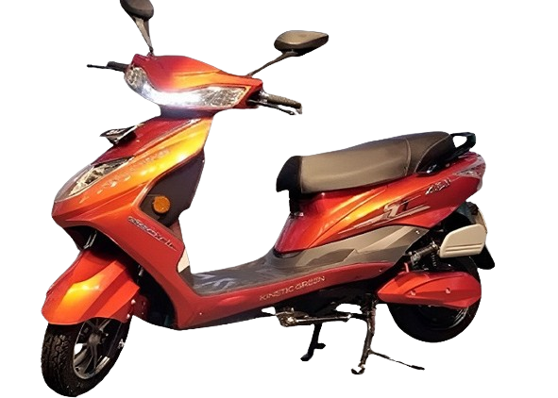
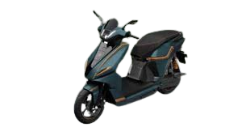
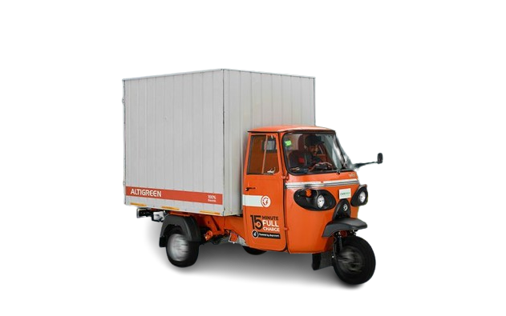
Annexure II: Key electric mobility facts and figures
20
85.60%
615
165
FAME-II target met
Number of EV OEMs in India
Total FAME II approved models
As of 29 January 2024
As of 29 January 2024
As of Q3 FY24
Note: Target of selling 1,562,090 EVs (2W, 3W, 4W and buses) under FAME-II scheme by FY22.
Recent electric vehicle launches
4,35,472
Kinetic Green Zulu
EV penetration
Price: INR 94,990 onwards
Range: 104 km
Battery capacity: 2.27kwh Lithium-ion
In Q3 FY24
4.65%
EVs sold
in Q3 FY24
Rivot NX100 Street Rider Max
Price: INR 1,59,000 onwards
Range: 300 km
Battery capacity: 5.76 kWh Lithium-ion
2W sold were EV
26
Altigreen Neev Tez
54.84%
Price: INR 4,04,000 onwards
Range: 98 km
Battery capacity: 8.8 kWh Lithium-ion
States notified EV policies
As of Q3 FY24
3W sold were EV
BMW i7 M70 xDrive
Price: INR 2,50,00,000 onwards
Range: 560 km
Battery capacity: 101.7 kWh Lithium-ion
For more updates visit CEEW-CEF Electric Mobility Dashboard
20
Source: Vahan Sewa dashboard, CEEW Centre for Energy Finance Electric Mobility dashboard, Department of Heavy Industries, CEA.
cef.ceew.in

Slide 21
About us: CEEW is among Asia’s leading policy research institutions
21
cef.ceew.in

Slide 22
CEEW Centre for Energy Finance
22
Build evidence
Consistent, reliable, and up to date monitoring & analysis of clean energy markets – investment, payment schedules, market trends, etc.
Create coherence
Periodic convening of multi-stakeholder groups to deliberate on market activities in clean energy
Design solutions
Design and feasibility pilots of fit-for-purpose business models & financial solutions for clean energy solutions
cef.ceew.in

Slide 23
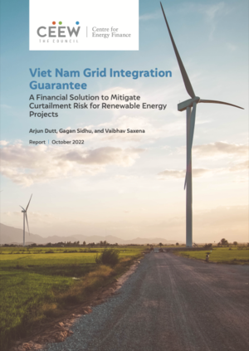
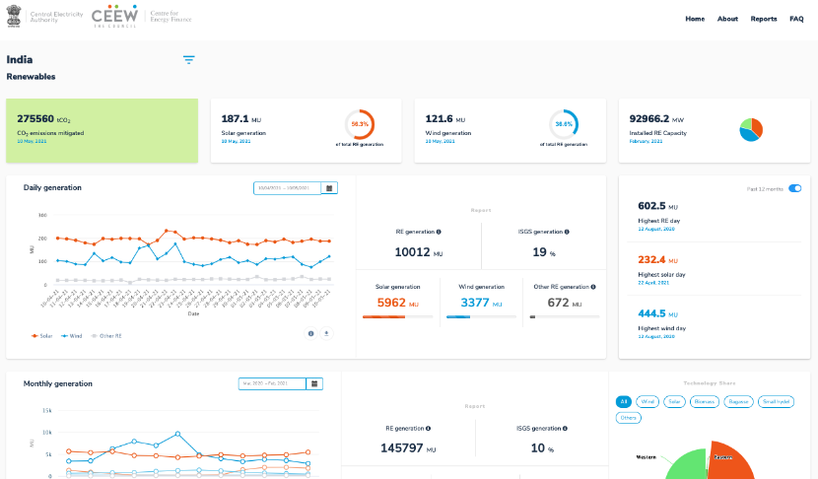
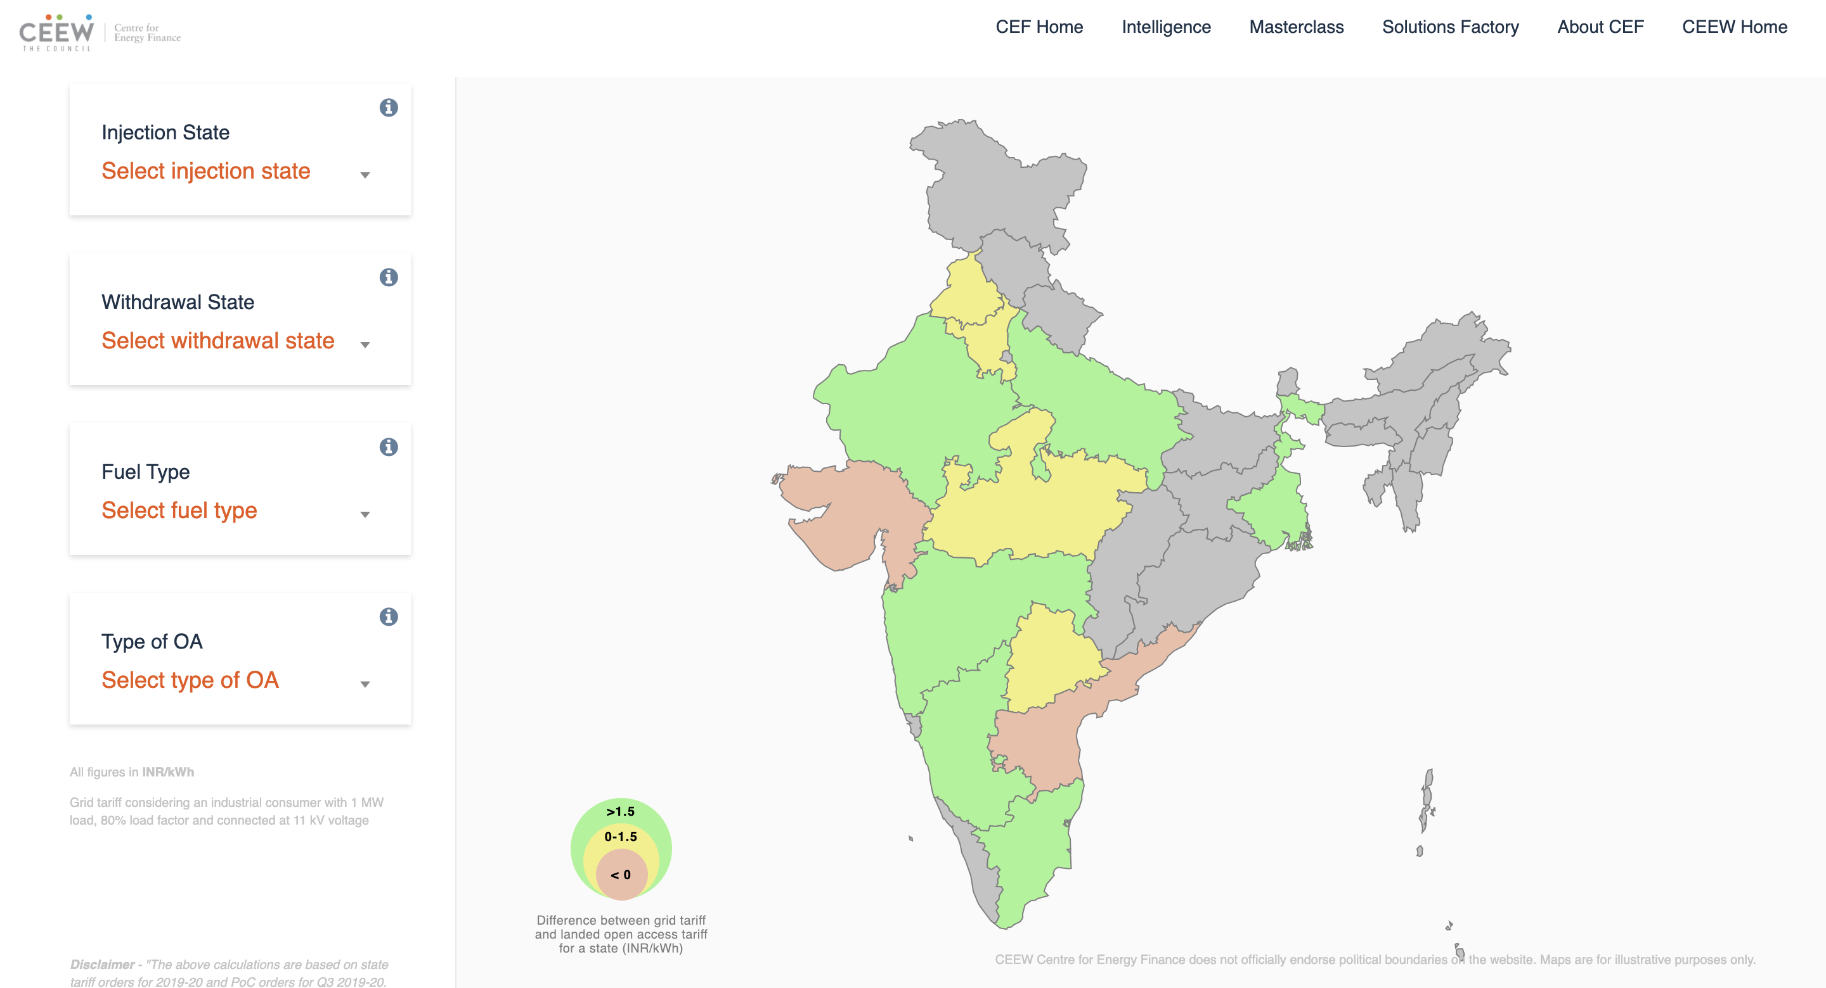
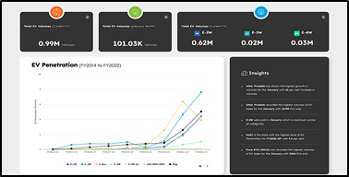
Our recent publications, dashboards and tools
23
Developing An Effective Carbon Market Framework Towards The Achievement Of Net-Zero In India
Greening India's Automotive Sector
Mobilizing Investment For Clean Energy In India
Viet Nam Grid Integration Guarantee
India Renewables Dashboard
Open Access Tool
Electric Mobility Dashboard
cef.ceew.in

