Slide 1
Cold Storages Powered by Farm Waste to Enhance Income of our Farmers in India
Anurag Agarwal – Founder, New Leaf Dynamic Technologies (P) Ltd
Copyright, New Leaf Dynamic Technologies (P) LTD

Slide 2
Country: Low Agriculture Incomes, Low Growth
Moving to growing Fruits & vegetables can triple incomes. But:
Unlike food grains, Fruits & vegetables are perishables
Hot climate
Everyone sells at harvest causing market glut
42% of our population in agriculture, and contributing less then 25% GDP
Niti Policy Paper 1/2017, Planning Commission of India. Average productivity from Fruits & Vegetables (HVC) is Rs 1.42 Lacs per Hectare as compared to Rs 0.41 Lacs from staples.

Slide 3
99% Shortage of Cold Storage
“The lack of an adequate and efficient cold chain infrastructure leads to massive post-harvest losses, estimated at INR 92,561crore annually. Perishables account for the bulk of post-harvest losses”
“Inadequate cold-chain infrastructure hampers India’s food exports as well”
Niti Aayog, New Strategy for India @75, Dec 2018, chapter 7, page 36

Slide 4
Use Grid Power ?
Cooling for 500 million tons
Agricultural electricity consumption is already rising fastest
If additional cold chain capacity is grid powered, 10X increase in consumption
Electricity consumption in Maharashtra
Data from Economic Survey of Maharashtra 2017-18

Slide 5
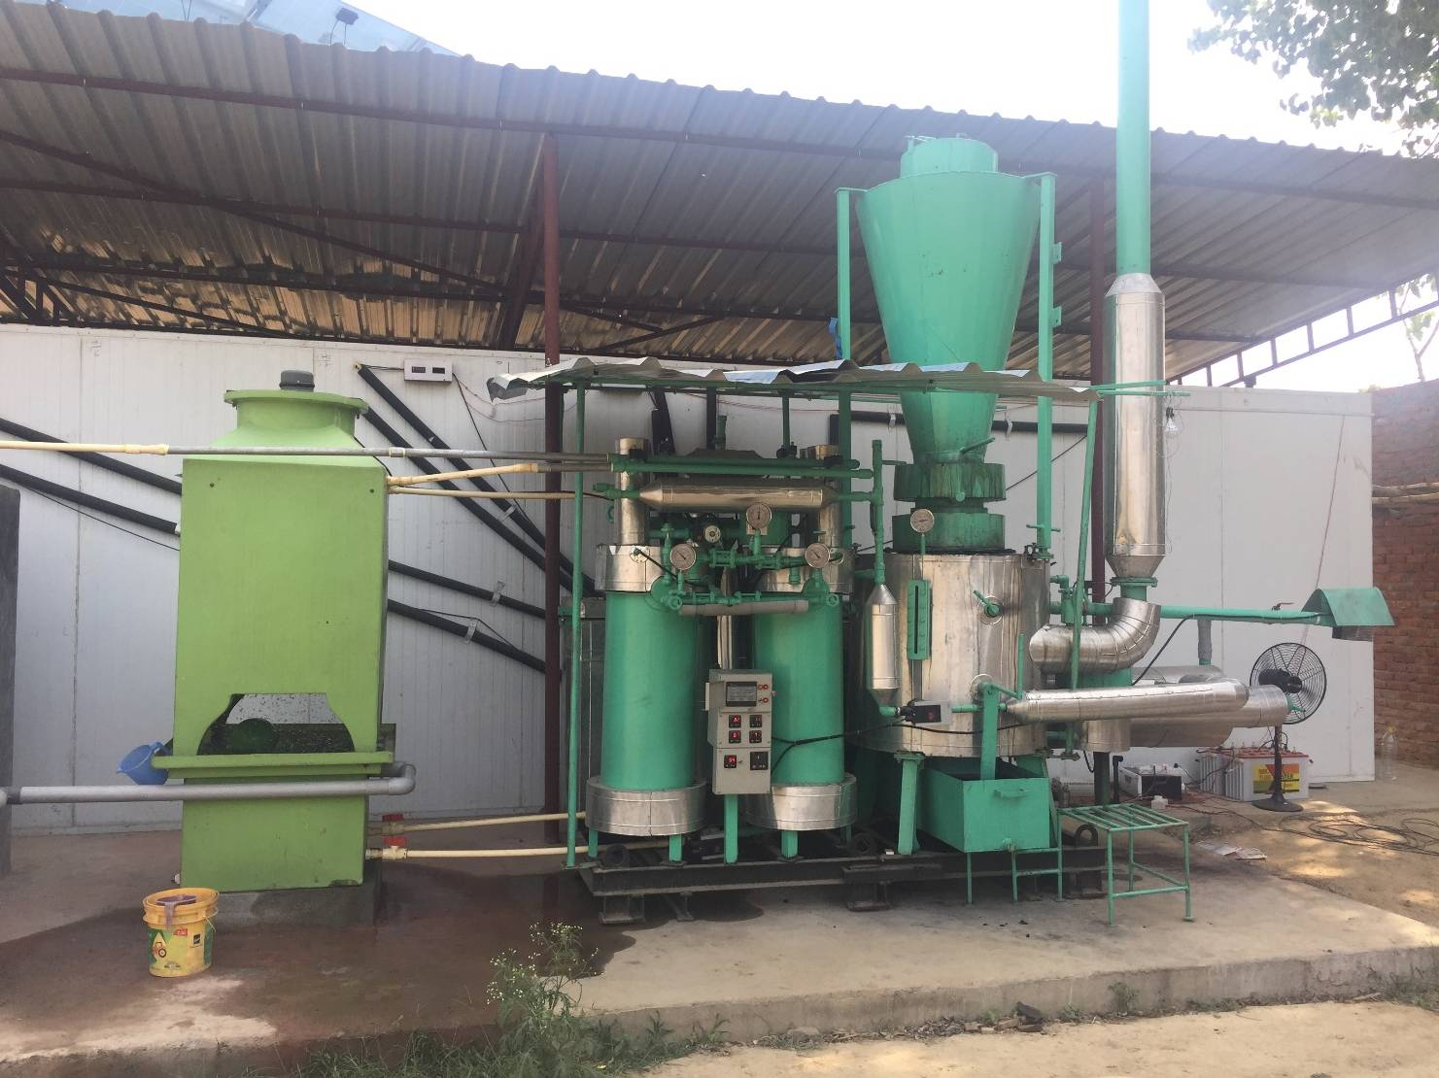
GreenCHILL Can Solve this Problem
15 Ton Cold storage for on farm usage
Powered by farm waste, no fossil fuels
Cools down to 0°C
Biomass consumption of 100 Kg/day
Green Refrigerant (no CFC/HFC)
Technology developed by New Leaf

Slide 6
New Leaf Founding Team
Anurag Agarwal: B.Tech, IIT Kanpur 1982, MS, Tennessee 1984 in Mechanical Engineering. 30 years industry experience in delivering engineering to the worlds largest Mechanical engineering companies including Bosch Rexroth, Parker Hannifin, Eaton Corp.
Rahas Sahoo: 25 Years’ experience in electrical and mechanical maintenance of fighter jets with the Indian Air Force. Responsible for manufacturing & support.
Akash Agarwal: Business Management, University of Utah, 2014. Responsible for sales of GreenCHILL. Currently setting up sales operations based out of Indore.
Notes:
6

Slide 7
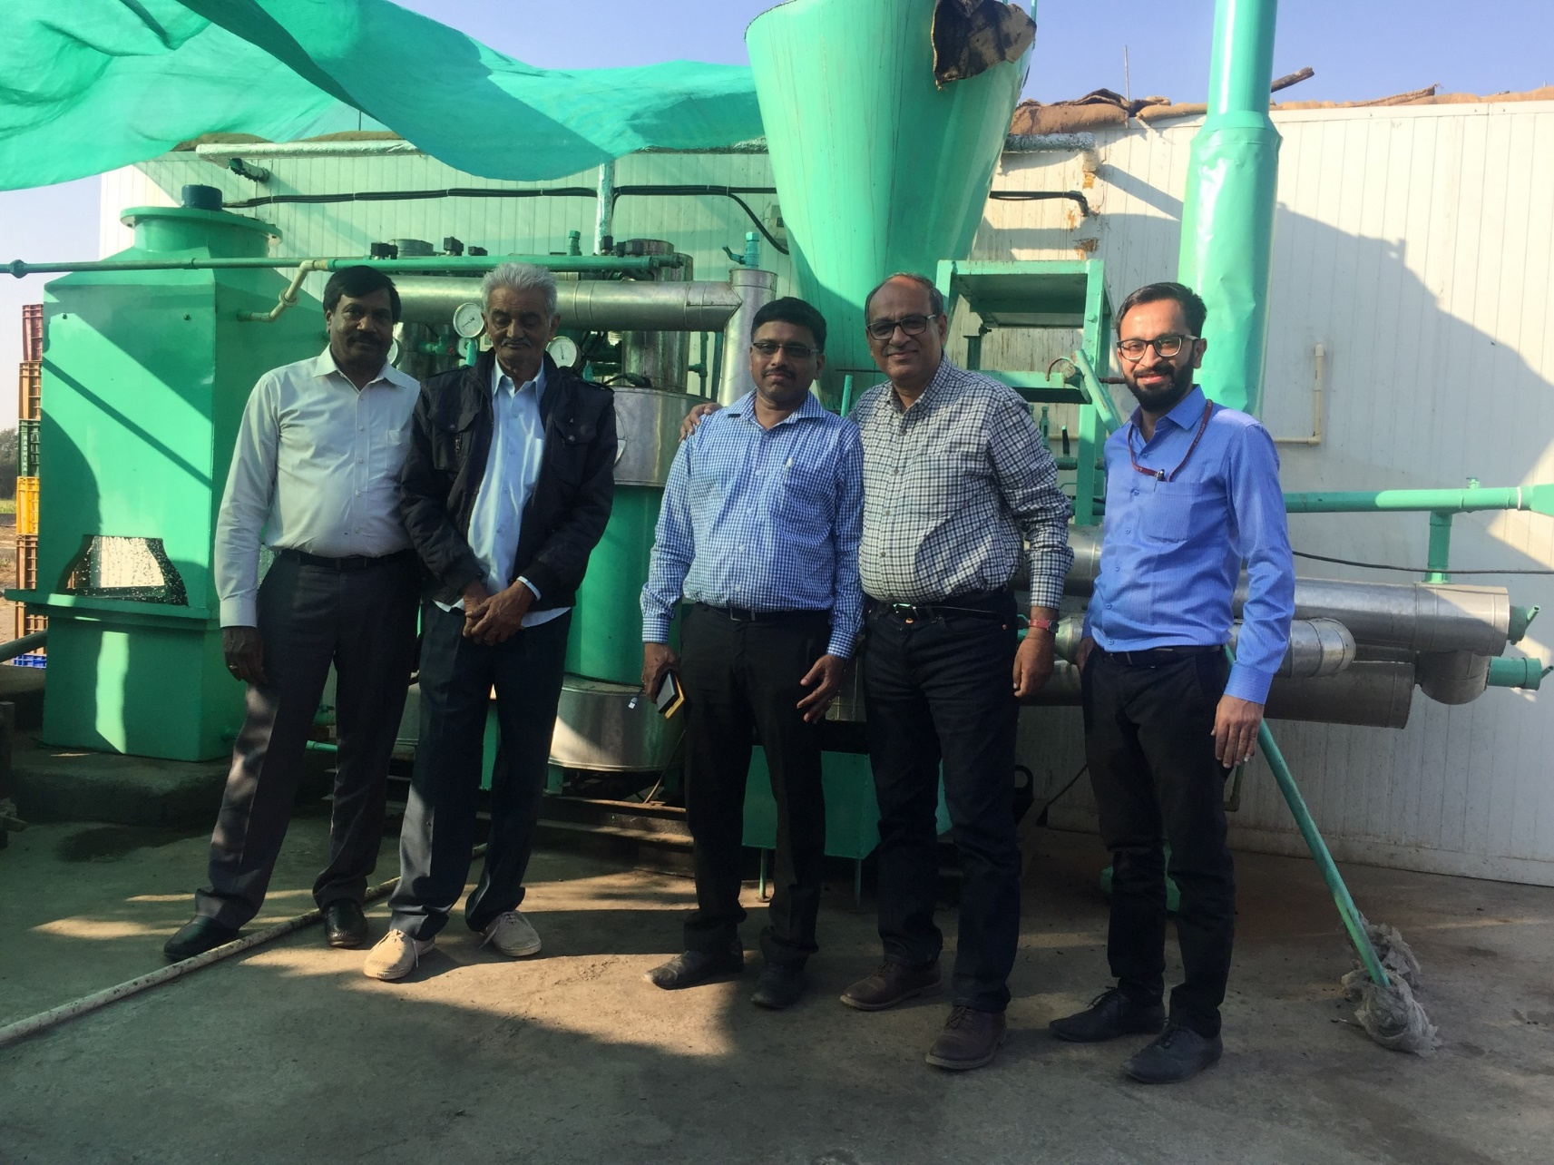
Bhim Bhai: Farmer in Junagadh using GreenCHILL
Lemon storage
Prices vary from 12 Rs/kg Mid January to 70 Rs/Kg March/April
2 to 3 harvests/year
Profit of 6 lacs/harvest
financed by Axis Bank now financing 4 more
Dr PV Rao, country head of Rural & Agri Banking of Axis Bank
Axis Bank
Axis Bank
Bhim Bhai
Anurag Agarwal, Founder New Leaf

Slide 8
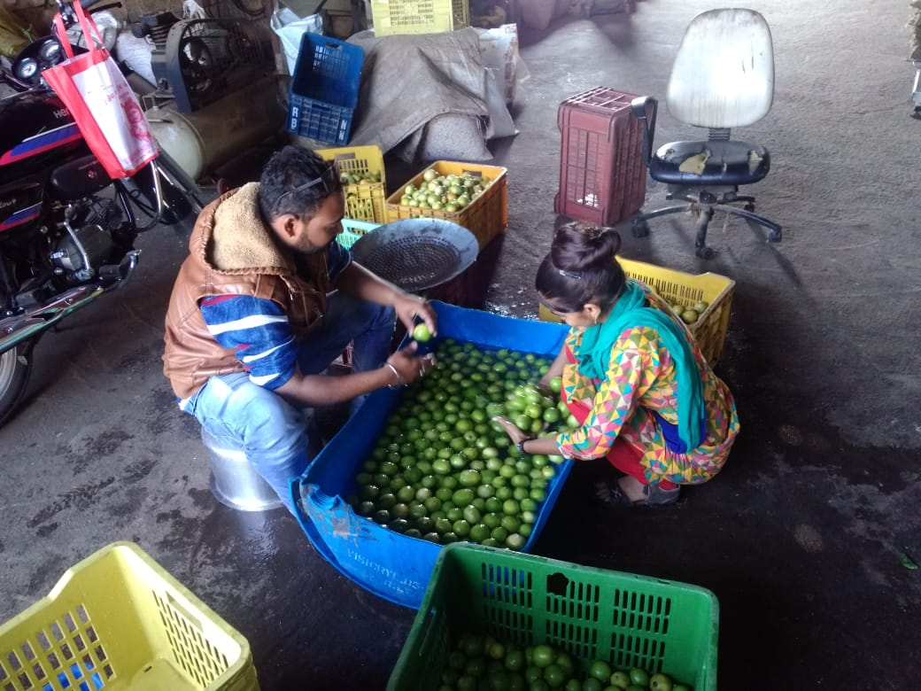
Bhim Bhai

Slide 9
GreenCHILL at Kapurthala & Hoshiarpur
Precooling Apples
Precooling Melon

Slide 10
Navsari
Ripening of Mangoes.
Add 2x to value

Slide 11
Predictable profits by storing
Seasonal predictable price variations, so assured income
Most perishables are easy to store
Some of them can be stored for many months
Commodity | Feb, 20 | Mar, 20 | %
Lemon | 2210 | 5430 | 145%
Tomato | 1064 | 1643 | 55%
Cauliflower | 433 | 1750 | 300%
Cabbage | 390 | 710 | 82%
Prices/quintal at Azadpur Wholesale Market, Delhi, 2019
Data for Horticulture Statics at a glance 2017, Ministry of Agriculture and Farmer Welfare

Slide 12
GreenCHILL: Low Running Cost to Increase Earnings
 | Diesel | Electricity | GreenCHILL
Running Cost per year | 13,500 liters/year ₹ 800,000 | 38,000 Units/year ₹ 2,70,000 | 19,500 Kg waste ₹ 0 to ₹ 60,000
Carbon Emission/Year | 35,000 Kg ¹ | 28,500Kg ² | Nil ³
¹2.7 Kg CO₂ emission per liter of diesel by generators
²Greenpeace data for India. 0.87 Kg CO₂ emission per unit electricity. 85% electricity is coal based in India
³ Farm waste is carbon neutral (ministry of renewable energy, India; US Environment Protection Agency; European Parliament; Greenpeace)

Slide 13
New Leaf Financials (Rs ‘00,000)
 | 2017-18¹ | 2018-19² | 2019-20³ | 2020-21³
Sales | 65.69 | 151 | 300 | 750
Profit/Loss | (48.32) | 2.8 | 30.0 | 80.0
4 years of product development cycle
Unaudited figures for financial year ending March 31st, 2019
Projections
Company looking to raise 4 Cr. now for expansion plans to enable to change its sales strategy from B2C to B2B

Slide 14
Thank You
New Leaf Dynamic Technologies (P) Ltd
Factory: A-150 Sector 80
NOIDA, UP 201301
Sales Office:
Indigram Labs
B1/B1 Mohan Cooperative Industrial Estate
New Delhi
WEB: www.NewLeafDynamic.com
Email: Anurag@NewLeafDynamic.com
Mobile: 98990 26930

