Slide 1
Crop Residue Burning in Punjab : Causes, Challenges and Identified Solutions
Niti Gupta
13 February 2019
© Council on Energy, Environment and Water, 2019

Slide 2
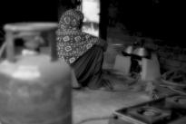
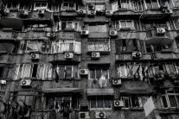
CEEW – Among South Asia’s leading policy research institutions
^{Energy Access}
^{Renewables}
^{Power Sector}
Industrial Sustainability & Competitiveness
^{Low-Carbon Pathways}
^{Risks & Adaptation}
^{Technology, Finance, & Trade}
^{Centre for Energy Finance}

Slide 3
Air pollution work at CEEW
Understand institutional and geographical gaps for actionable information
Understand regulatory and enforcement capacity
Create a platform for behaviour change communication
Image: Niti Gupta/CEEW

Slide 4
Every year stubble is burnt on around 5.7 million acres of land in Punjab.

Slide 5
No significant decrease in fire counts in Punjab
Source: CEEW ANALYSIS

Slide 6
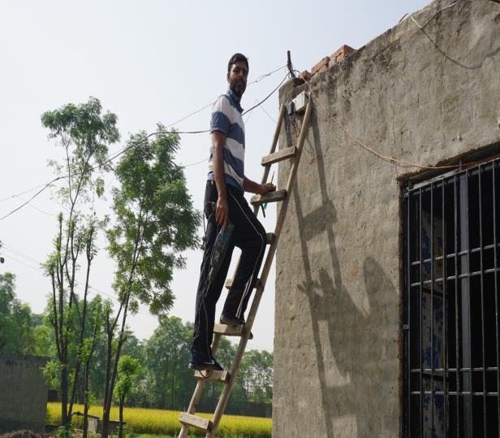
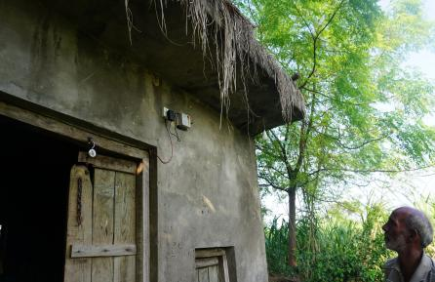
Rural India’s ignored air pollution problem
CEEW installed 48 low cost sensors in October 2018 across four districts – Ludhiana (16), Sangrur (12), Hoshiarpur (8) and Pathankot (12)
Source: Niti Gupta/CEEW

Slide 7
Increase in PM 2.5 during peak burning season
Source: CEEW Analysis
Notes:
As against the standard limit of 60 microgram per meter cube, PM 2.5 levels in November ranged in between 219 to 630 micrograms per meter cubed in Sangrur.
Difference in air quality among paddy-intensive regions (Ludhiana and Sangrur) and less paddy cultivated regions of Pathankot and Hoshiarpur.

Slide 8
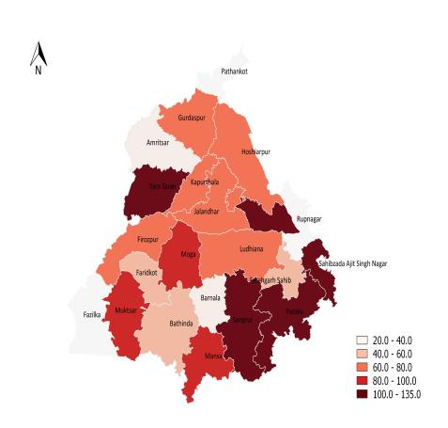
Shift in cropping pattern and groundwater depletion
Groundwater level (in feet) 2017
Groundwater level (in feet) 2007
One kilogram of rice consumes 3000-5000 litres of groundwater (Kaur et al., 2015). If the rice-wheat monoculture remains, it is expected that by 2023 the water table depth in central Punjab will fall below 70 feet in 66 per cent of the area, below 100 feet in 34 per cent area and much below 130 feet in 7 per cent of the area (Sidhu et al., 2010).

Slide 9
Shortage of Labour : Growth opportunities and higher remunerations due to MNREGA / Increase in labour charges
Source: Niti Gupta/CEEW

Slide 10
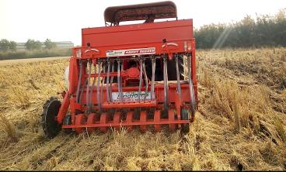
Why are farmers still defying the mandates?
Manufacturing output of Happy Seeder was
lagging behind demand
No standard rate for renting
Happy Seeder
Gap in awareness and
communication
Fragmented market for
crop residue management
Picture source: CEEW

Slide 11
What more can we do about it?
Monitoring the fire counts and rural air quality
Promotion of short-duration rice varieties
Promote rental model for agricultural implements
Crop diversification
picture source: Niti Gupta/CEEW

Slide 12
Thank you
ceew.in | @CEEWIndia

