Slide 1
CEEW Energy Horizons
18 July 2019, Abu Dhabi
Rana Adib
REN21 Secretariat
gsr@ren21.net

Slide 2
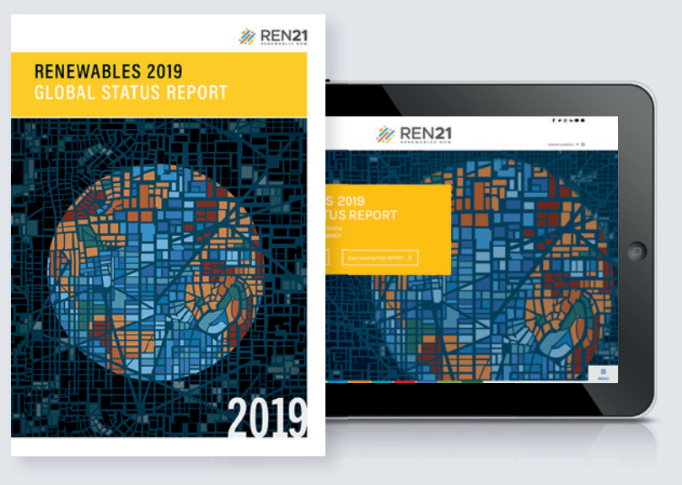
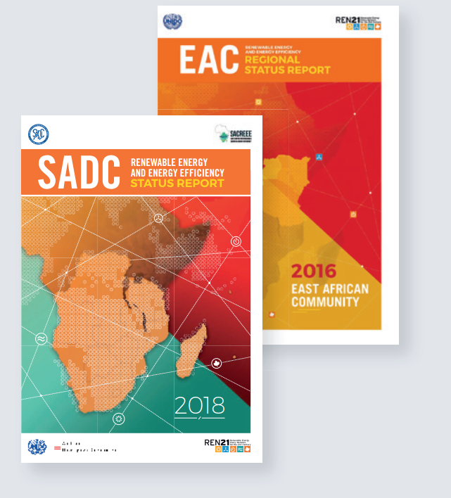
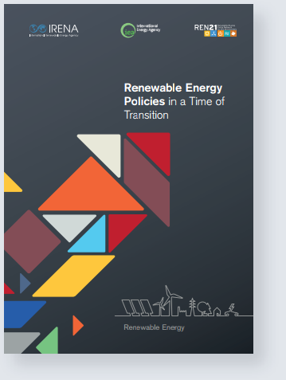
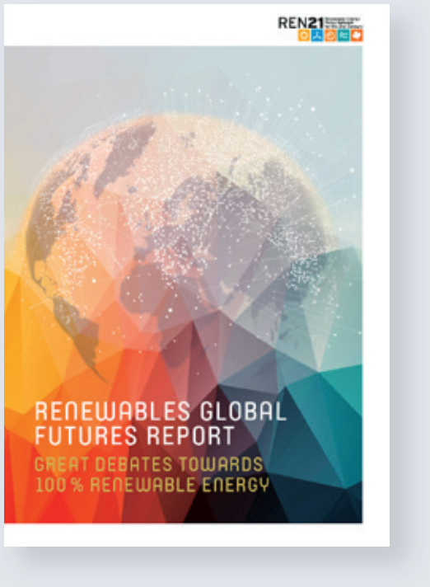
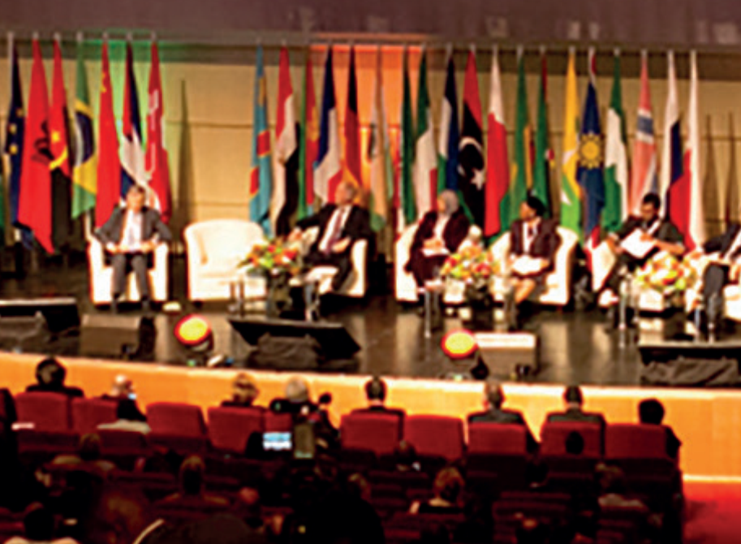
REN21 – A policy network to build a sustainable energy future with renewables
Who we are…
What we do…
Global Status Report:
yearly publication since 2005
Renewables in Cities
Status Report:
Regional Reports
Thematic Reports
Global Futures Reports
23-25 October, 2019
Notes:
Pour ceux qui ne nous connaissent pas, REN21 est le reseau politique des énergies renouvelables pour le 21e siècle.
Nous sommes une communauté d’acteurs passionés, qui travaillent ensemble à contruire un future énergétique durable basé sur les renouvelables.
Nous sommes aussi un reseau d’experts internationaux provenant d’organisations très diverses (ONG, associations professionnelles, gouvernements, instituts de recherches et universités…),
qui travaille activement à faire évoluer la manière de penser les énergies renouvelables.
Comment fait-on :
Nous assurons un suivi de l’état des EnR pour apporter les faits et les preuves (à l’echelle mondiale, régionale ou de manière thématique et très prochainement à l’echelle des villes).
Mais aussi en captant les tendences actuelles.
Toutes ces informations, nous les amenons dans les débats mondiaux (que ce soit en interne de notre communauté avec la REN21 Academy – ou bien à l’externe avec les Conférences Internationales des Energies Renouvealbles – IREC)

Slide 3
Renewables Global Status Report
Collaborative annual reporting since 2005 building on international expert community.
The report features:
01. Global Overview
02. Policy Landscape
03. Market & Industry Trends
04. Distributed Renewables for Energy Access
05. Investment Flows
06. Energy Systems Integration and Enabling Technologies
07. Energy Efficiency
08. Feature: Renewable Energy in Cities
Notes:
The REN21 Renewables Global Status Report (GSR) provides an annual look at the advances in renewable energy markets, policy frameworks and industries globally.
The production of the GSR builds on a global community of over 1500 experts, who have helped REN21 produce what is today one of the most widely referenced reports in the sector.
This year’s GSR 2019 marks 14 years of REN21 reporting; it includes thousands of data points and uses hundreds of documents and personal communications with experts from around the world to provide the most up-to-date information available.

Slide 4
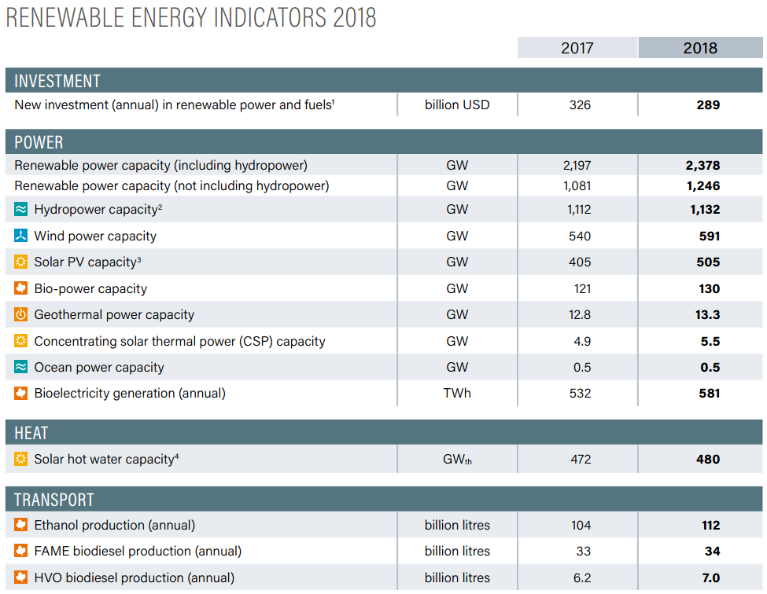
Another strong year for renewable energy
Total global capacity rose 8% in 2018
Non-hydro capacity grew 15%
1,246 GW by the end of 2018
181 GW of renewable power added
Leaders:
Solar PV = 100 GW (55% of new additions)
Wind power = 51 GW (28%)
Notes:
Renewable energy had another strong year in 2018. Total capacity including hydropower grew 8% and reached 2,378 GW by year’s end.
Growth is even faster when looking at technologies beyond hydropower. 161 GW of non-hydropower capacity = 1,246 GW by the end of 2018
was added, growing 15% on 2017 levels.
By the end of the year, hydropower no longer accounted for more than half of installed renewable power capacity (48%). Meanwhile, wind power rose to comprise roughly 25% of the installed renewable power generation capacity, while solar PV exceeded 20% for the first time (21%).
Renewable energy has a global reach: Over 90 countries have more than 1 GW, while more than 30 have at least 10 GW.
For non-hydropower capacity, 17 countries renewable energy had installed capacity greater than 10 GW – mainly wind power and solar PV – and 45 countries had capacity above 1 GW .

Slide 5
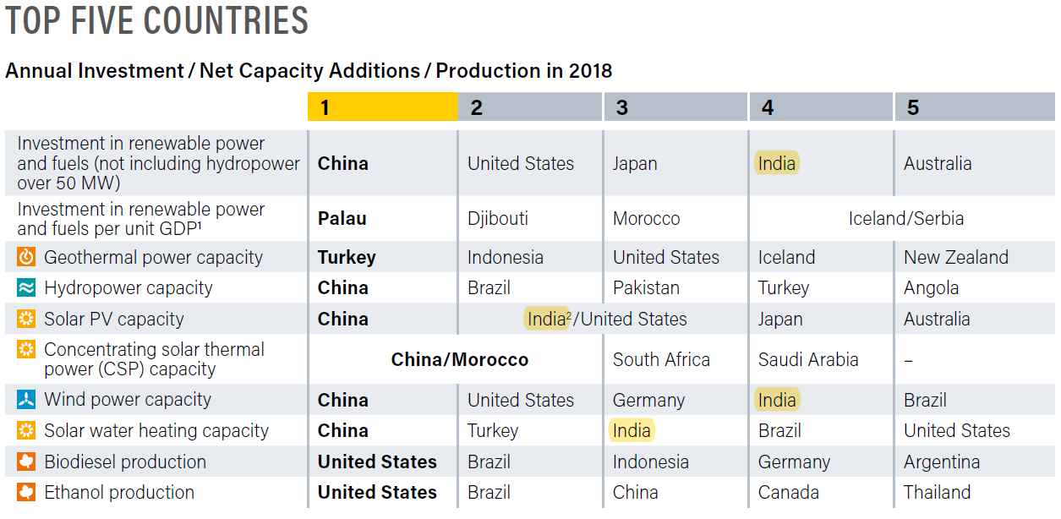
Notes:
Renewable energy had another strong year in 2018. Total capacity including hydropower grew 8% and reached 2,378 GW by year’s end.
Growth is even faster when looking at technologies beyond hydropower. 161 GW of non-hydropower capacity = 1,246 GW by the end of 2018
was added, growing 15% on 2017 levels.
By the end of the year, hydropower no longer accounted for more than half of installed renewable power capacity (48%). Meanwhile, wind power rose to comprise roughly 25% of the installed renewable power generation capacity, while solar PV exceeded 20% for the first time (21%).
Renewable energy has a global reach: Over 90 countries have more than 1 GW, while more than 30 have at least 10 GW.
For non-hydropower capacity, 17 countries renewable energy had installed capacity greater than 10 GW – mainly wind power and solar PV – and 45 countries had capacity above 1 GW .

Slide 6
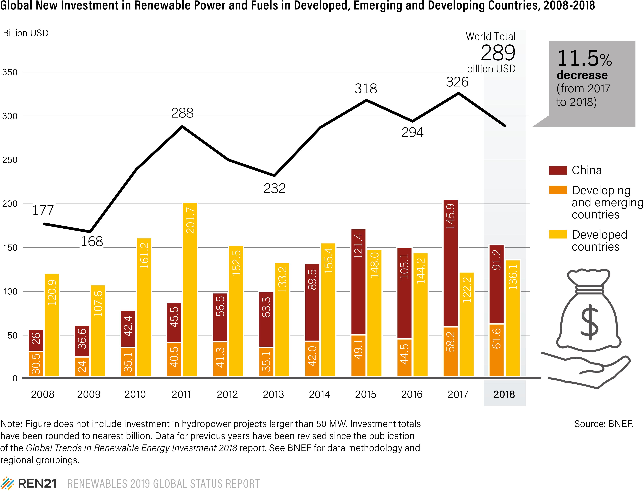
Investment in renewable energy fell in China, rose elsewhere
Global investment in renewable power and fuels totalled USD 288.9 billion, a decrease of 11.5%
Fifth consecutive year in which investment topped USD 280 billion
India: USD 15.4 billion, 4th globally, a decrease of 16%
Notes:
Global investment fell 11.5% in 2018, driven by a sharp decline in China, resulting from policy changes that reduced financial support for solar PV projects.
Developing and emerging economies overtook developed countries in renewable energy investment for the first time in 2015. After extending their lead in 2017, they retained it in 2018, albeit by a smaller amount.
2018 increasing diversification of investment – less dependent on a handful of countries
Investment in developing and emerging countries decreased 25% to USD 152.8 billion (due largely to decreases in China), while that in developed countries increased 11% to USD 136.1 billion.

Slide 7
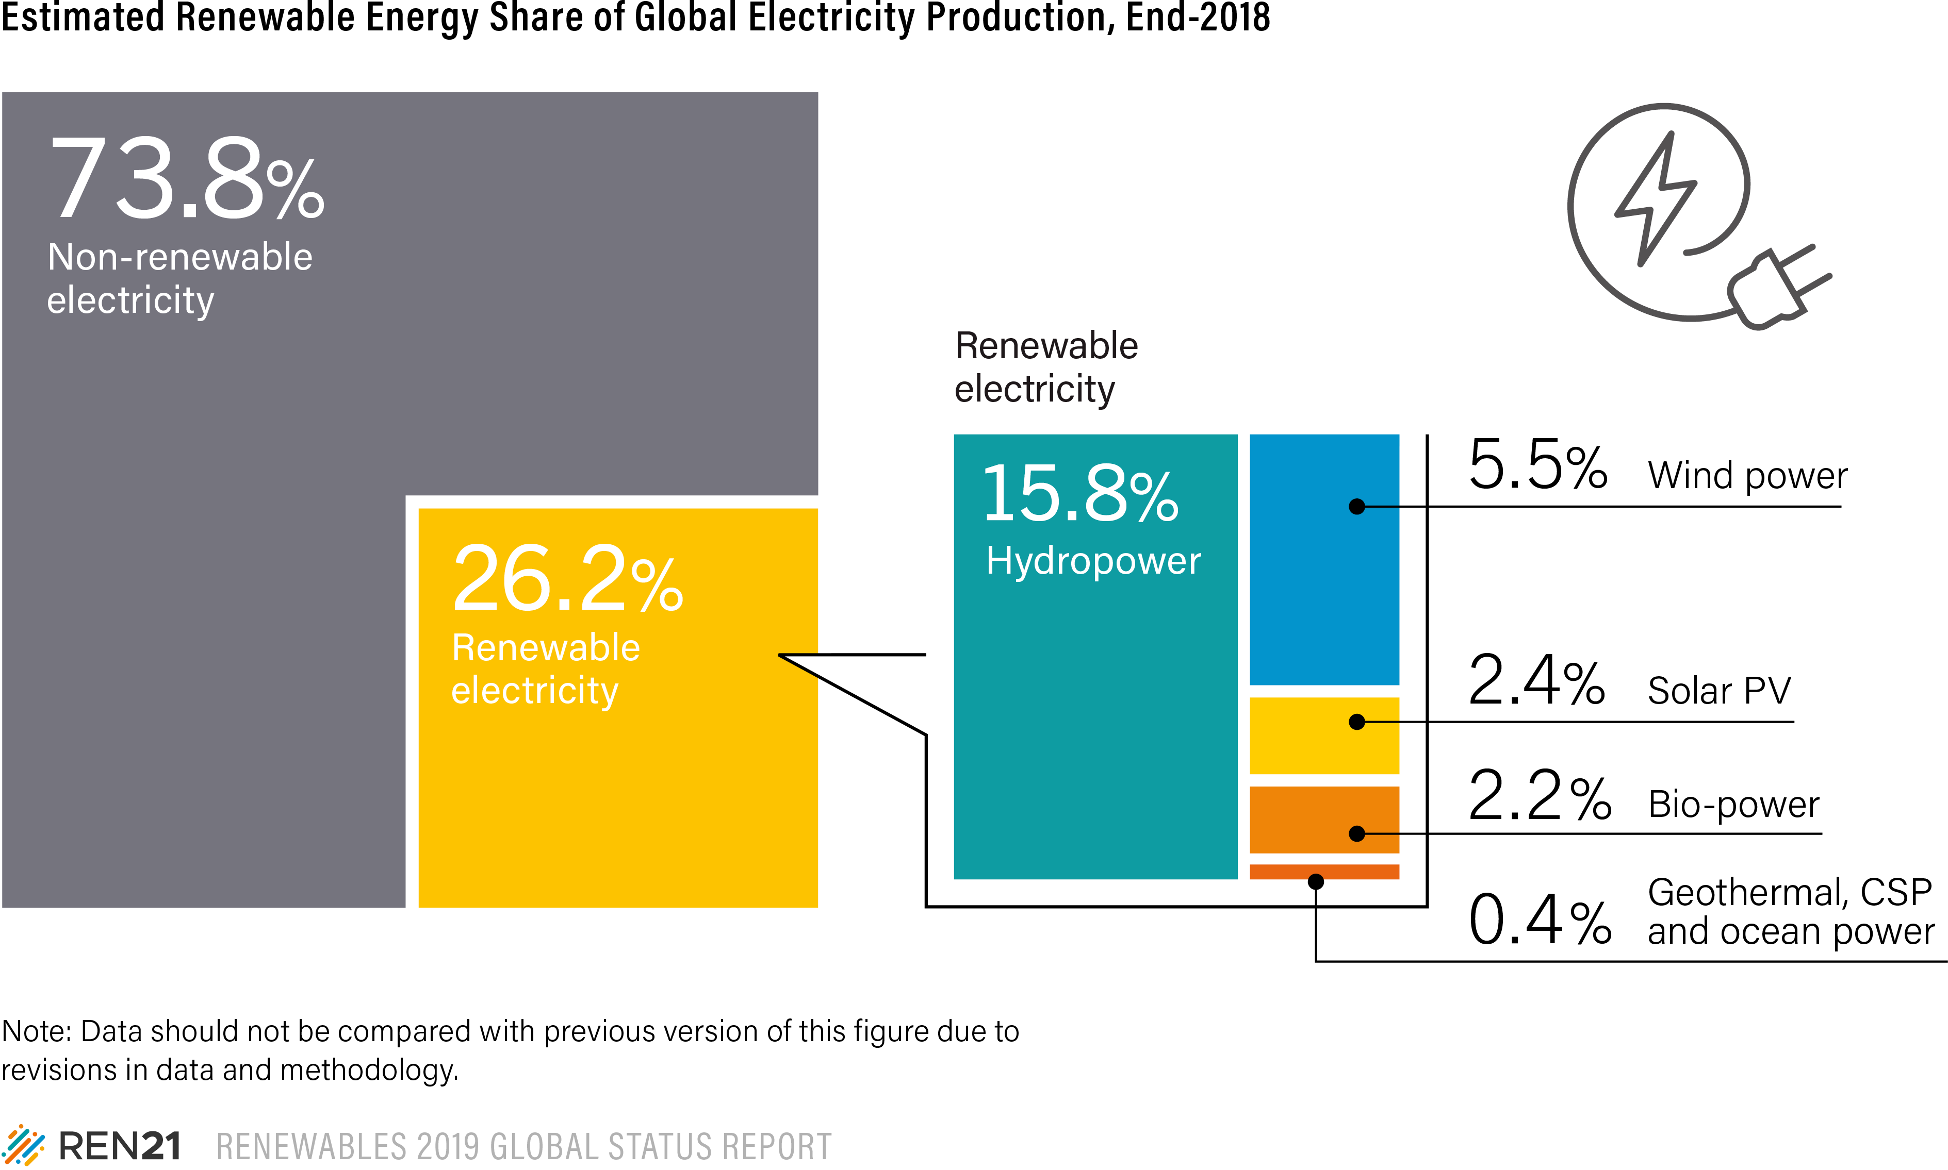
Power sector leading: Renewables supply more than 26% of global electricity
Renewables supplied an estimated 26.2% of global electricity at the end of 2018
For the first time, more electricity was from solar PV than bio-power
Notes:
Le développement des énergies renouvelables est une réussite tout particulièrement dans le secteur de l'électricité.
Chaque année, la production d'électricité à partir d'énergies renouvelables est supérieure à celle de l'année précédente.
En fin d’année 2018, la part des énergies renouvelables dans la production d'électricité atteignait environ 26,2%.
Parmi cette production d’électricité renouvelable, l'hydroélectricité représentait encore environ 60 %, suivie par l'éolien (21 %), le solaire photovoltaïque (9 %) et la biomasse (8 %).
Bien que l'électricité renouvelable gagne rapidement du terrain à travers de nombreux pays et régions, elle se heurte à des difficultés pour atteindre une part plus importante du total mondial.
Cela s'explique principalement par
la poursuite de la forte croissance de la production totale d'électricité (+4% en 2018)
ainsi que par la persistance des investissements dans les capacités de production d'énergie fossile (et nucléaire) et les subventions.

Slide 8
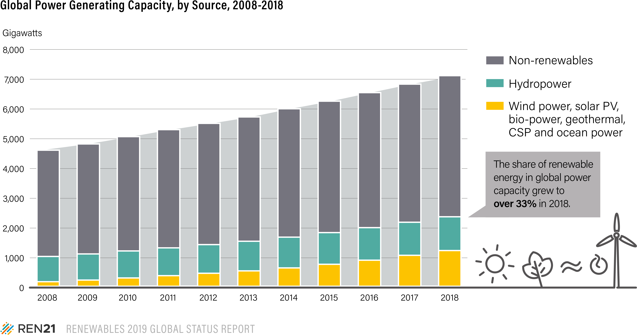
Renewable power now makes up over one-third of global capacity
Renewable energy is now more than 33% of global installed power generating capacity
Within renewable capacity, hydropower (1,132 GW) no longer makes up half of installed capacity
Wind power (592 GW): accounts for 25% and solar PV (505 GW) covers over 21%
Notes:
Overall, renewable energy has grown to account for more than 33% of the world’s total installed power generating capacity.
The global composition of installed renewable power capacity continued to shift during 2018.
Hydropower no longer accounted for half of the cumulative renewable power capacity in operation, falling below 48% by year’s end.
Meanwhile, wind power rose to comprise roughly 25% of the installed renewable power generation capacity, while solar PV exceeded 20% for the first time.

Slide 9
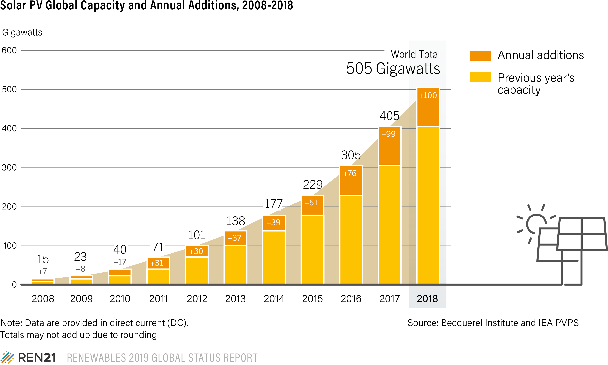
Solar PV capacity additions pass 100 GW mark in 2018
Solar PV capacity additions were more than 100 GW for the first time
Cumulative capacity reached 505 GW, an increase of 25% from 2017
India: 33 GW, 5th in the global rankings
Notes:
The annual global market for solar photovoltaics (PV) increased only slightly in 2018, but enough to surpass the 100 GW level (including on- and off-grid capacity) for the first time.
Cumulative capacity increased approximately 25% to at least 505 GW
This compares to a global total of around 15 GW only a decade earlier

Slide 10
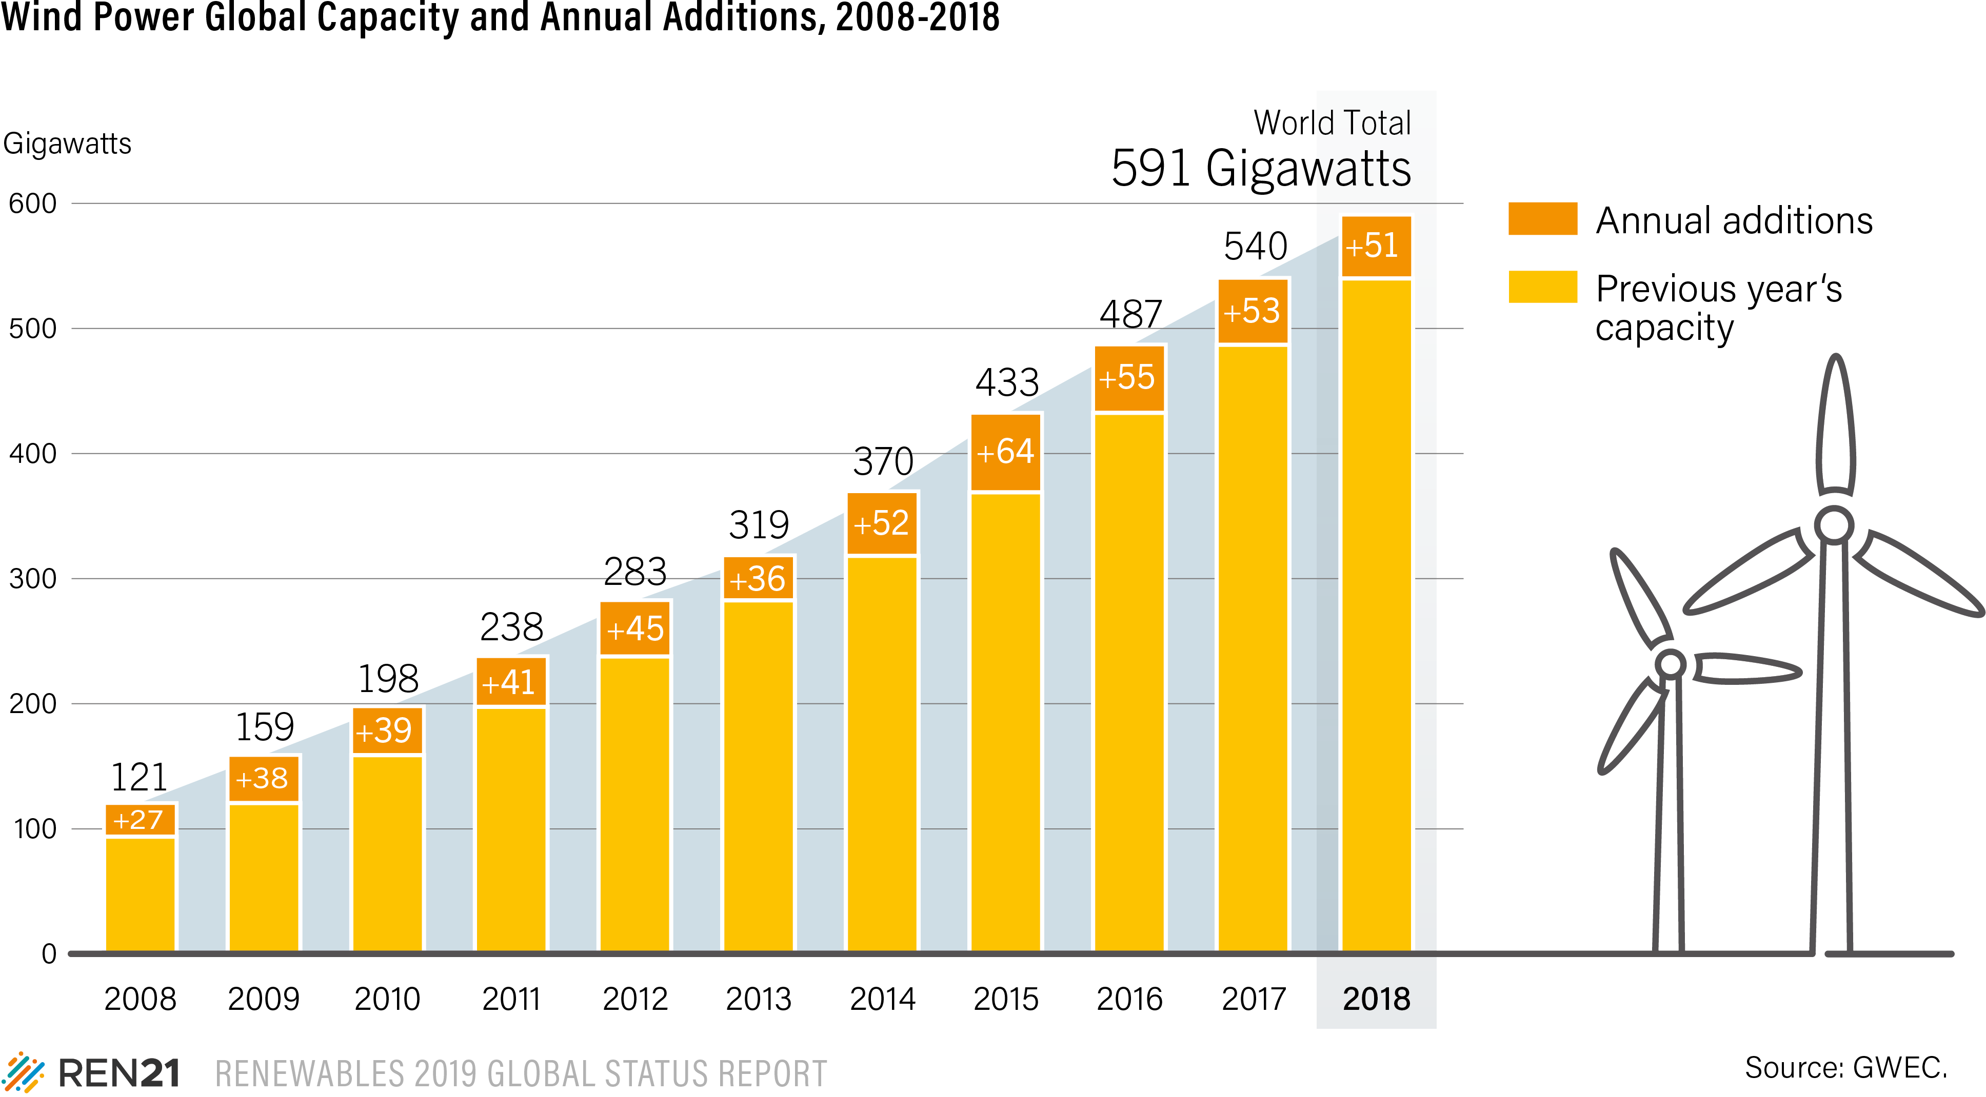
Wind power capacity continues to increase steadily year-on-year
The additions in 2018 pushed cumulative capacity up 9% to 591 GW
Of the 51 GW added, nearly 47 GW was onshore and 4.5 GW was offshore
India: 35.1 GW total installed wind capacity, decrease in 2018 of 50%
Notes:
Onshore installations accounted for all of the market decline
New wind farms reached commercial operation in at least 47 countries in 2018
Asia was the largest regional market, representing nearly 52% of added capacity.
Wind power is characterised by stable installations, falling prices in a competitive industry and growing interest in offshore wind power, following successes in Europe.

Slide 11
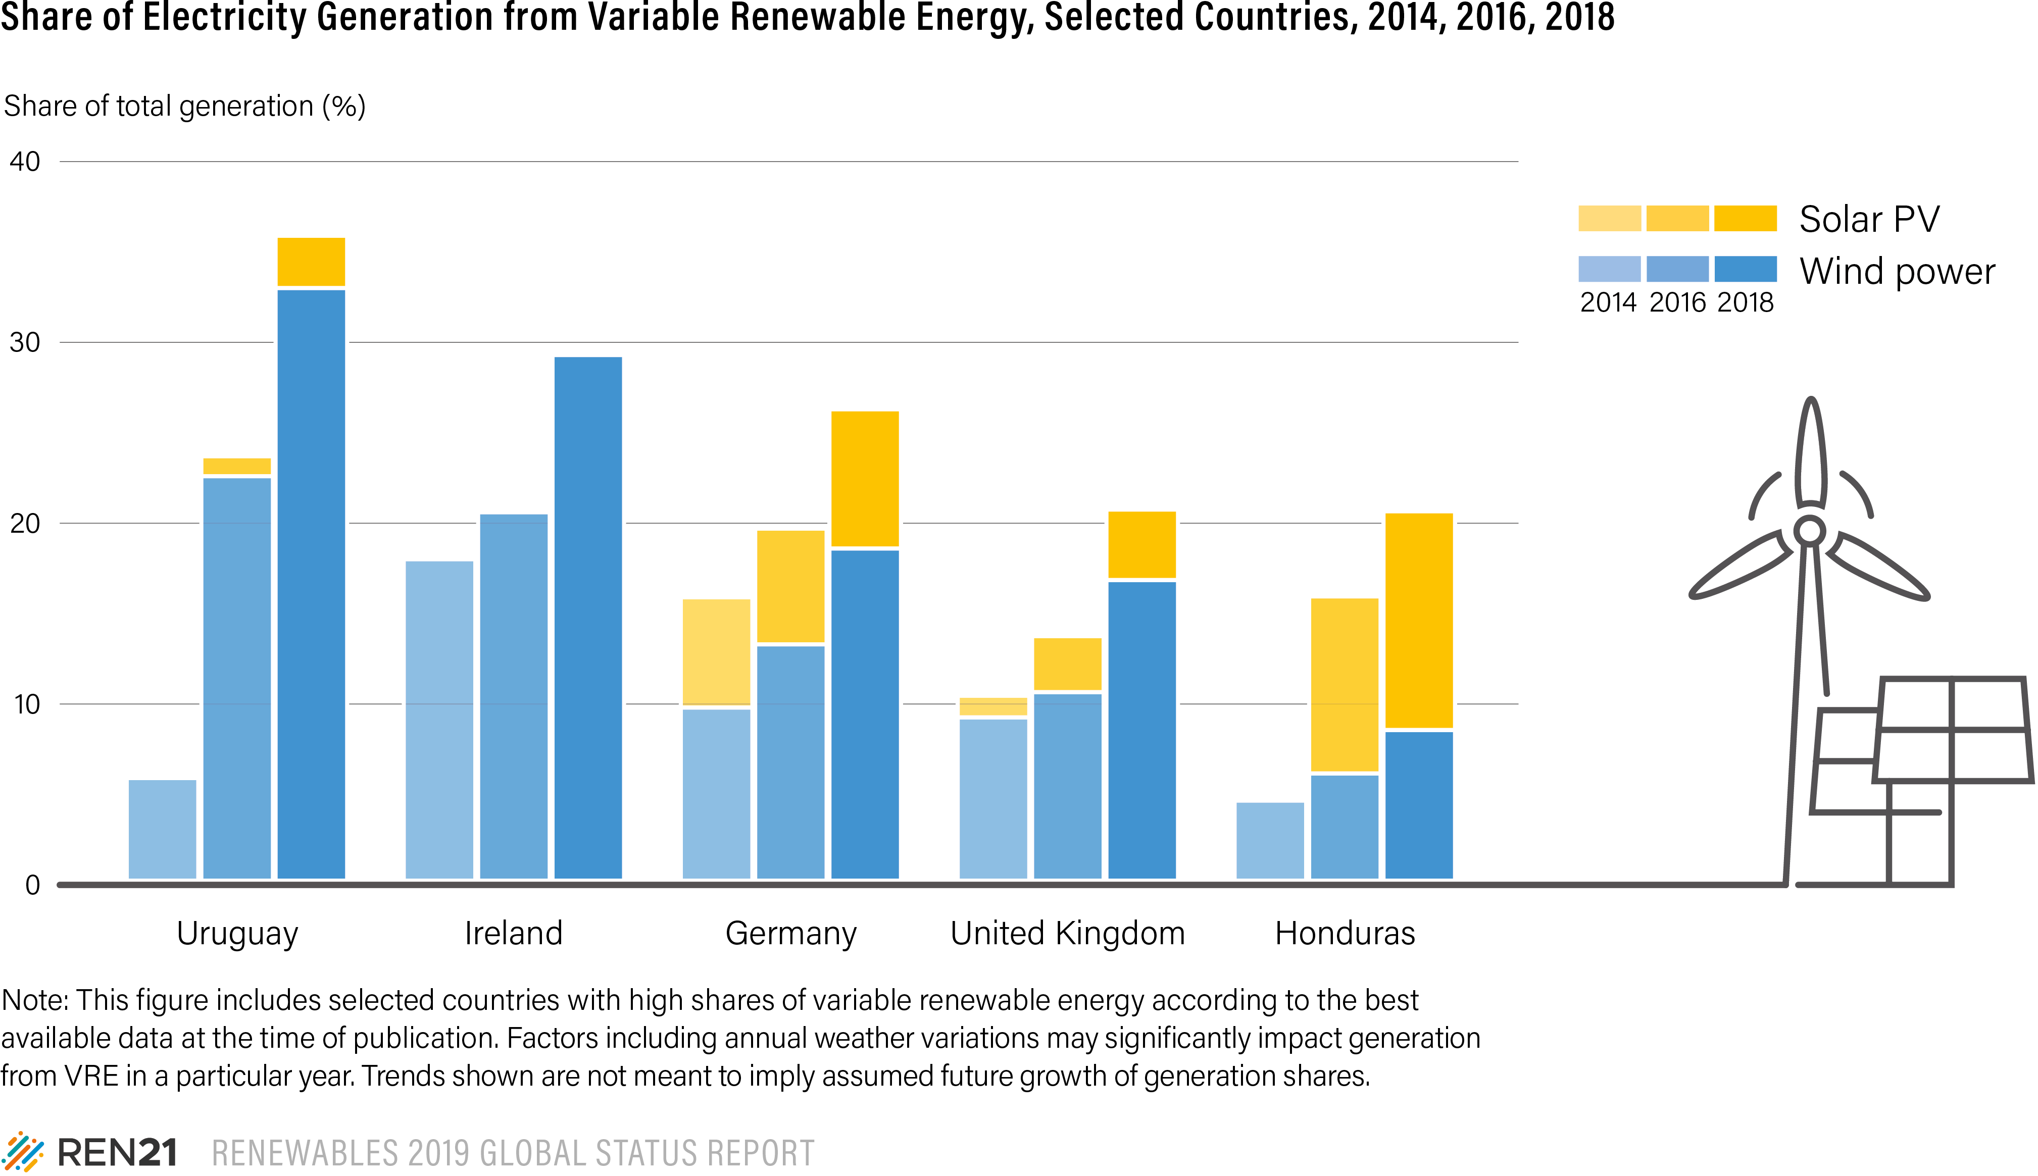
Variable renewable shares have grown dramatically in some countries
The power sector is transforming rapidly in some countries
Variable renewables have seen penetration rates above 20% in at least nine countries in 2018
Average annual growth rates of more than 10% in at least five countries
Notes:
In numerous countries around the world, the power sector has experienced significant transformation, driven primarily by the rapid increase in penetration of variable wind and solar generation.
This growth is due in part to quickly declining costs for solar PV and wind power, which have made these renewable energy sources the most economical options for new power-generating capacity in an increasing number of markets.
Variable renewables already have seen high levels of penetration in power systems around the world, with average compound annual growth rates of more than 10% between 2014 and 2018 in countries such as Uruguay, Ireland, Germany, the United Kingdom and Honduras.

Slide 12
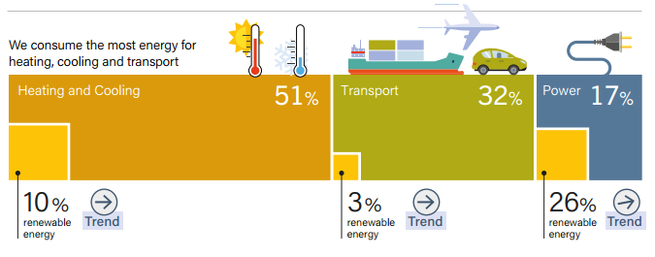
Beyond power: over 80% of demand for heating, cooling, and transport
Over half of final energy demand is from the heating and cooling sector
< 10% of this demand is supplied by renewable energy
32% of final energy demand is for transport end-uses
Just over 3% is renewable and primarily met by biofuels
Around 26% of electricity was renewable in 2016
Notes:
What do this year’s numbers tells us?
THREE KEY MESSAGES:
1)renewable; power is here to stay
2) Progress in the power sector offers major insights for overcoming the slow growth of renewables in heating, cooling and transport
3) A sustainable energy future requires vision, ambition and policies
And a fourth supporting message is better understanding opportunities created by end-use sectors
As of the end of 2016, heating and cooling accounted for around 51% of final energy use, transport for 32%, and final electricity demand (excluding the purposes of heating, cooling or transport) for around 17% .
Modern renewables contributed only 9.8% of final heat consumption. Direct renewables supplied some 8% of global heat demand, while renewable electricity accounted for the remaining share (1.8%) in total final demand.
The vast majority (95.9%) of global transport energy needs were met by oil and petroleum products (and 0.8% non-renewable electricity), with small proportions met by biofuels (3.0%) and renewable electricity (0.3%).

Slide 13
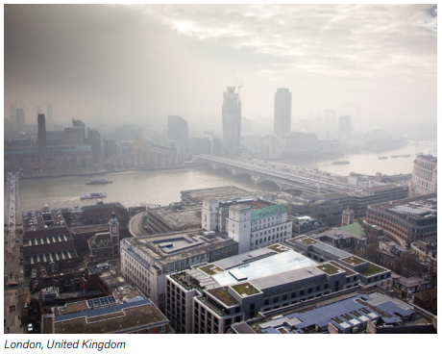
Heating and Cooling – Distributed solutions and local markets
Notes:
C’est pour répondre à ce besoin de donées que nous lancerons plus tard dans l’année le premier rapport sur le statut Mondial des renouvelables dans les villes.

Slide 14
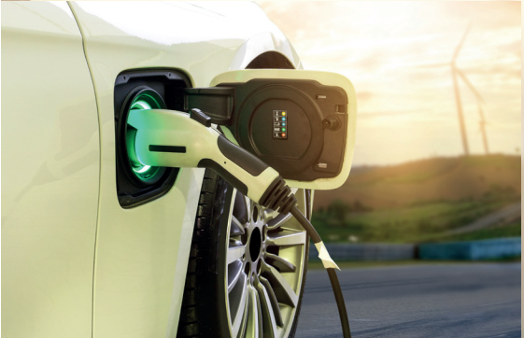
Biofuels and EVs growing but renewable share in transport remains low
Global energy demand in transport increased 45% since 2000
Transport accounts for 23% of global CO₂ emissions
The renewable share of transport grew slightly to 3.3%
Biofuels make up majority of renewable contribution, but sector increasingly open to electrification
Notes:
Regardons à présent le secteur du transport:
Il s’agit du secteur où la demande mondiale augmente le plus (45 % entre 2000 et 2017), en raison de l'augmentation du nombre et de la taille des véhicules légers ainsi que de la demande croissante de transport aérien et de fret.
Dans les transports, la quasi-totalité (95,9 %) des besoins mondiaux en énergie a été couverte par les carburants fossiles et pétroliers.
Il en a résulté une augmentation globale des émissions de CO2 du secteur des transports : Le secteur dans son ensemble est responsable d'environ 23 % des émissions mondiales de CO2 liées à l'énergie en 2016.
La part des énergies renouvelables dans les transports reste négligeable (3,3% en 2016) même si elle a légèrement augmenté par rapport à l’année précédente (3,1%).
- - - - - - -
La majeure partie est fournie par des biocarburants liquides, mais le secteur est de plus en plus ouvert à l'électrification, ce qui offre des possibilités d'intégrer davantage les énergies renouvelables.
Le parc de véhicules électriques sur les routes du monde est passé à plus de 5 millions en 2018, soit une croissance de 63% par rapport à 2017.
Malgré l'augmentation de la production d'éthanol et de biodiesel en 2018, la croissance de l'utilisation des biocarburants pour les transports reste limitée par les incertitudes politiques et la lenteur des progrès dans le développement de carburants renouvelables pour des marchés comme l'aviation.

Slide 15
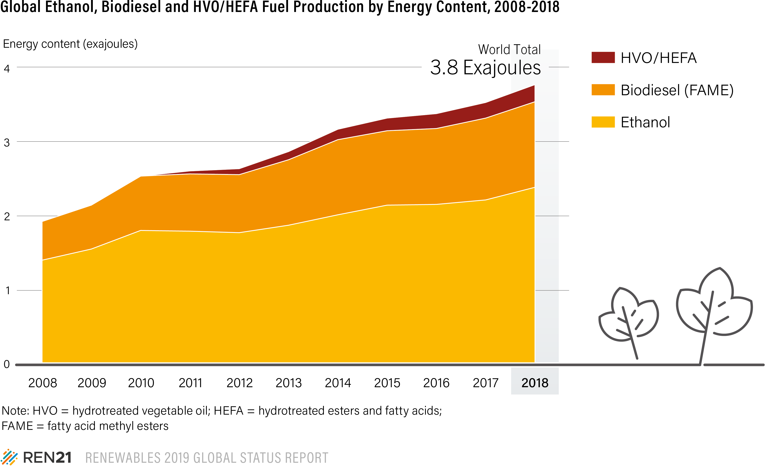
Biofuels production increases, dominated by US and Brazil
Biofuels production increased nearly 7% in 2018
US and Brazil together produced 69% of all biofuels
India: 6th largest ethanol producer (+70% in 2018)
Biomethane and advanced biofuels represent still small shares, though biomethane is growing rapidly in some countries
Notes:
La majeure partie des énergies renouvelables dans les transports vient donc des biocarburants liquides.
En 2018, la production mondiale de tous les biocarburants a augmenté de près de 7 % par rapport à 2017, pour atteindre 153 milliards de litres (soit 3,8 EJ).
Mais seulement deux pays, les États-Unis et le Brésil, dominent la production – ils produisent ensemble 69 % de tous les biocarburants en 2018 - suivis par la Chine (3,4 %), l'Allemagne (2,9 %) et l'Indonésie (2,7 %).
En 2018, l'éthanol représentait environ 63 % de la production de biocarburants, le biodiesel FAME 31 % et les carburants issus de l’hydrotraitement des huiles et matières grasses végétales 6 %.
Notons aussi que la contribution du biométhane augmente rapidement dans certains pays, notamment en Europe. Néanmoins, il représentait moins de 1 % du total des biocarburants en 2018.
Mais le secteur est de plus en plus ouvert à l'électrification, ce qui offre des possibilités d'intégrer davantage les énergies renouvelables

Slide 16
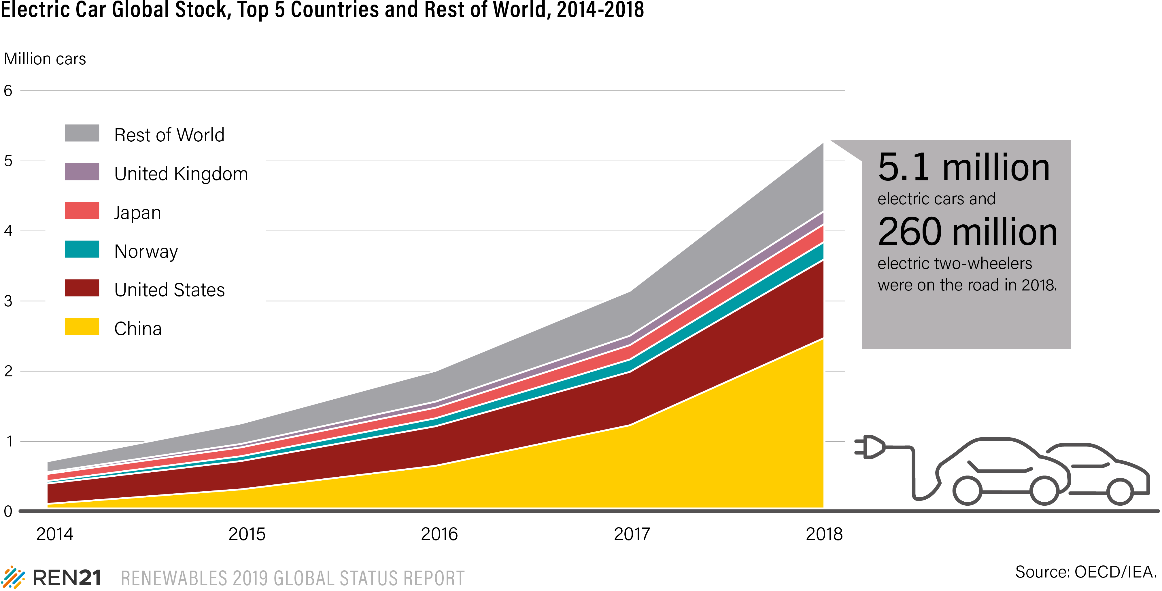
Electric passenger vehicle stock grew over 60%
260 million electric two-wheelers and 40 million electric three-wheelers
More than 2 million electric cars (inc. battery EV and plug-in hybrid EV) were sold in 2018 (+68%)
EV markets highly concentrated: 50% in China, 22% in the US; 40% of all EVs in just 20 cities
Share of RE power: around 25%
Notes:
Le véhicule électrique constitue bien une tendance de fonds et une réelle opportnité.
Le stock mondial de VE pour particuliers est en forte croissance, avec un total de plus de 5,1 millions d'unités en 2018, soit une augmentation de 63 % par rapport à 2017.
En 2018, environ 2 millions de voitures électriques neuves ont été vendues, soit une augmentation des ventes de 68% par rapport à l'année précédente. Les premiers marchés sont la Norvège (env. 50%), l’Islande (19%), la Suède (8%) et les Pays-Bas (7%).
Néanmoins, les voitures électriques représentaient encore une faible part de l'ensemble des voitures particulières, soit un peu plus de 2,1 % à la fin de l'année.
Les marchés des VE restent également très concentrés : fin 2018, 40 % de tous les VE utilisés étaient regroupés dans seulement 20 villes (qui représentent ensemble 3 % de la population mondiale).
Et nous ne pouvons pas encore parler de transition mondiale car la Chine et les Etats-Unis détenaient à eux seuls près de 72 % du stock mondial de VE à la fin de 2018.
Il faut considerer l’essort du Véhicule Electrique comme une réelle opportunité (si il est lié à une politique d’augmentation des EnR dans le mix electrique et si le stockage est utilisé pour stabiliser le reseau).
Dans ce domaine, L’Autriche fait figure de bon élève, car c’est le seul pays qui lie les subvention d’achat de VE à la souscription d’un contrat d’approvisionnement d’électricité à partir des renouvelables.
- - - - - -
Enfin, il faut noter que le véhicule électrique est aujourd’hui une solution pour le transport de passagers mais pas encore pour le transport routier (camions), le maritime ou l’aviation. D’où l’importance de developer également les carburants synthétiques issus d’électricité renouvelable.
- - - - -
Les ventes de nouveaux VE ont atteint près de 1,3 million d'unités en Chine, dont un peu plus d'un million de VE passagers, dont les ventes ont augmenté de plus de 80 % d'une année sur l'autre.
La Norvège est restée en tête de la part de marché totale des voitures électriques neuves, et environ la moitié des voitures neuves immatriculées dans le pays en 2018 étaient soit des véhicules électriques à batterie (BEV) (30%) soit des véhicules électriques hybrides rechargeables (PHEV) (20%). Les marchés suivants étaient l'Islande (19 %), la Suède (8 %) et les Pays-Bas (7 %).

Slide 17
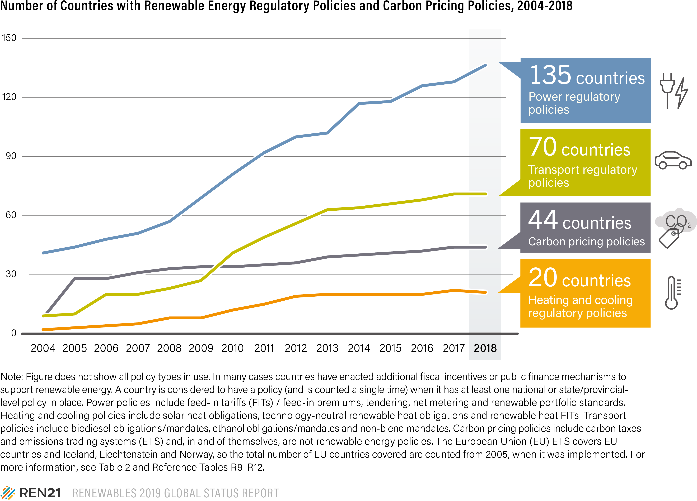
Advances in power made possible by policy support, other sectors lag
Renewable power auctions were held in at least 48 countries
FITs in place in 111 countries
No new countries adopted biofuels mandates
The number of countries with H&C regulatory policies fell by 1
Notes:
Advances in the power sector have been made possible by consistent and ambitious policy support.
Renewable power auctions were held in at least 48 countries worldwide in 2018, up from 29 countries in 2017. Feed-in tariﬀ (FIT) policies continue to play a role in policy schemes and were in place in 111 countries by year’s end. Also, net metering policies existed in at least 66 countries at the national or sub-national level.
Outside the power sector, policies for renewables have advanced at a slower pace.
No additional countries adopted biofuel mandates in 2018, but some countries that had mandates in place added new ones, and several existing mandates were strengthened.
No new countries added regulatory incentives or mandates for renewable heating and cooling in 2018, and Kenya suspended its solar water heating regulation in August 2018.
Carbon pricing policies are among the policy mechanisms that can stimulate interest in low-carbon, renewable energy technologies to meet climate mitigation goals.
By the end of 2018, these covered 44 countries, while policies were scheduled for implementation in at least two more countries in 2019 (Argentina, Singapore)

Slide 18
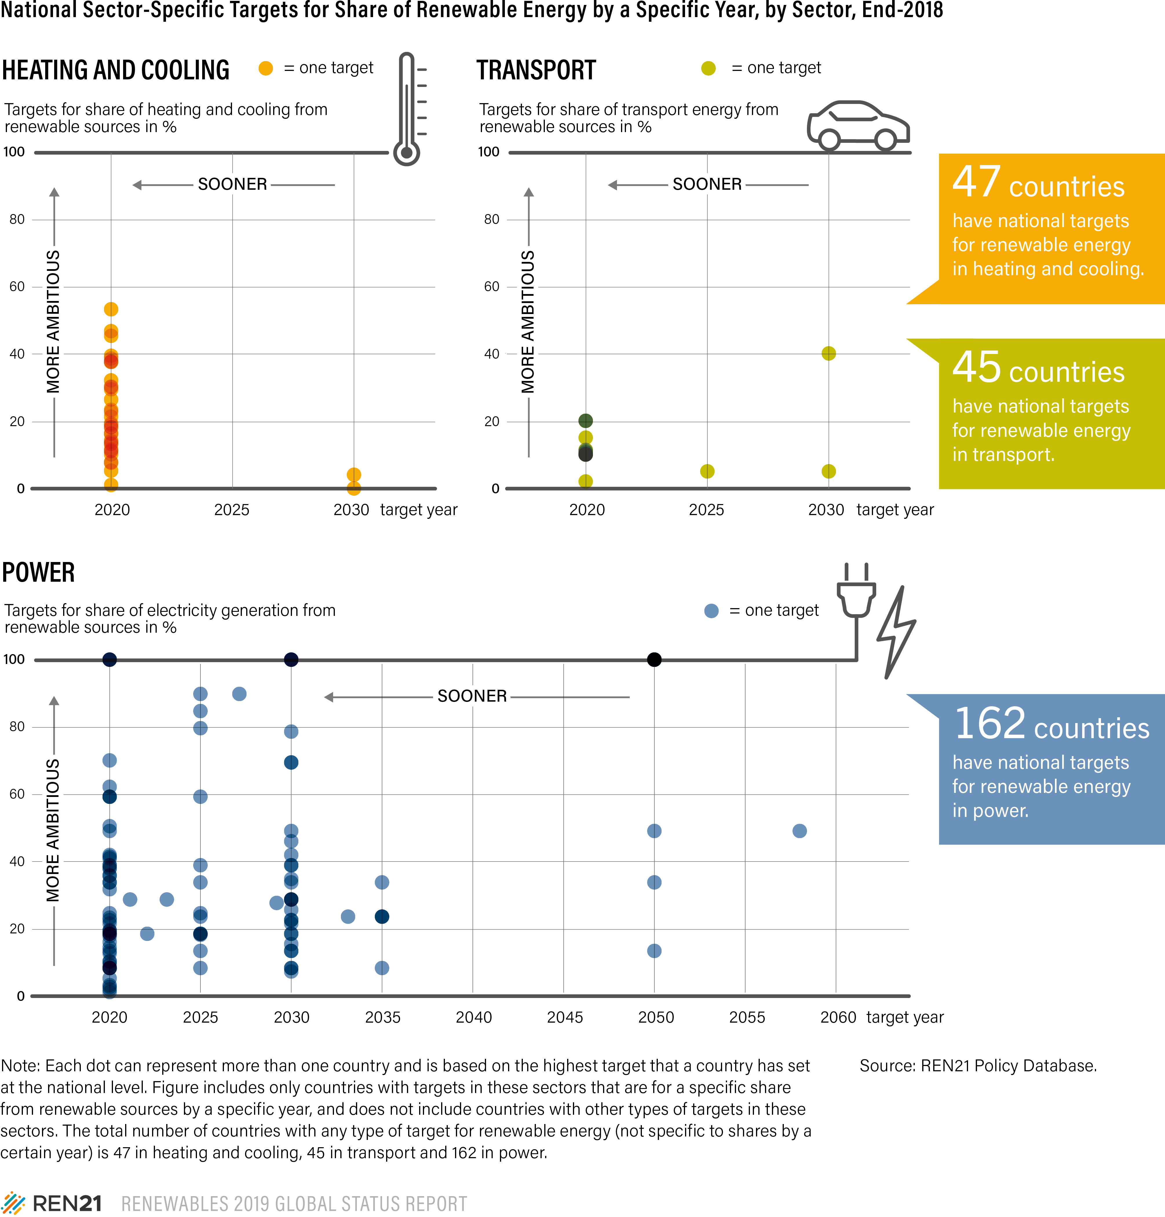
Targets uneven across sectors
Power sector: targets remain more ambitious, more numerous than in heating and cooling and transport
Fewer than 10 countries and states/provinces had economy-wide targets for at least 50% renewable energy
Still only 1 country with a target for 100% renewables in total final energy
Notes:
Similarly, targets for renewable energy are more ambitious in the power sector than in the heating, cooling and transport sectors, with some countries – and many more sub-national governments – aiming for 100% renewable electricity.
Targets for renewable heating, cooling and transport are not only far less numerous, but also often far less ambitious.
This trend has continued despite the much greater contribution of the heating, cooling and transport sectors to total final energy consumption.
The 100% renewable energy movement continued to gain traction worldwide in 2018. However, the majority of commitments apply only to the power sector.
Denmark remains the only country with a target for 100% renewables in total final energy.

Slide 19
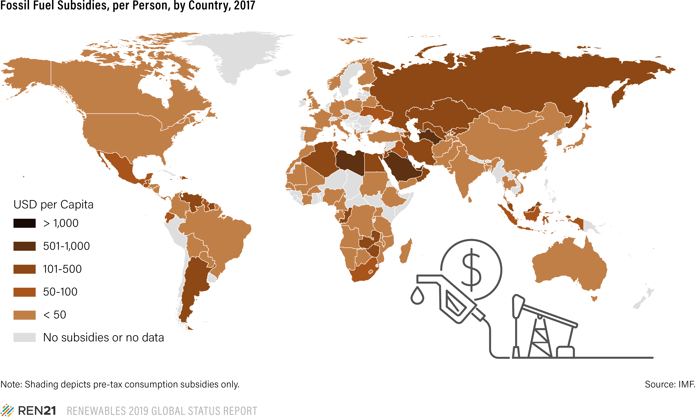
Not a level playing field: fossil fuel subsidies are still widespread
Global subsidies for fossil fuel consumption reached an estimated USD 300 billion in 2017
an 11% increase from the year before
about double the estimated support for renewable power generation
Fossil fuel subsidies remained in place in at least 115 countries in 2017
73 countries provide subsidies of more than USD 100 million each
Notes:
ASIA: numerous countries with FF reserves or dependency
weak policy support for renewable
Asia is responsible for 40% of global emissions -
Need an annual investments in renewables and energy efficiency by roughly a factor of 6 by 2050 as compared to 2015
Renewable energy is not competing on a level playing field.
Global subsidies for fossil fuel consumption reached an estimated USD 300 billion in 2017, an 11% increase from the USD 270 billion the year before, and about double the estimated support for renewable power generation.
of roughly 6 fold investment
While at least 40 countries have undertaken some level of fossil fuel subsidy reform since 2015, fossil fuel subsidies remained in place in at least 115 countries in 2017, with at least 73 countries providing subsidies of more than USD 100 million each.
Whether supported by subsidies or not, low fossil fuel prices encourage further demand for fossil fuels and challenge renewable energy markets, especially in the heating and transport sectors.
Additionally, the coal industry and major oil and gas companies spend upwards of USD 200 million each year lobbying to delay, control or block policies aimed at addressing climate change and on advertisements to influence public opinion.

Slide 20
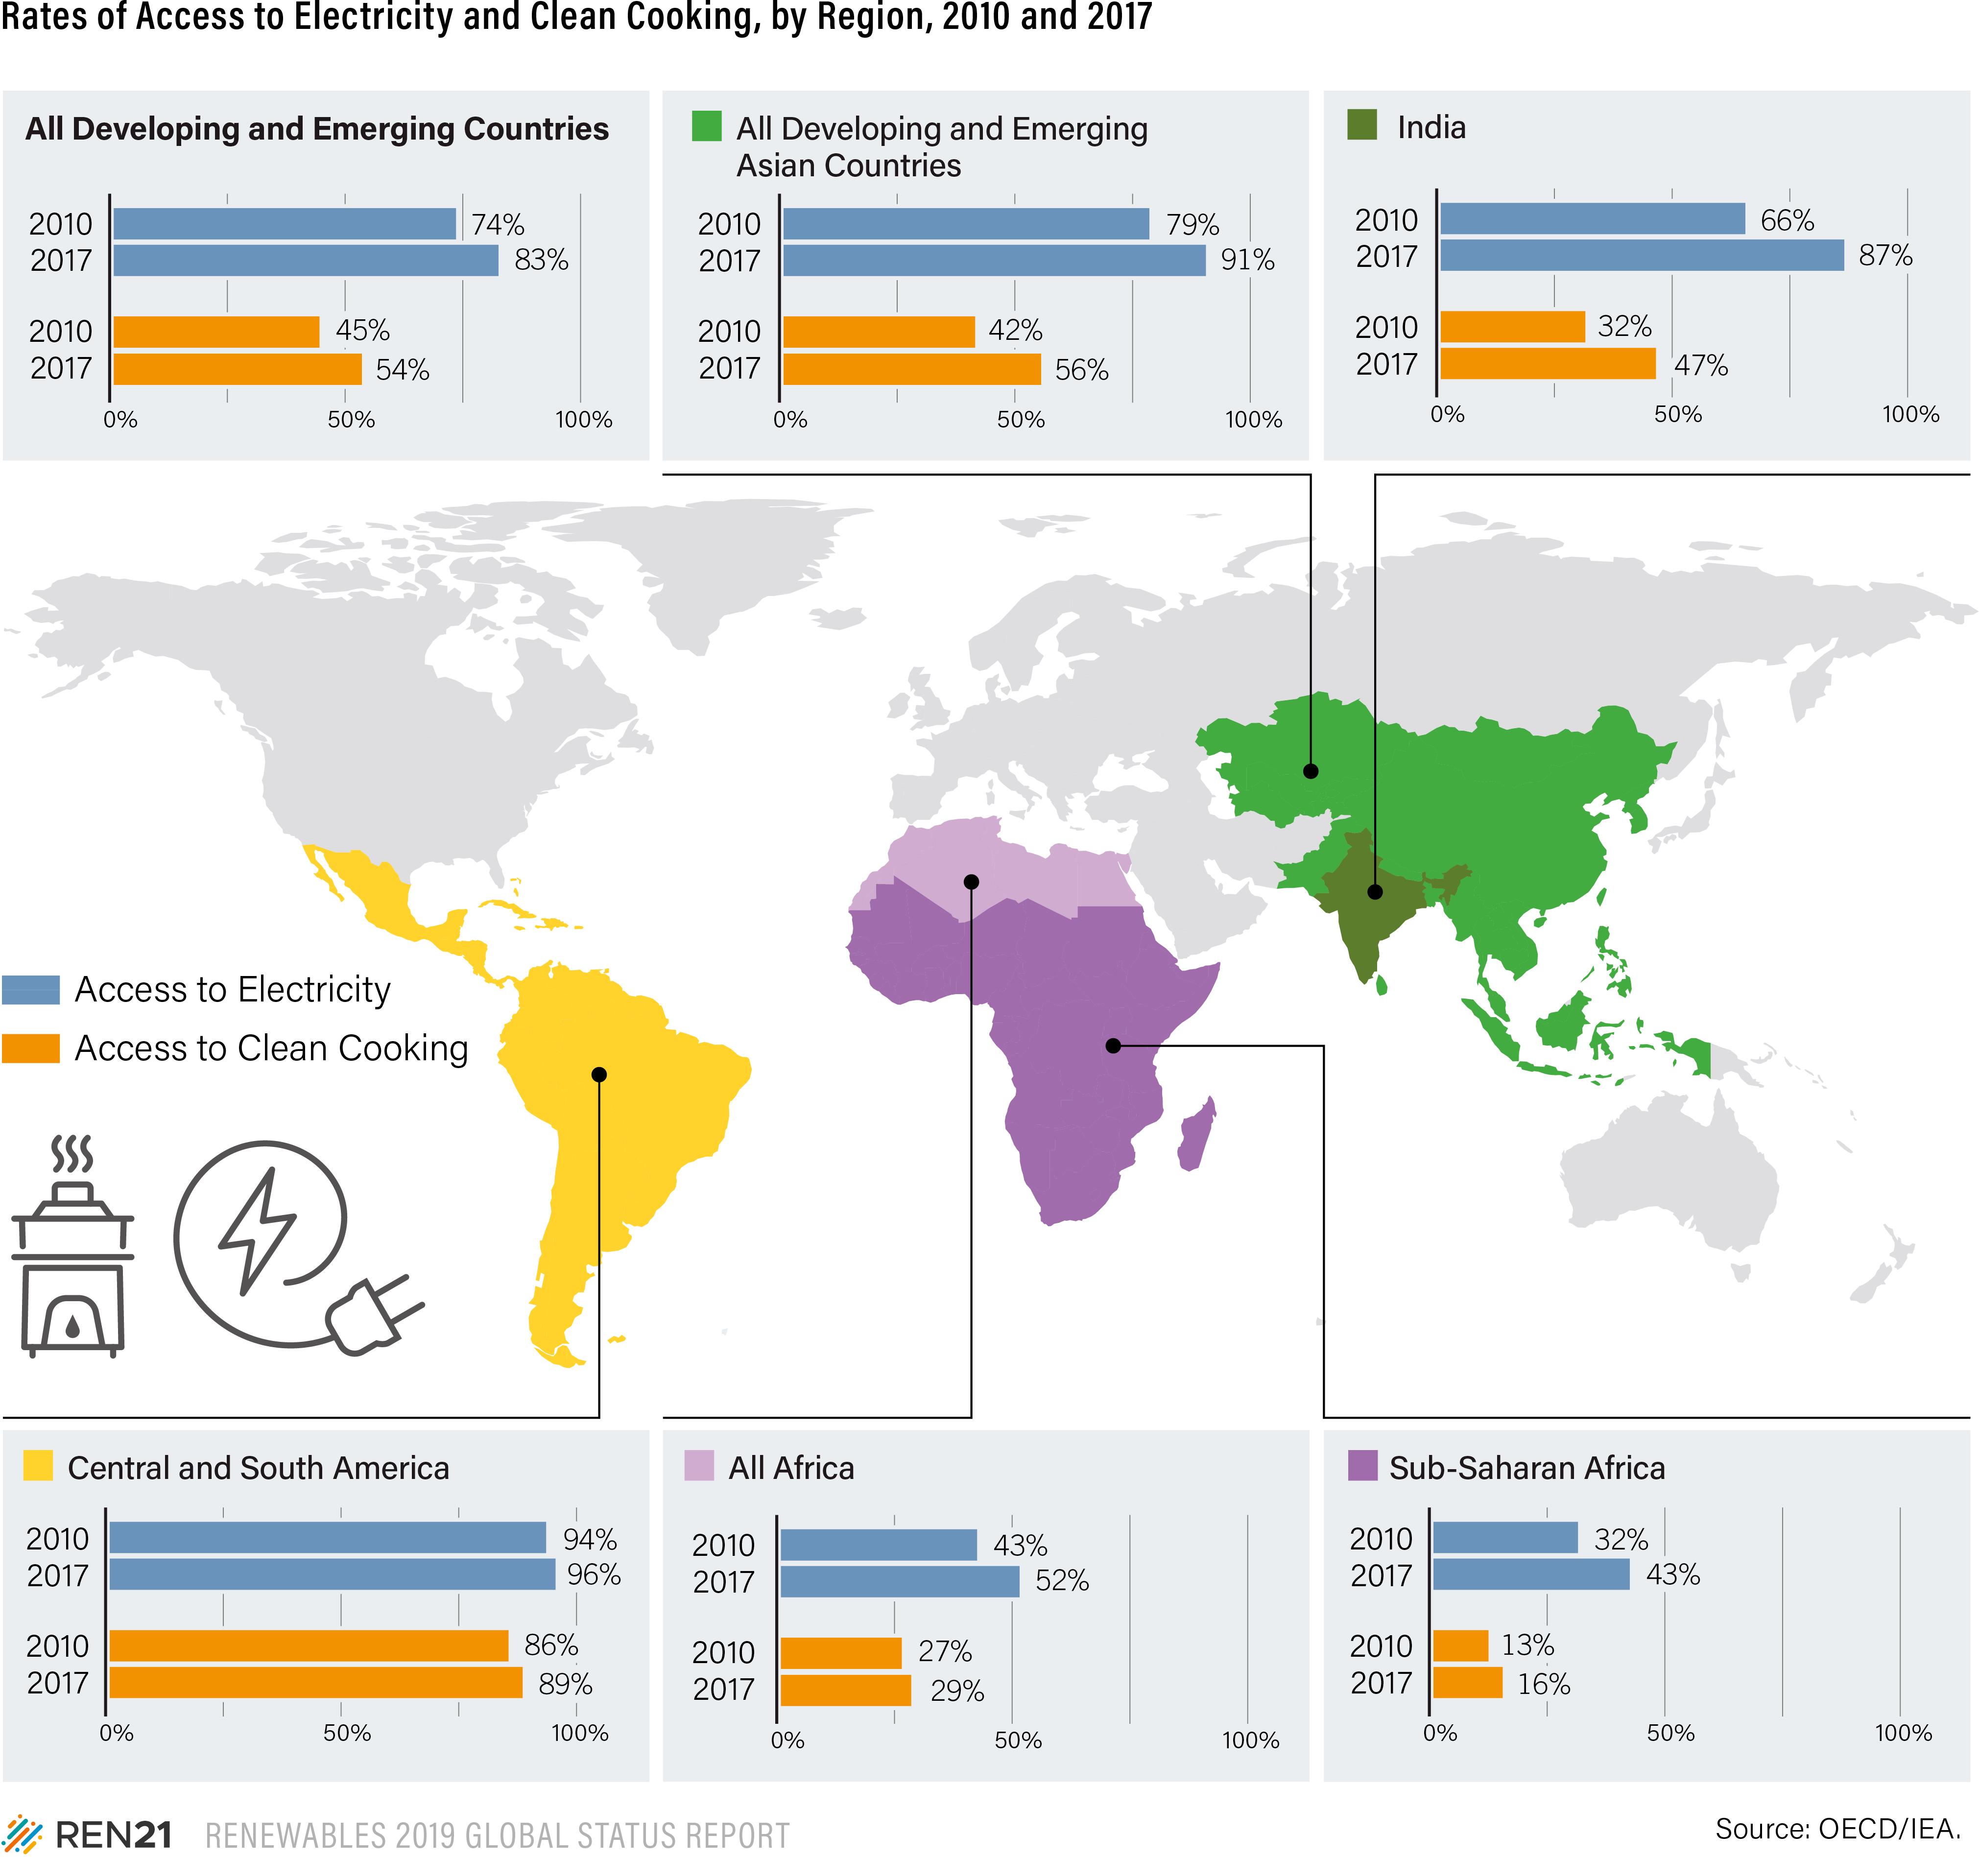
Access to energy expanding
In 2017:
13% of the global population lived without electricity – approx. 992 million people
36% of the global population lived without clean cooking – approx. 2.7 billion people
A majority live in rural areas of sub-Saharan Africa and Asia-Pacific regions
Notes:
Part of Asia are fully (or almost fully) electrified
Parts are not but overall making better progress that SSA
For the first time, the number of people living without access to electricity fell below the 1 billion mark in 2017 (representing a global population share of 13%).
In contrast, almost three times more people (or 2.7 billion) are still living without access to clean cooking facilities (it represents 36% of the global population).
In places where the electric grid does not reach or is unreliable – mostly Sub-Sharan Africa and Asia-Pacific – distributed renewable for energy access (DREA) technologies provide the most cost-effective options for generating electrical and mechanical power, heating water and space, cooking and baking, and enabling various productive uses.
In 2018, an increasing number of national governments demonstrated their interest in DREA systems by enhancing the enabling environment

Slide 21
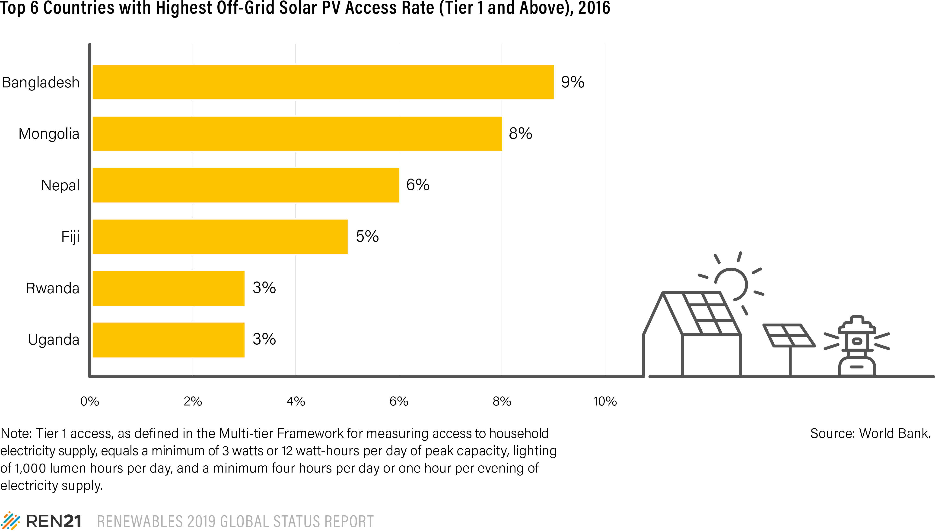
Off-grid solar PV is increasingly widespread
150 million people across Africa and Asia benefit from energy access through off-grid solar systems
5% of the population in Africa
2% of the population in Asia
Notes:
Already, an estimated 5% of the population in Africa and 2% of the population in Asia – or nearly 150 million people across these two regions – benefit from energy access through oﬀ-grid solar systems (i.e. solar lights/lanterns, solar home systems and solar mini-grids)
For example, off-grid solar systems provides electricity access to about 9% of the population of Bangladesh, or 3% of the population in Rwanda as well as in Uganda.

Slide 22
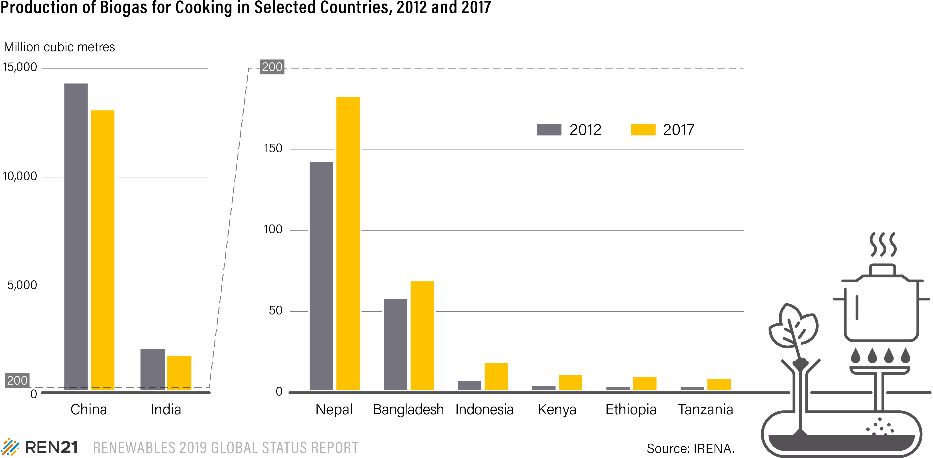
Production of biogas for cooking expands in new markets
125 million people using biogas for cooking
China = 111 million
India = 9 million
China: 13.1 billion m³ of biogas produced for cooking;
India: 1.7 million m³
Use of biogas for cooking grew over the past five years
Asia: Bangladesh, Cambodia, Indonesia, Nepal
sub-Saharan Africa: Burkina Faso, Ethiopia, Kenya, Tanzania,Uganda
Notes:
An estimated 125 million people worldwide used biogas for cooking in 2017, mainly in China (111 million) and India.
Although the production of biogas for cooking decreased between 2012 and 2017 in the traditional markets of China and India, it increased greatly in other Asian countries such as Bangladesh, Cambodia, Indonesia and Nepal.
On the African continent, biogas production increased nearly 200% during that period to around 44 million cubic metres, mainly in the five countries engaged in the Africa Biogas Partnership Programme: Burkina Faso, Ethiopia, Kenya, Tanzania and Uganda.
Overall, however, the market for clean cooking solutions continues to be dominated by liquefied petroleum gas (LPG).

Slide 23
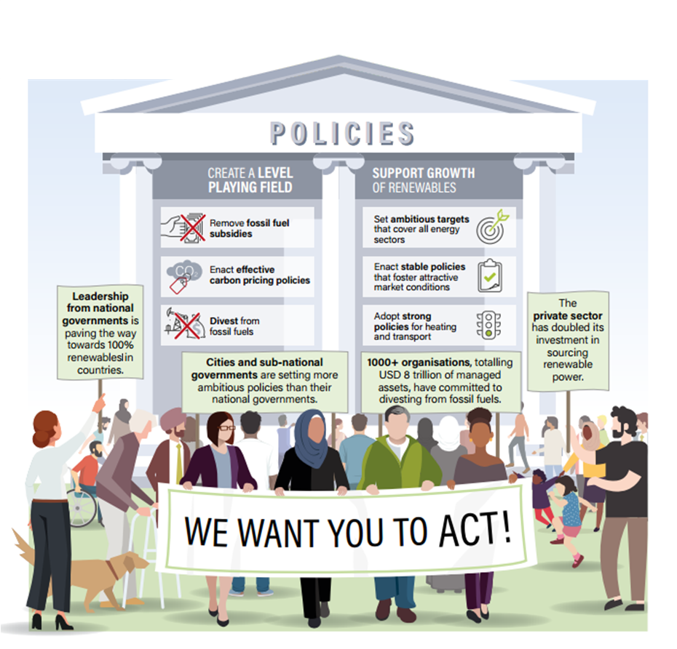
The transition is possible – positive examples are showing the way!
Leadership from national governments is paving the way towards 100% renewables in countries.
Cities and sub-national governments are setting more ambitious policies than their national governments.
1000+ organisations, totaling USD 8 trillion of managed assets, have committed to divesting from fossil fuels.
The private sector has doubled its investment in sourcing renewable power.
Notes:
Pour conclure je me suis demandé si je devais finir par un message plutôt positif ou négatif.
Et bien il sera plutôt négatif au regard de l’urgence climatique.
Bon malgrés tout il est clair qu’une la transition est possible.
Cette transition sera possible par la mise en oeuvre de cadres politiques clairs et ambitieux.
Les gouvernements peuvent s’appuyer sur des initiatives (locales) qui soutiennent déjà la transition énergétique.
Des pays comme le Costa Rica, qui produit déjà près de 100 % de son électricité à partir de sources renouvelables, a annoncé son intention d'interdire complètement les combustibles fossiles et de devenir le premier pays décarboné au monde. On peut également citer l’Irlande qui est devenu le premier pays à s'engager à désinvestir son fonds souverain du charbon, du pétrole et du gaz naturel.
Au niveau infranational, les villes jouent un rôle de premier plan dans le déploiement des énergies renouvelables et adoptent certains des objectifs les plus ambitieux pour les énergies renouvelables au niveau mondial. Dans de nombreux cas, ces engagements et ces mesures dépassent même l'ambition de leur pays.
Sur le plan financier, plus de 1 000 organisations se sont engagées à désinvestir leurs actifs liés aux énergies fossiles. Ils gèrent tout de même plus de 8 000 milliards de dollars d'actifs financiers.
Enfin, le secteur privé intensifie son approvisionnement en énergies renouvelables. En 2018, 13 GW de capacité renouvelables ont été signées, soit plus du double qu’en 2017.

Slide 24
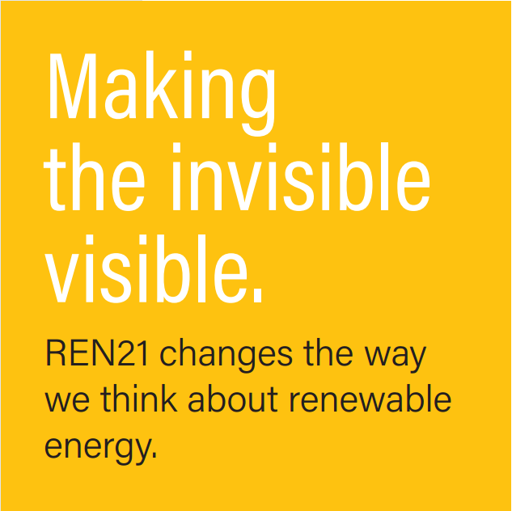
Renewable Energy Policy Network for the 21st Century
Global Status Report:
yearly publication since 2005
Renewables in Cities
Status Report:
Regional Reports
Global Futures Reports
Thematic Reports
REN21 Academy
International Renewable Energy Conferences
SAVE THE DATE:
22-25 October 2019
Seoul, Republic of Korea
^{www.ren21.net/gsr}
^{Subscribe to our newsletter}
^{www.ren21.net}

