Slide 1
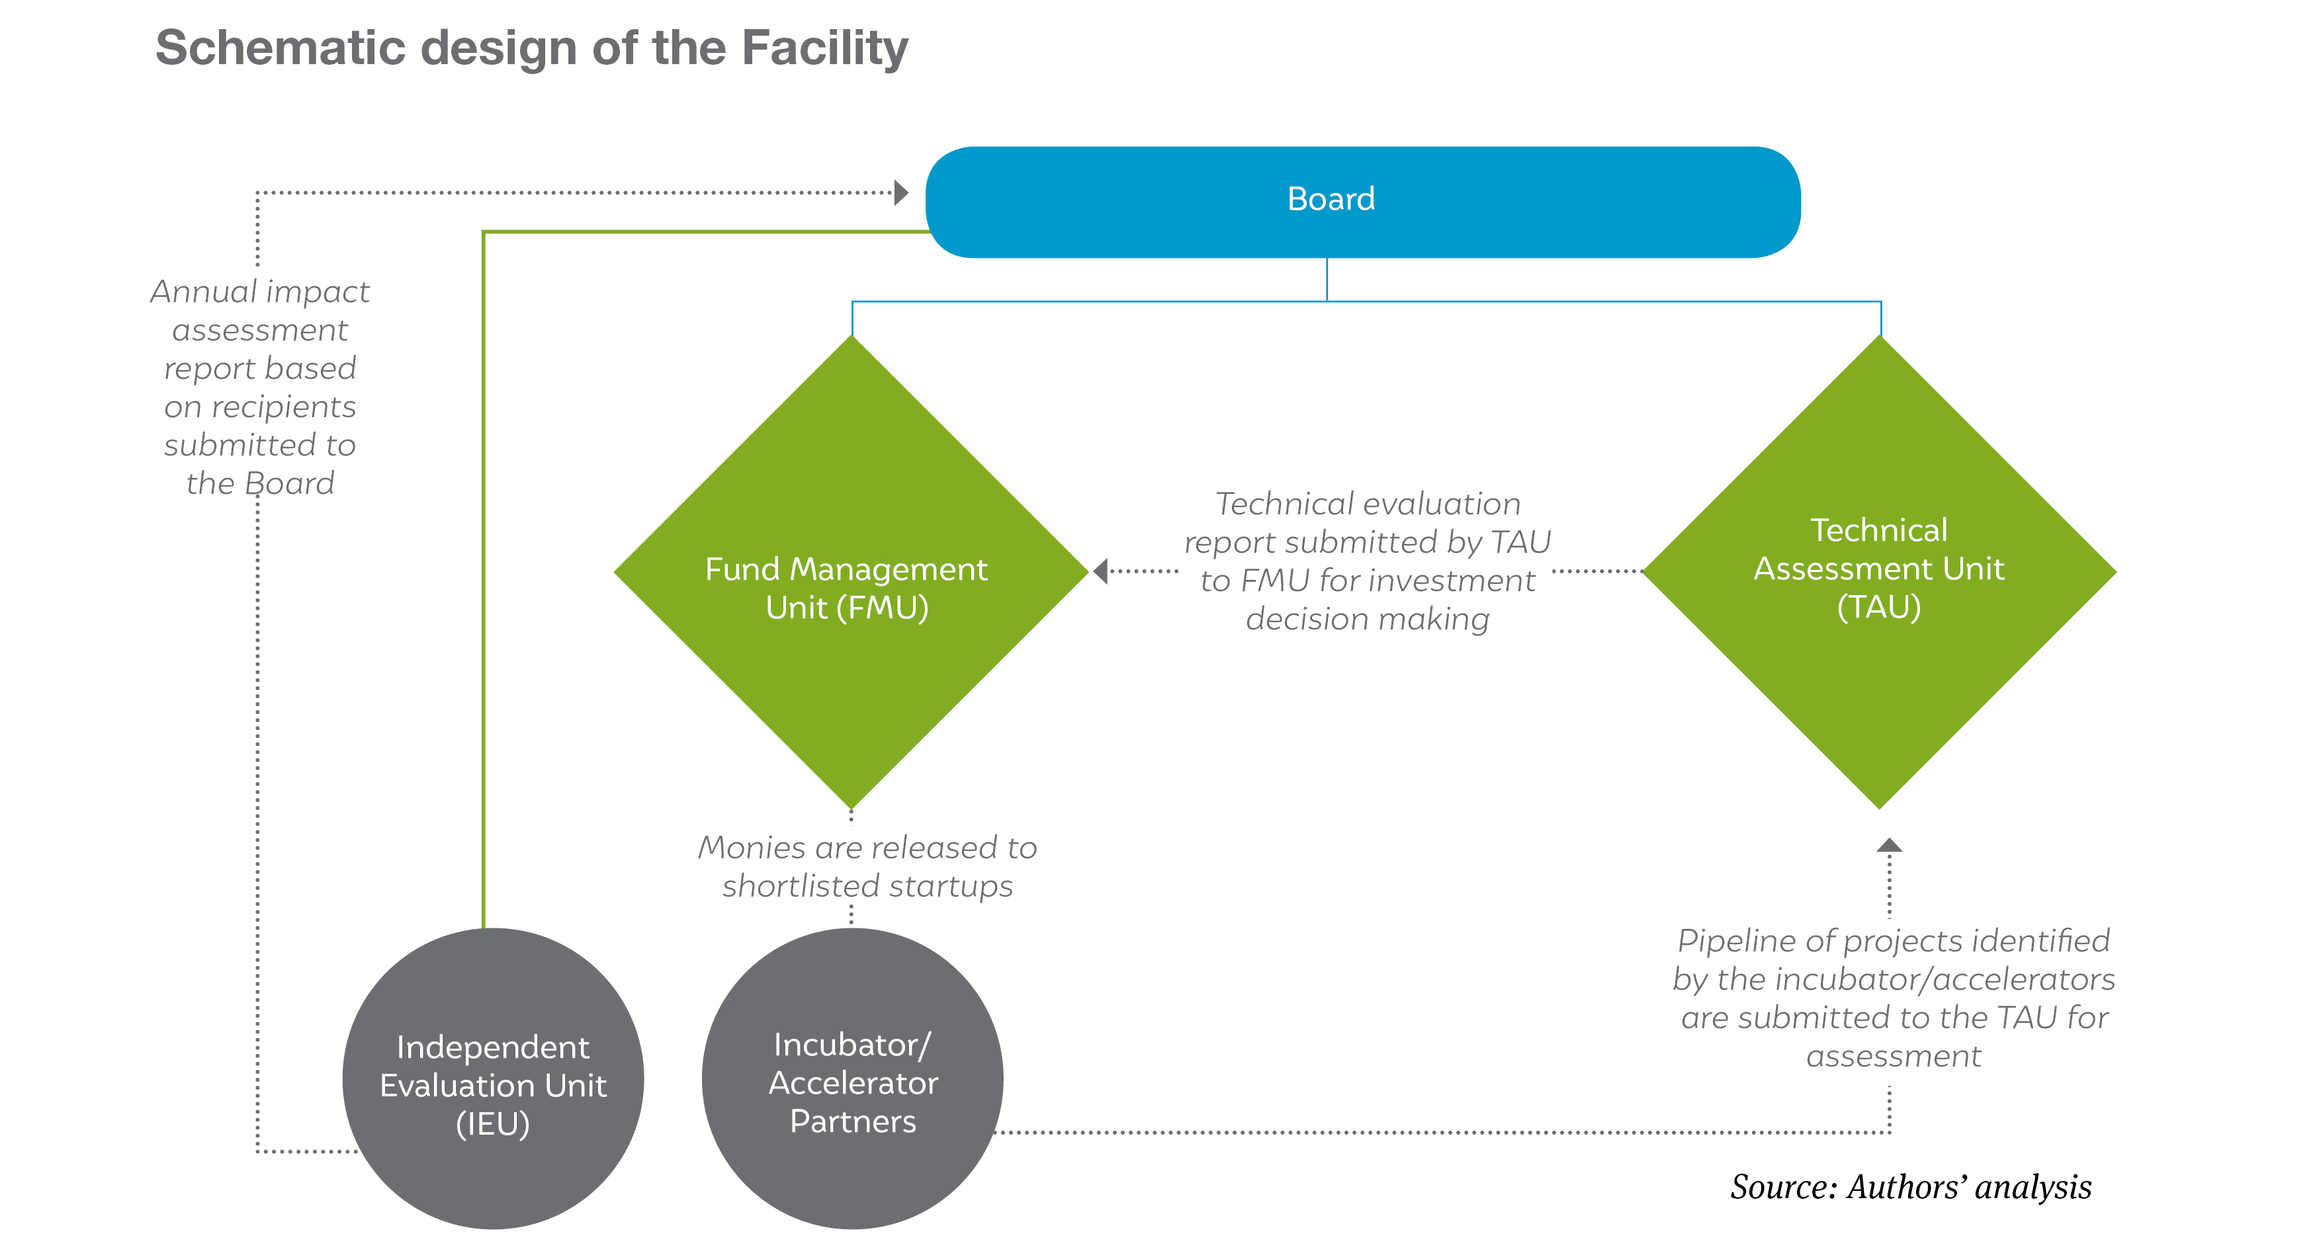
Business Demonstration Facility
Source: Chawla and Aggarwal, Financing Clean Energy innovation – Feasibility Study, CEEW Centre for Energy Finance, July 2019

Slide 2
Thank you
Join the conversation by using #EnergyHorizons
ceew.in | @CEEWIndia

