Slide 1
Financing the energy transition in emerging economies The role of evidence and bespoke solutions
Kanika Chawla and Rishabh Jain
CEEW Centre for Energy Finance
Energy Horizons 2019, New Delhi
19 July 19
© Council on Energy, Environment and Water, 2019

Slide 2
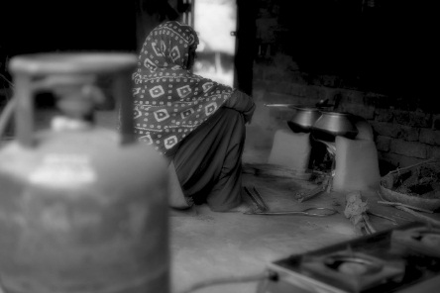
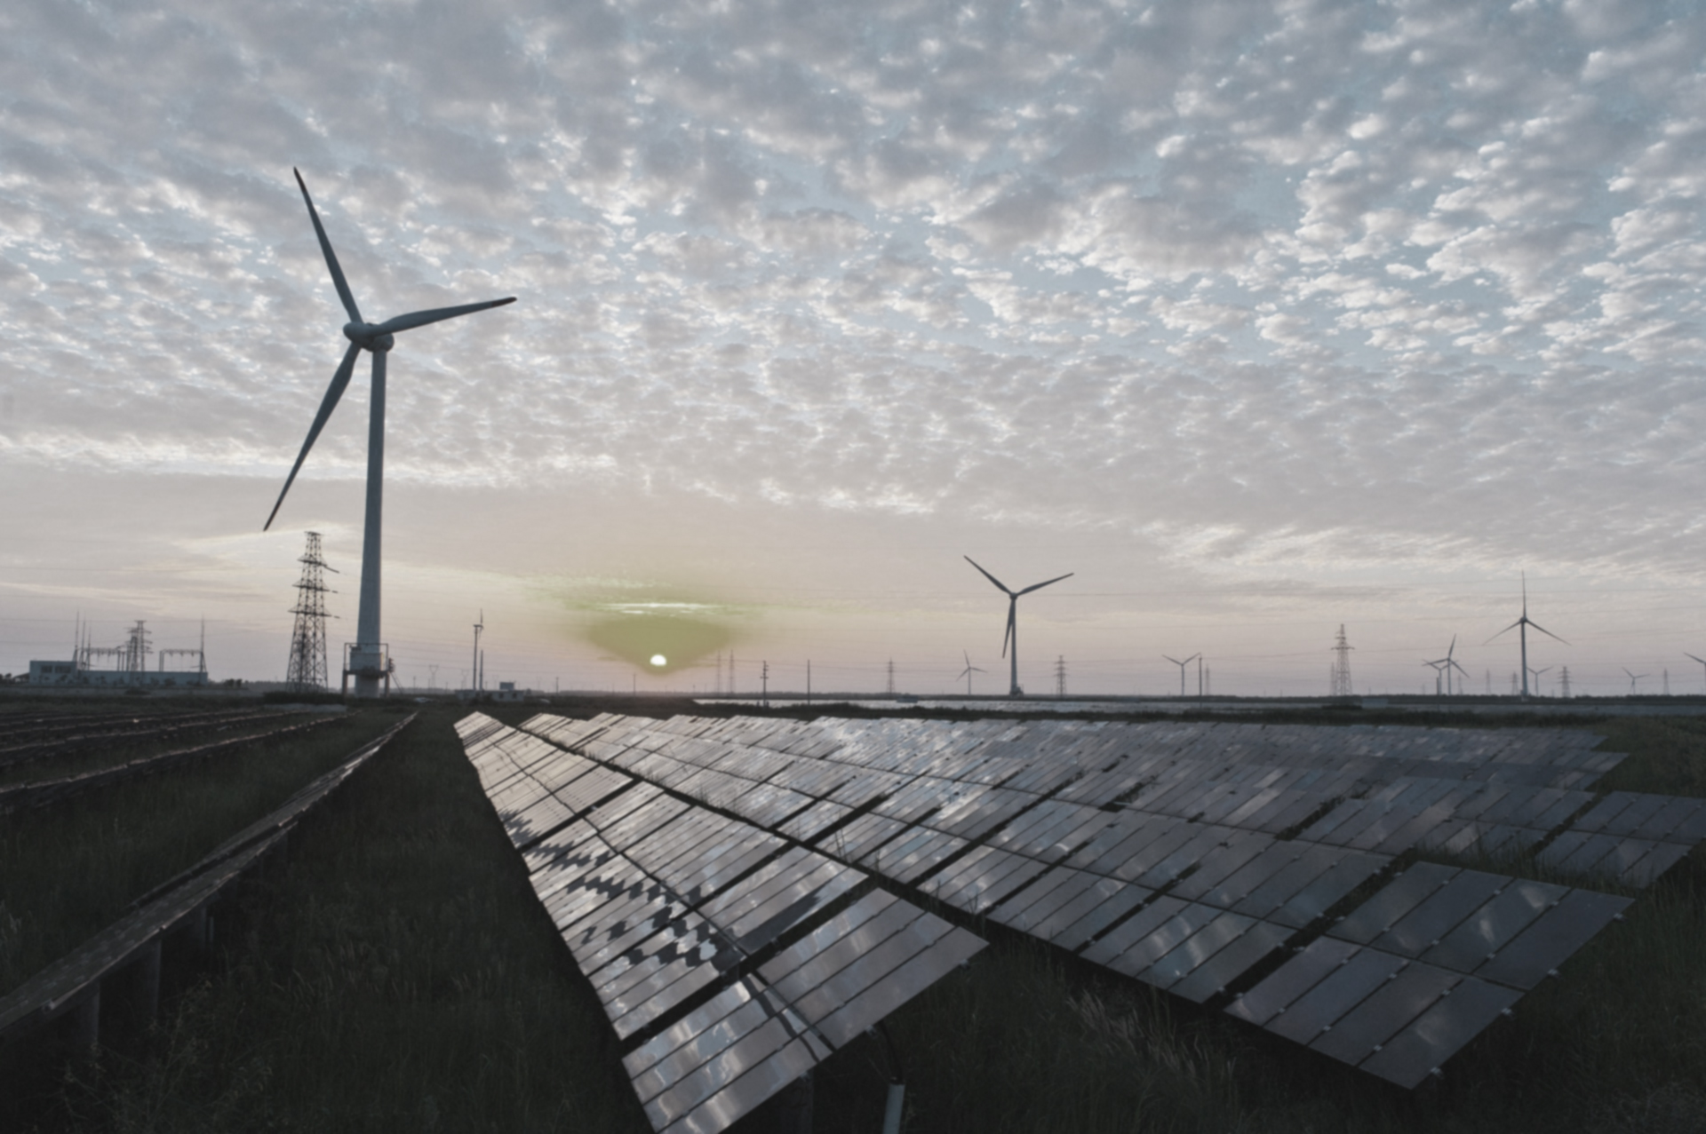
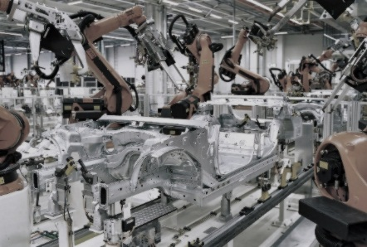
CEEW – Among South Asia’s leading policy research institutions
^{Energy Access}
^{Renewables}
^{Power Sector}
Industrial Sustainability & Competitiveness
^{Low-Carbon Pathways}
^{Risks & Adaptation}
^{Technology, Finance, & Trade}
^{Centre for Energy Finance}

Slide 3
Deepening Markets
Increasing Transparency
Attracting Capital

Slide 4
Market Intelligence

Slide 5
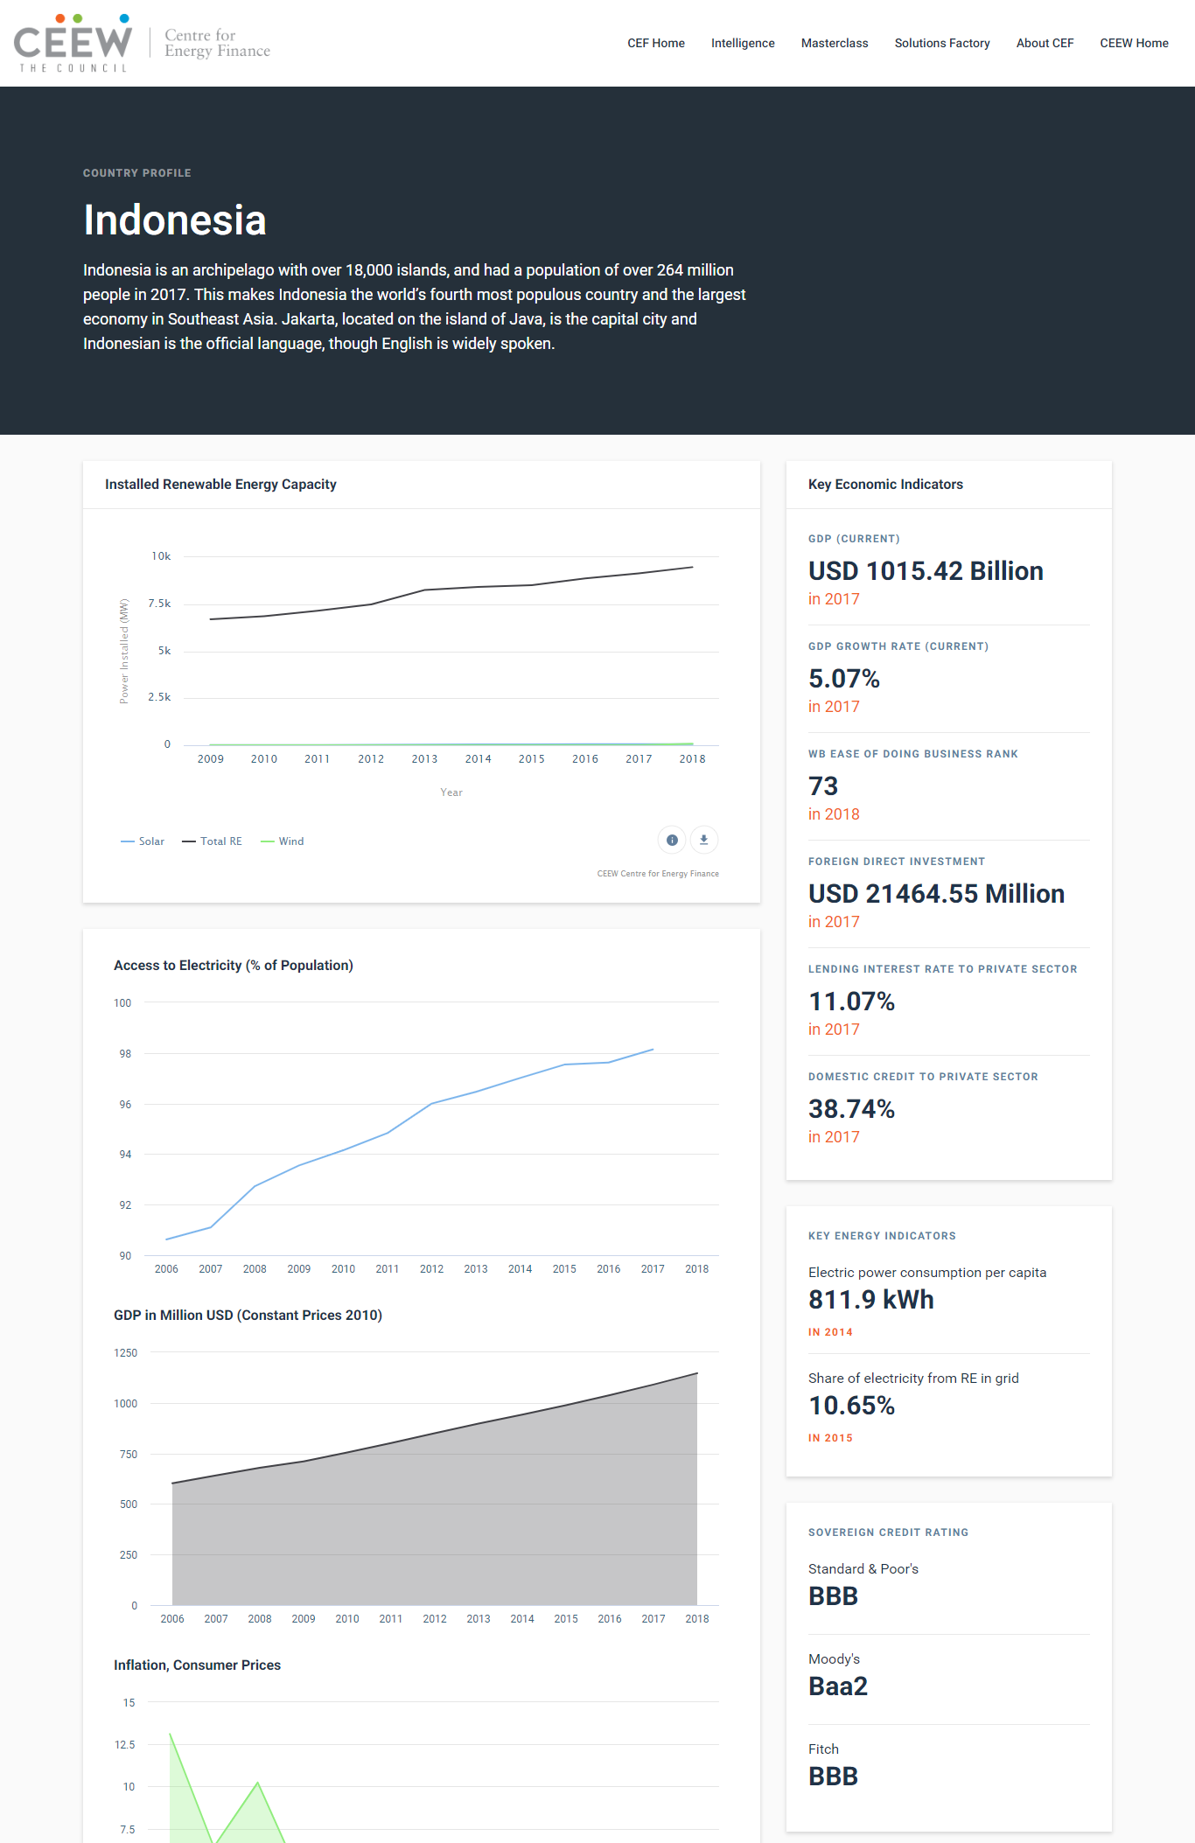
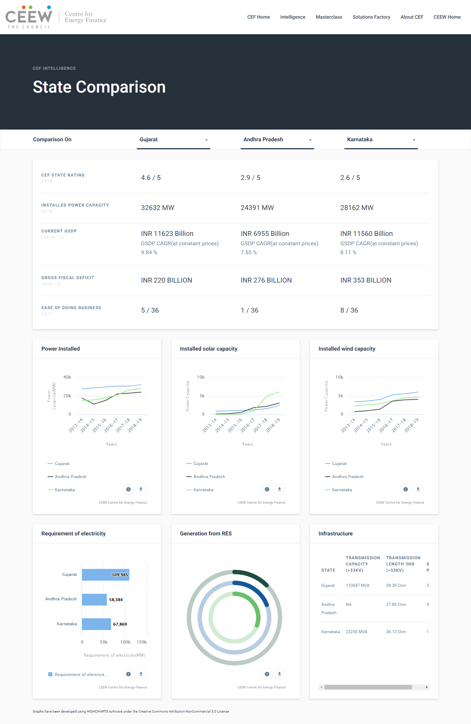
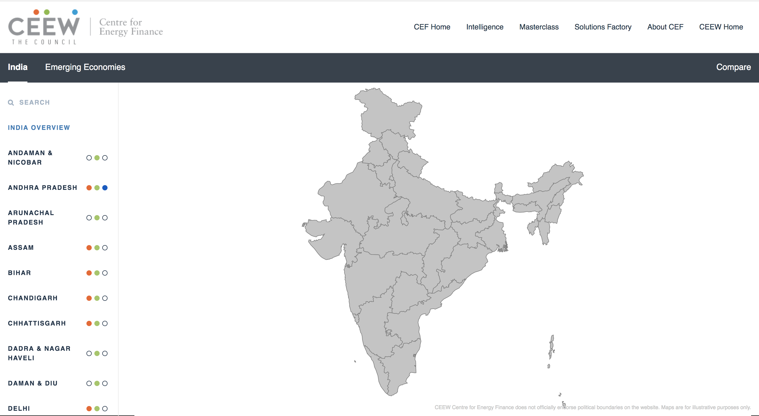
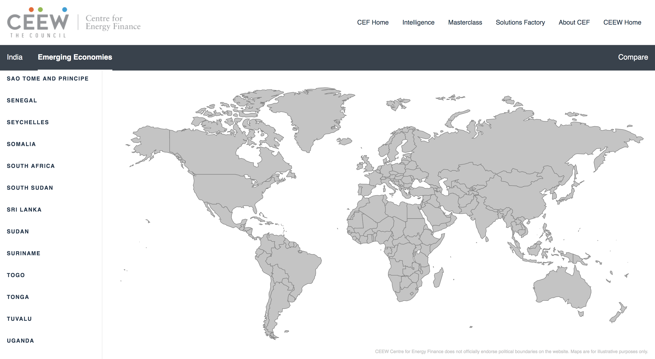
CEF Intelligence – dynamic & real-time data dashboard
Information on 50+ countries
Possibility to explore an emerging
country or an Indian state
Compare countries or states on various parameters
Economic indicators
Energy indicators
Key indicators
Imp trends
Infra indicators
Source: CEEW Centre for Energy Finance

Slide 6
CEF Intelligence – dynamic & real-time data dashboard
Key information
Imp
trends
Key
regulations
Imp indicators
Source: CEEW Centre for Energy Finance

Slide 7
Solutions Factory

Slide 8
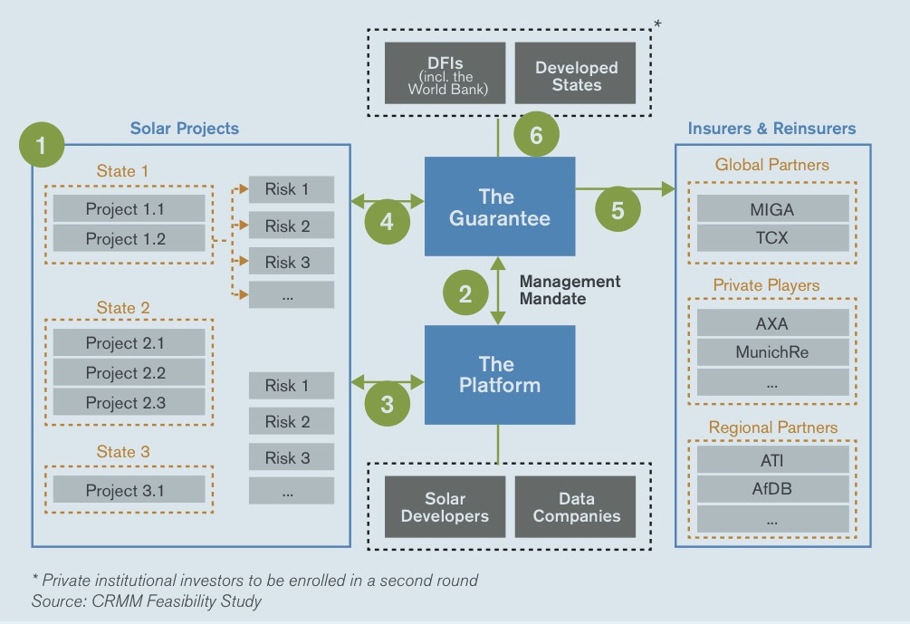
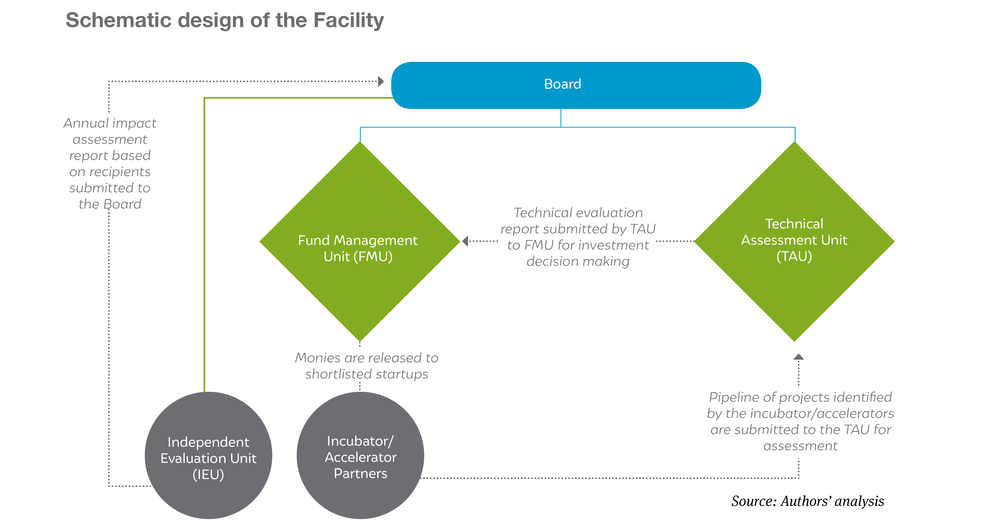
CEF Solutions Factory – market responsive financial interventions
Source: Common Risk Mitigation Mechanism Feasibility Study 2017; Business Demonstration Facility Feasibility Study 2019

Slide 9
Clean Energy Investment Trends 2019

Slide 10
Market concentration of developers sanctioning new projects remains high
Top developers with access to financing on favourable terms have the advantage in structuring competitive bids
Even top developers have limited capacity to finance new projects every year
Considerations of portfolio diversification across locations and offtakers could be impacting bidding patterns
Industry consolidation in the wind industry is reflected in reduced churn in 2018
CEEW CEF – IEA Clean Energy Investment Trends 2019

Slide 11
Debt financiers’ risk perceptions for renewable energy projects have declined
Interest rate spreads for lending to solar PV and wind projects have declined by 75-125 basis points from 2014-2018
Capital structures for solar PV have become more debt-heavy whereas those for wind have remained stable
CEEW CEF – IEA Clean Energy Investment Trends 2019

Slide 12
Debt financiers’ risk perceptions for renewable energy projects have declined
Median loan tenures have lengthened for both solar PV and wind
Long-tenure debt enabled by reset clauses for interest rates and provisions for refinancing
Thermal projects developed by state-owned integrated utilities appear to benefit from some financing advantages vis-à-vis other thermal projects and RE projects
More debt-heavy capital structures (debt-to-equity ratio of 80:20)
Longer loan tenures (16-24 years)
Loans structured at a single fixed rate, though with provisions for reset
CEEW CEF – IEA Clean Energy Investment Trends 2019

Slide 13
Thank you
Join the conversation by using #EnergyHorizons
ceew.in | @CEEWIndia

