Slide 1
Electricity systems of the future in the economies of the future
Kanika Chawla
Director, CEEW Centre for Energy Finance
Energy Horizons 2019, New Delhi
18 July 2019
© Council on Energy, Environment and Water, 2019

Slide 2
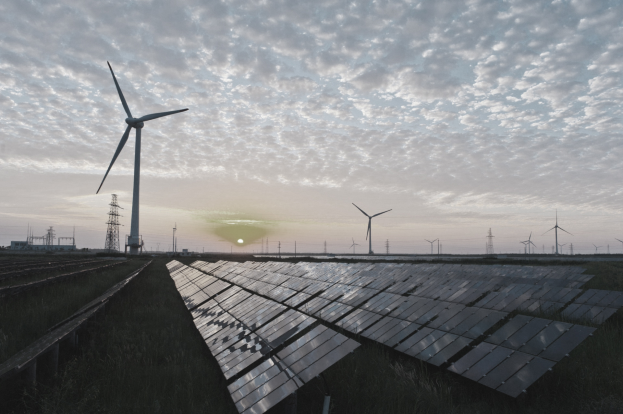
CEEW – Among South Asia’s leading policy research institutions
^{Energy Access}
^{Renewables}
^{Power Sector}
Industrial Sustainability & Competitiveness
^{Low-Carbon Pathways}
^{Risks & Adaptation}
^{Technology, Finance, & Trade}
^{Centre for Energy Finance}

Slide 3
An evolving market design for electricity…
1
2
3
De-carbonization
International commitments and domestic priorities are driving a shift towards a greater share of renewable energy in electricity generation
Decentralization
The power sector is shifting from unidirectional power flows (generator to consumer) to bi-directional flows with increased consumer-led, dispersed generation
Digitization
A shift in focus from supply to demand side thinking requires the use of digital technologies to aggregate ‘prosumers’, forecast intermittent power and operate the grid in an efficient manner
Are policies and regulatory regimes in emerging economies equipped to keep pace with these sectoral trends?
Source: Author

Slide 4
But the transition in each country is unique, requiring bespoke interventions
Offtake risk and power sector design
Execution risk and the ease of doing business
Grid integration risk
India
South Africa
Political and macroeconomic risk
Demand risk
Grid integration risk
Indonesia
Demand risk
Policy and regulatory risk
Execution risk
How do we enable a shift from a one size fits all approach for emerging economies?
What are the key factors to be considered while designing the electricity markets of the future?
Source: CEEW Centre for Energy Finance Analysis

Slide 5
A nimble and interactive energy system
In future, consumer will be at the center with rapid innovation in technology and business models
Generation
Transmission & distribution
Market operation
Retail
Flexible generation
High share of distributed energy
Accurate forecasting
Freedom for consumers to choose generation source
Grid scale storage
Maintenance using predictive analytics
Real time monitoring (e.g. Drones)
Smart network planning
Advanced forecasting and scheduling
Smart grids to manage prosumers
Increased competition for consumers
P2P transactions
Smart metering, billing and payment
Digital communication with consumers
Grid-to-vehicle and vehicle-to-grid
Consumption analytics – energy efficiency
How do we drive the behavioural shift? and build operational capacity to operate a more nimble electricity system?
Source: Author

Slide 6
Public money will play an important role in the transition
Budgetary allocation
Financial cooperation
Fiscal incentives
Capitalisation of ministries and departments
Capitalisation of incentive schemes
Establishing preferential G2G lines of credit
Offering sovereign guarantee for sectoral credit schemes
Tax holidays
Accelerated depreciation benefits
Waiver of duties and charges
Finance intermediation
Taxation
Viability gap funding
Low cost lending through public NBFCs, green banks, or development banks
Sovereign or sub-sovereign issued green bonds for re-lending
Trade barriers to protect domestic industry
Carbon tax and levies
Import duties
Capital subsidies
Gap funding
Direct benefit transfers
Source: Author

Slide 7
Thank you
Join the conversation by using #EnergyHorizons
ceew.in | @CEEWIndia

